Slide 1
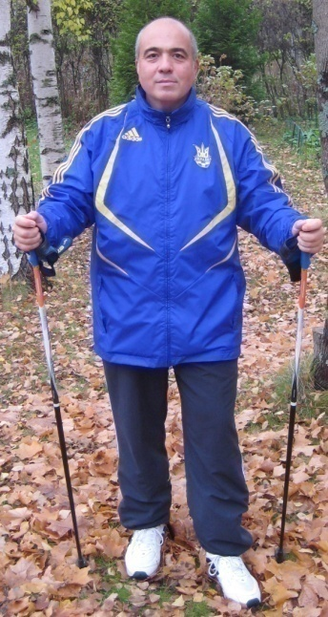
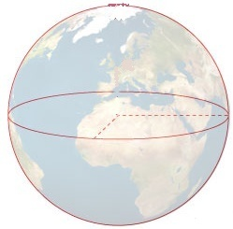
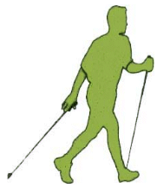
Vagan Terziyan
doing round-the-World trip
by Nordic Walking
≈ 40 075 km

Slide 2
I DID THIS !!!
Year | Distance (km)
Dec. 2008 – May 2010 | 2 500
June 2010 – May 2011 | 2 500
June 2011 – May 2012 | 3 660
June 2012 – May 2013 | 3 340
June 2013 – May 2014 | 3 400
June 2014 – May 2015 | 4 100
June 2015 – May 2016 | 4 000
June 2016 – May 2017 | 4 000
June 2017 – May 2018 | 3 500
June 2018 – May 2019 | 4 500
June 2019 – 7 Nov 2020 | 4 575
Total: 12 years | *** 40 075*
≈ 40 075 km
Sanya active: ≈ 25 000* (31.12.2021)

Slide 3
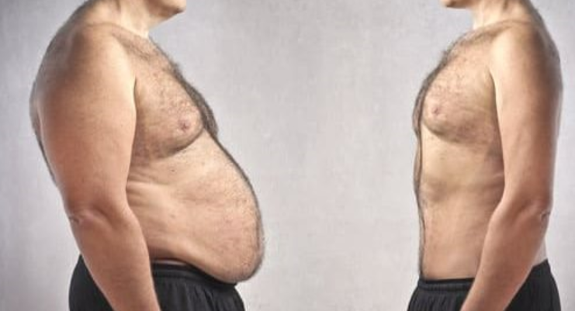
My contribution to the Nordic Walking Theory
(based on my personal experience)
If your aim is to loose some extra weight, then you must walk (if your health allows, of course) with the speed equal to at least your-height/per-second and during about 1.5 - 2.5 hours per exercise. Good to collect in average about 10 km per-day during the year.

