Slide 2
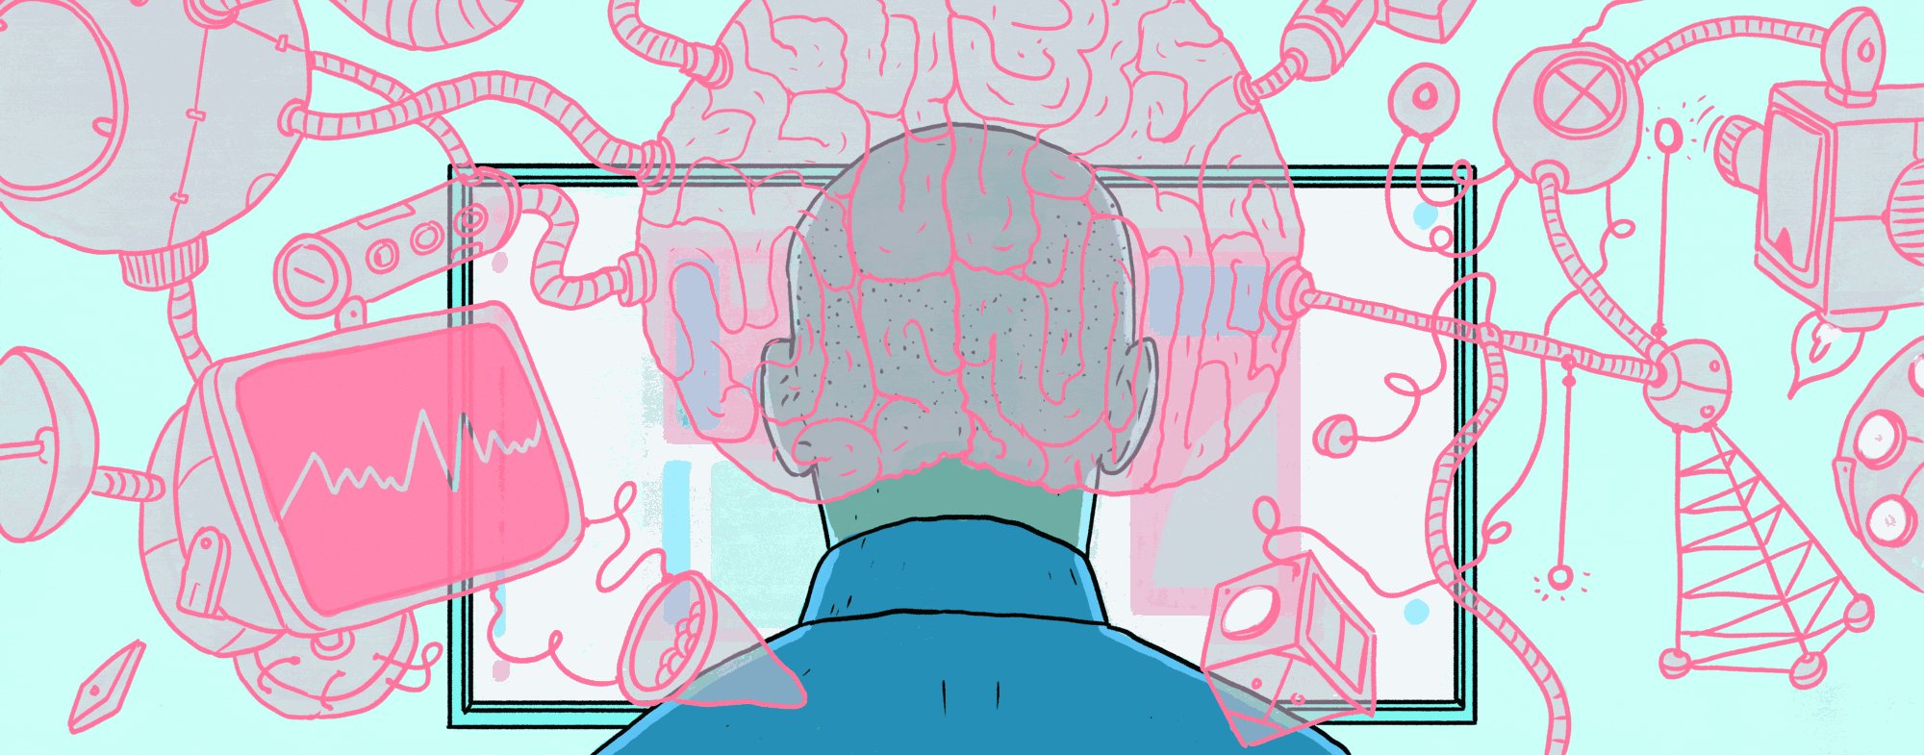
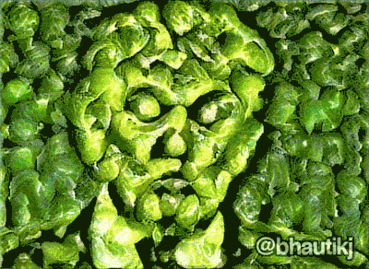
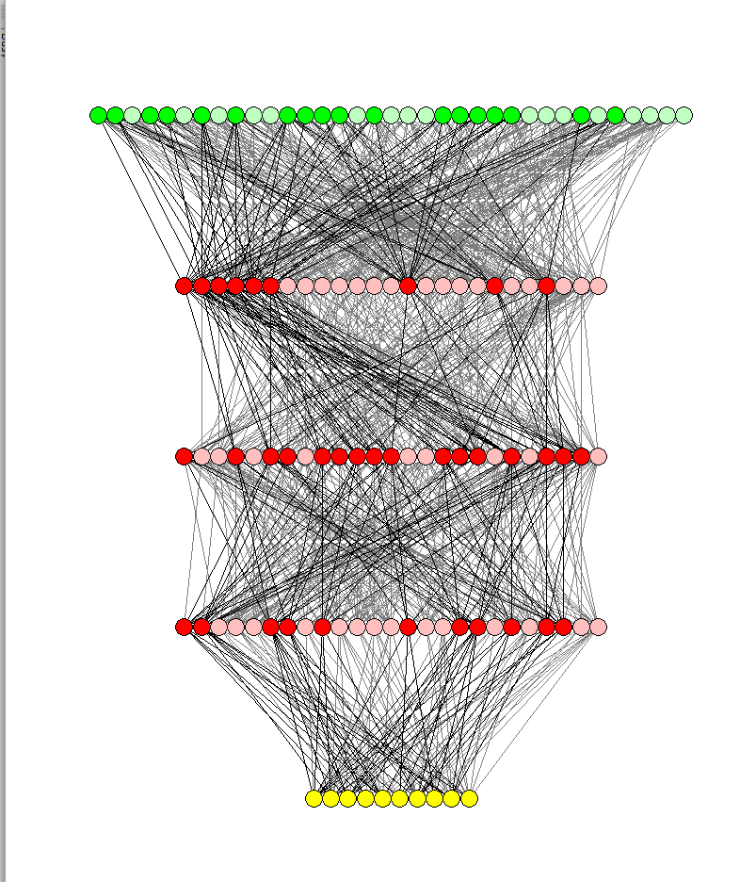
Part IV: Neural Networks with Memory: Recurrent Neural Networks and LSTM Networks lectures from the course: TIES4910: Deep Learning for Cognitive Computing
Fall 2017
Vagan Terziyan
Department of Mathematical Information Technology, University of Jyvaskyla
URL:https://ai.it.jyu.fi/vagan

Slide 3
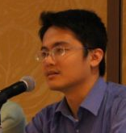
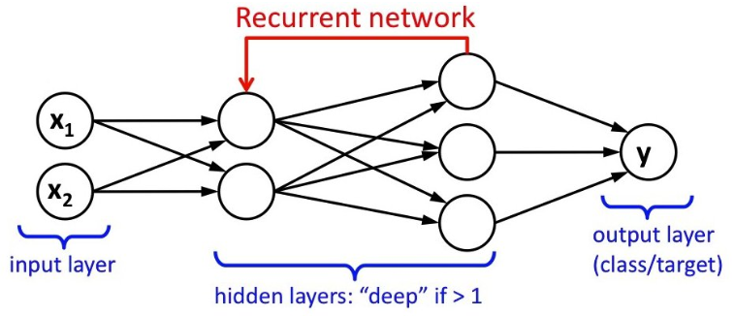
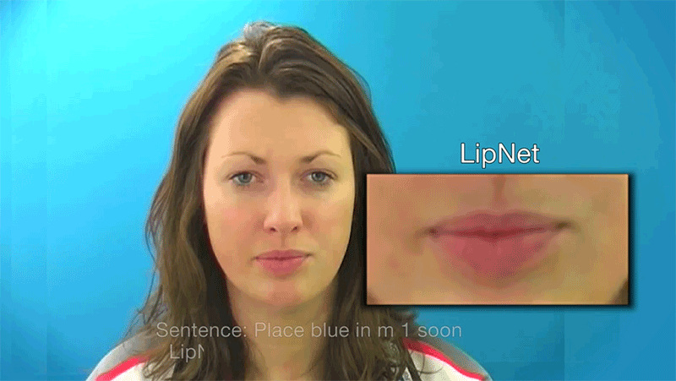
Concerns of the Part-IV:
What is Recurrent Neural Network (RNN) and how it works;
What is Long Short-Term Memory (LSTM) network and how it works;
How they are used;
How to train a RNN and LSTM.
Content is provided mostly on the basis of slides from Hung-yi Lee courses, compiled and edited by Vagan Terziyan

Slide 4
I am grateful to Hung-yi Lee for his excellent animated slides and ideas I have reused in the presentation, as well as anonymous photographers and artists, whose photos and pictures (or their fragments) posted on the Internet, have been used in the presentation.
Beware on hidden slides!

Slide 5
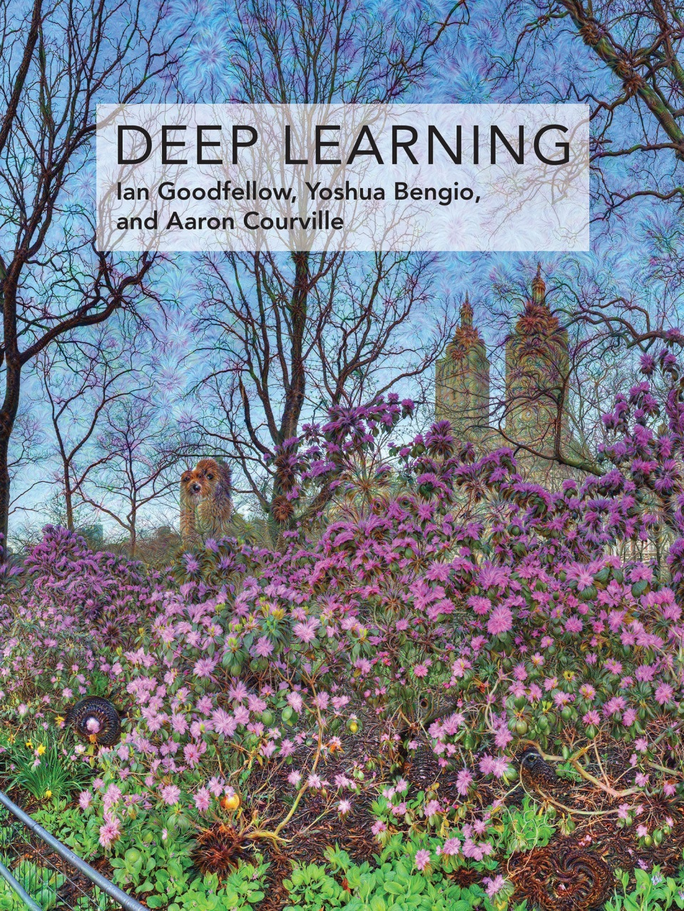
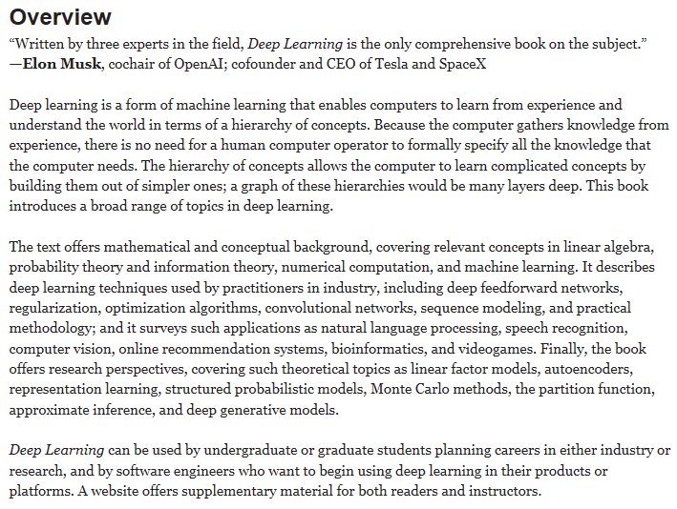
Recommended reading
Goodfellow, I., Bengio, Y., & Courville, A. (2016). Deep Learning, MIT Press, 787 pp.
http://www.deeplearningbook.org

Slide 6
Deep Learning resources:
http://deeplearning.net/

Slide 7
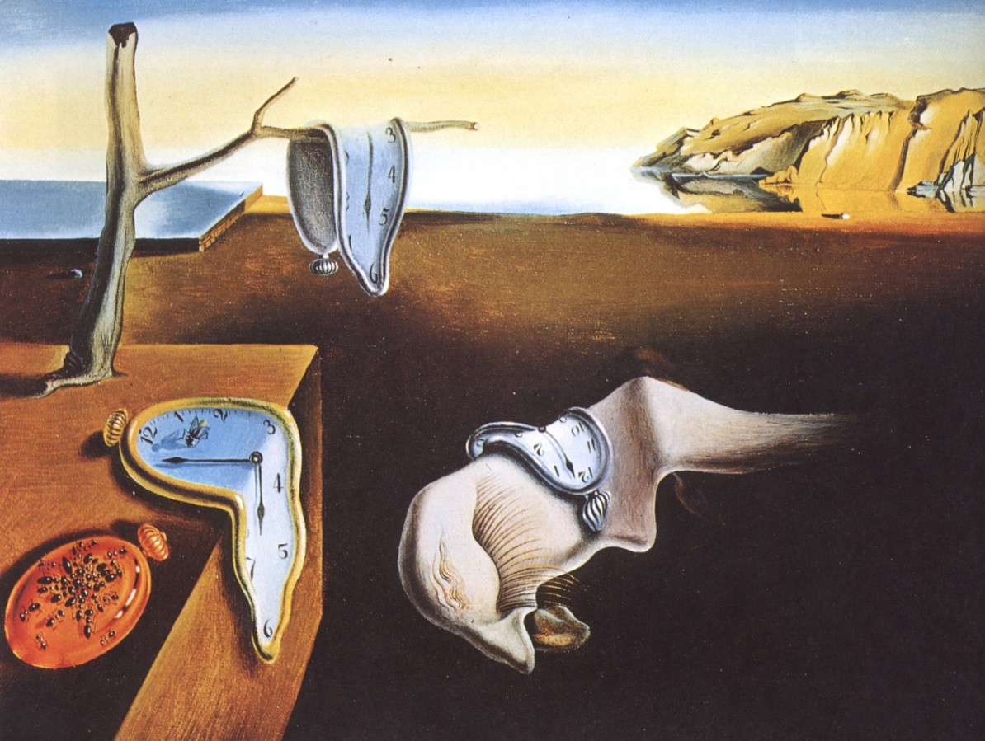
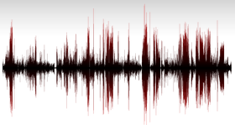
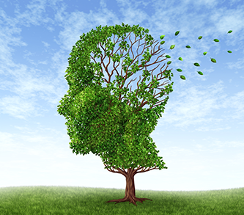
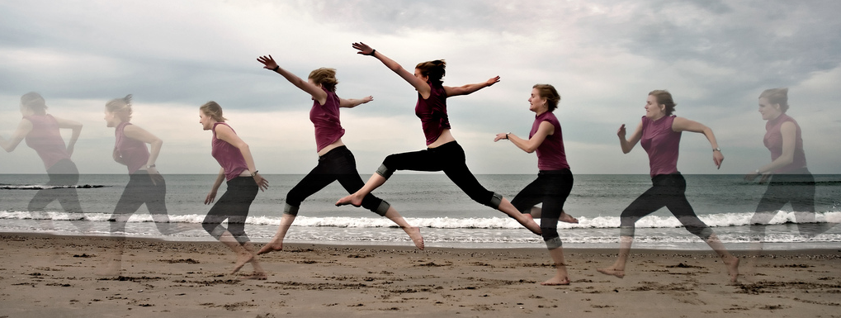
“Time”, “Sequence”, “Memory”, … :
Can Neural Networks handle these?

Slide 8
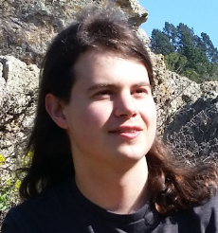
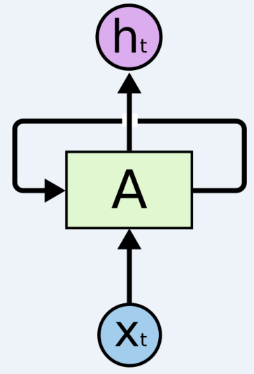
“Recurrent neural networks are one of the staples of deep learning, allowing neural networks to work with sequences of data like text, audio and video. They can be used to boil a sequence down into a high-level understanding, to annotate sequences, and even to generate new sequences from scratch!”
Recurrent Neural Networks have loops
In the diagram, a chunk of neural network, A , “looks” at some input x_{t} and outputs a value h_{t}. A loop allows information to be passed from one step of the network to the next.
An “unrolled” recurrent neural network
These loops make recurrent neural networks seem kind of mysterious. However, if you think a bit more, it turns out that they aren’t all that different than a normal neural network. A recurrent neural network can be thought of as multiple copies of the same network, each passing a message to a successor.

Slide 9
Recurrent Neural Networks use a kind of memory to process sequences
“The idea behind RNNs is to make use of sequential information. In a traditional neural network we assume that all inputs (and outputs) are independent of each other. But for many tasks that’s a very bad idea. If you want to predict the next word in a sentence you better know which words came before it. RNNs are called recurrent because they perform the same task for every element of a sequence, with the output being depended on the previous computations. Another way to think about RNNs is that they have a “memory” which captures information about what has been calculated so far. In theory RNNs can make use of information in arbitrarily long sequences, but in practice they are limited to looking back only a few steps …”
http://www.wildml.com/2015/09/recurrent-neural-networks-tutorial-part-1-introduction-to-rnns/

Slide 10
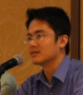
Neural Network needs Memory
Name Entity Recognition
Detecting named entities like name of people, locations, organization, etc. in a sentence.
1
DNN
0.1
people
apple
0
…
0.1
location
0
0.5
organization
0.3
none
0

Slide 11
Neural Network needs Memory
Name Entity Recognition
Detecting named entities like name of people, locations, organization, etc. in a sentence.
target
ORG
target
NONE
y¹
y²
y³
y⁴
y⁵
y⁶
y⁷
DNN
DNN
DNN
DNN
DNN
DNN
DNN
x¹
x²
x³
x⁴
x⁵
x⁶
x⁷
the president of apple eats an apple
DNN needs memory!

Slide 12
Recurrent Neural Network (RNN)
The output of hidden layer are stored in the memory.
copy
Memory can be considered as another input.

Slide 13
Memory is important
$$x^{1}$$
$$x^{2}$$
$$x^{3}$$
1
1
Input:
2 dimensions
4
7
4
7
1
1
1 4 4
+
1 7 7
3
2
1
$${\hat{y}}^{1}$$
$${\hat{y}}^{2}$$
$${\hat{y}}^{3}$$
Output:
1 dimension
1
2
3
Network needs memory to achieve this

Slide 14
In our example we will use neurons with the following activation functions
1
0
10
10

Slide 15
Memory is important
1
y
Network with Memory
-10
1
1
11
$$x^{1}$$
$$x^{2}$$
$$x^{3}$$
Memory
Cell
4
7
4
7
1
1
1
0
0
c₁
10
11
11
1
1
$${\hat{y}}^{1}$$
$${\hat{y}}^{2}$$
$${\hat{y}}^{3}$$
1
2
3
1
1
1
1
1
x₁
x₂
4
7

Slide 16
Memory is important
2
y
Network with Memory
-10
1
1
12
$$x^{1}$$
$$x^{2}$$
$$x^{3}$$
Memory
Cell
4
7
4
7
1
1
1
0
0
c₁
10
12
12
1
1
$${\hat{y}}^{1}$$
$${\hat{y}}^{2}$$
$${\hat{y}}^{3}$$
1
1
2
3
1
1
1
1
1
x₁
x₂
4
7

Slide 17
Memory is important
3
y
Network with Memory
-10
1
0
3
$$x^{1}$$
$$x^{2}$$
$$x^{3}$$
Memory
Cell
4
7
4
7
1
1
1
0
0
c₁
10
3
3
1
1
$${\hat{y}}^{1}$$
$${\hat{y}}^{2}$$
$${\hat{y}}^{3}$$
1
0
1
2
3
1
1
1
1
1
x₁
x₂
1
1

Slide 18
Recurrent Neural Network (RNN)
The output of neurons are stored in the memory cells.
……
copy
Fully
connected
……
……
Fully
connected
Fully
connected
Learned from data
……

Slide 19
Recurrent Neural Network (RNN)
y=Softmax(W_{o}a)
The output of neurons are stored in the memory cells.
……
W_{o}a
copy
W_{o}
a=σ(W_{i}x+W_{h}h)
……
……
h
W_{i}x+W_{h}h
a
W_{h}
W_{i}
x
……

Slide 20
Recurrent Neural Network (RNN)
y’=Softmax(W_{o}a’)
The output of neurons are stored in the memory cells.
……
W_{o}a’
copy
W_{o}
a’=σ(W_{i}x’+W_{h}a)
……
……
h
W_{i}x’+W_{h}a
a
W_{h}
W_{i}
a’
x’
……

Slide 21
Recurrent Neural Network (RNN)
Input data: $x^{1} x^{2} x^{3}$……
(x^{i} are vectors)
y¹
y²
y³
W_{o}
copy
W_{o}
copy
W_{o}
a¹
a²
a³
0
a¹
a²
W_{h}
W_{h}
W_{h}
W_{i}
W_{i}
W_{i}
x¹
x²
x³
The same network is used again and again.
Output y^{i} depends on x¹, x², …… x^{i}

Slide 22
RNN (output depends on input and memory)
With order
Input data: $x^{1} x^{2} x^{3}$……
(x^{i} are vectors)
y¹
y¹=softmax(W_{o}a¹)
copy
W_{o}
a¹=σ(W_{i}x¹+W_{h}0)
memory
0
a¹
W_{h}
W_{i}
x¹

Slide 23
RNN (output depends on input and memory)
With order
Input data: $x^{1} x^{2} x^{3}$……
(x^{i} are vectors)
y¹
y²
y²=softmax(W_{o}a²)
copy
W_{o}
a²=σ(W_{i}x²+W_{h}a¹)
memory
0
a¹
a²
W_{h}
W_{i}
x²

Slide 24
RNN (output depends on input and memory)
With order
Input data: $x^{1} x^{2} x^{3}$……
(x^{i} are vectors)
y¹
y²
y³
y³=softmax(W_{o}a³)
copy
W_{o}
a³=σ(W_{i}x³+W_{h}a²)
memory
0
a¹
a²
a³
W_{h}
W_{i}
x³

Slide 25
RNN (output depends on input and memory)
With order
Input data: $x^{1} x^{2} x^{3}$……
(x^{i} are vectors)
y¹
y²
y³
y¹
y²
y³
W_{o}
W_{o}
W_{o}
init
W_{h}
W_{h}
W_{h}
……
W_{i}
W_{i}
W_{i}
x¹
x²
x³
Output y^{i} depends on x^{i} …… x², x¹

Slide 26
RNN – Training
Training data:
$x^{1} x^{2} x^{3}$……
${\hat{y}}^{1} {\hat{y}}^{2} {\hat{y}}^{3}$……
Training the parameters to let $y$ close to $\hat{y}$
$${\hat{y}}^{1}$$
$${\hat{y}}^{2}$$
$${\hat{y}}^{3}$$
Backpropagation Through Time (BPTT)
y¹
y²
y³
error
δ
W_{o}
W_{o}
W_{o}
init
W_{h}
W_{h}
W_{h}
……
also trainable
W_{i}
W_{i}
W_{i}
x¹
x²
x³

Slide 27
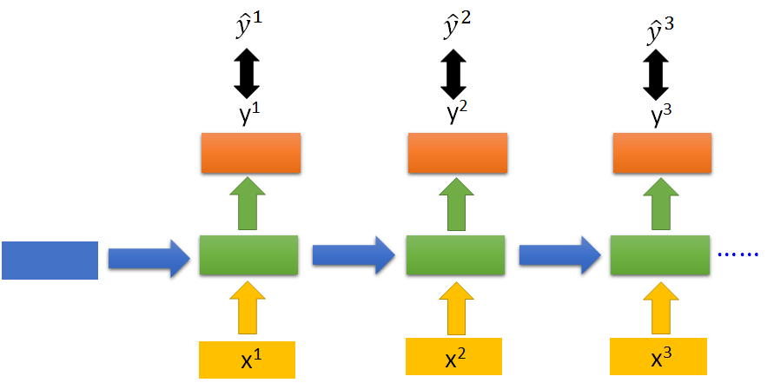
$${\hat{y}}^{3}$$
y³
UNFOLD
A deep neural network
x³
Input: init, x1, x2, x3
output: y³
x²
target: ${\hat{y}}^{3}$
init
x¹

Slide 28
$${\hat{y}}^{3}$$
y³
Some parameters are shared.
UNFOLD
i
$$w_{1}$$
Initialize w₁, w₂ by the same value
k
i
j
$$w_{1}←w_{1}−\frac{∂C}{∂w_{1}}$$
$$−\frac{∂C}{∂w_{2}}$$
$$w_{2}$$
x³
$$w_{2}←w_{2}−\frac{∂C}{∂w_{2}}$$
$$−\frac{∂C}{∂w_{1}}$$
k
i
j
x²
k
j
init
x¹

Slide 29
Bidirectional RNN
……
x^{i-1}
x^{i}
x^{i+1}
……
y^{i-1}
y^{i}
y^{i+1}
……
……
x^{i-1}
x^{i}
x^{i+1}

Slide 30
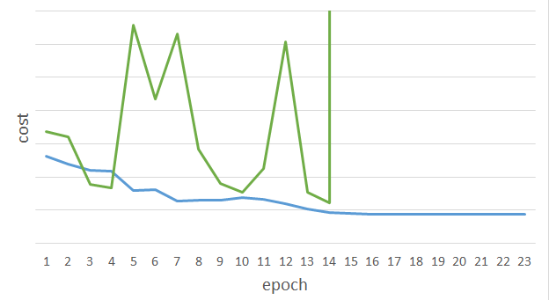
Unfortunately ……
RNN-based network is not always easy to learn
Real experiments on Language modeling
sometimes
Lucky

Slide 31
Example: A simple RNN
0.7
Cost C⁵⁰ = (y⁵⁰ - 0.7)²
y¹
y²
y³
y⁵⁰
0.5
……
w_{r}
w_{r}
w_{r}
w_{r}
w_{i}
w_{i}
w_{i}
w_{i}
1
1
1
1

Slide 32
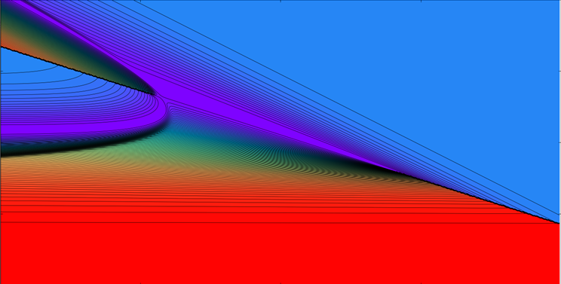
Example: A simple RNN
red: large C⁵⁰
purple: small C⁵⁰
Cost C⁵⁰ = (y⁵⁰ - 0.7)²
w_{r}
w_{i}

Slide 33
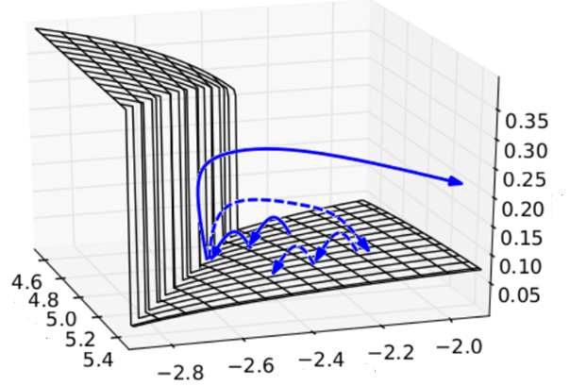
Example: A simple RNN
Clipped gradient
The error surface is either very flat or very steep.
Cost C⁵⁰
w_{r}
w_{i}
http://jmlr.org/proceedings/papers/v28/pascanu13.pdf

Slide 34
Why?
$$w=1$$
$$y^{1000}=1$$
Large gradient
Small Learning rate?
$$w=1.01$$
$$y^{1000}≈20000$$
$$w=0.99$$
$$y^{1000}≈0$$
small gradient
Large Learning rate?
$$w=0.01$$
$$y^{1000}≈0$$
=w⁹⁹⁹
y¹
y²
y³
y¹⁰⁰⁰
Toy Example
1
1
1
1
……
w
w
w
1.01⁹⁹⁹ > 20000
1
1
1
1
0.99⁹⁹⁹ < 4.4 ∙10⁻⁵
1
0
0
0
0.01⁹⁹⁹ = 10⁻¹⁹⁹⁸

Slide 35
Exploding Gradients
Cost C⁵⁰
= (y⁵⁰ - 0.7)²
$$δ^{50}=\frac{dC^{50}}{dy^{50}}σ^{′}\left(z^{50}\right)$$
Some parameters are shared.
$$δ^{1}={\left(w_{r}\right)}^{49}……$$
If w_{r} is large
0.7
$$δ^{49}=δ^{50}w_{r}σ^{′}\left(z^{49}\right)$$
Gradient explode
$$……$$
If w_{r} is small
$$δ^{1}=δ^{2}w_{r}σ^{′}\left(z^{1}\right)$$
y⁵⁰
RNN would be useless
0.5
$$δ^{1}$$
$$δ^{2}$$
$$δ^{49}$$
$$δ^{50}$$
w_{r}
w_{r}
w_{r}
w_{i}
w_{i}
w_{i}
w_{i}
1
1
1
1

Slide 36
Exploding Gradients
$${\hat{y}}^{3}$$
$$δ^{2}=σ′\left(z^{2}\right)∘{{\left(W_{h}\right)}^{T}δ}^{3}$$
y³
$∘$ : element-wise multiplication
$$δ^{1}=σ′\left(z^{1}\right)∘{{\left(W_{h}\right)}^{T}δ}^{2}$$
$$δ^{3}$$
Multiplying ${\left(W_{h}\right)}^{T}$ many times
W_{h}
$$δ^{2}$$
W_{h}
$$δ^{1}$$
W_{h}
init

Slide 37
Be careful when training RNN …
Clipping (normalizing) the gradients
Advanced gradient descent technology
Try LSTM
Reference:
Pascanu, Razvan, Tomas Mikolov, and Yoshua Bengio. "On the difficulty of training recurrent neural networks." Proceedings of The 30th International Conference on Machine Learning. 2013.
http://jmlr.org/proceedings/papers/v28/pascanu13.pdf

Slide 38
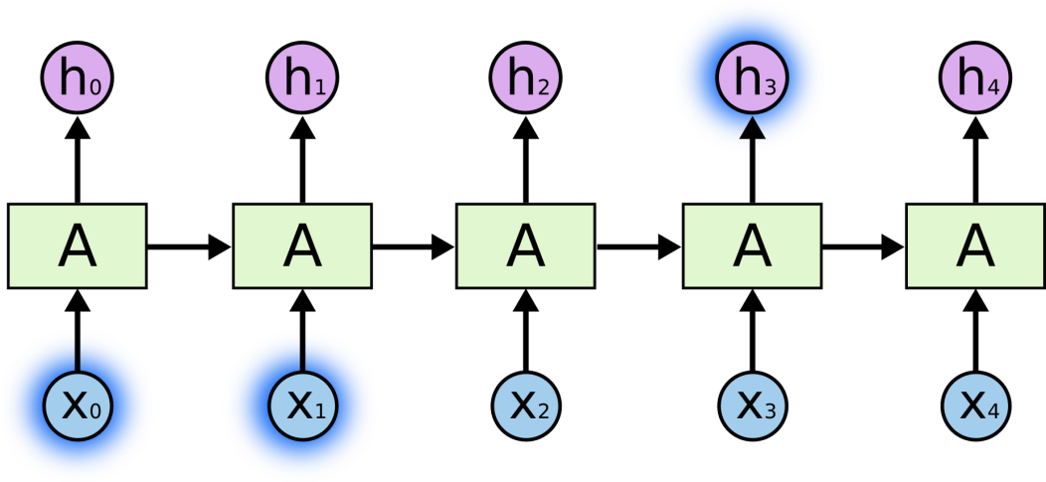
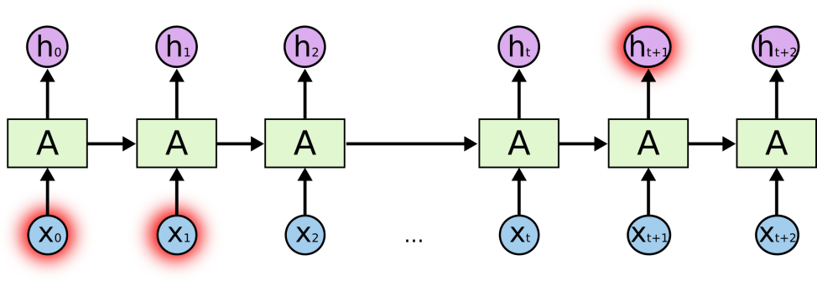
One of the appeals of RNNs is the idea that they might be able to connect previous information to the present task, such as using previous video frames might inform the understanding of the present frame. If RNNs could do this, they’d be extremely useful. But can they? It depends. Sometimes, we only need to look at recent information to perform the present task. For example, consider a language model trying to predict the next word based on the previous ones. If we are trying to predict the last word in “The clouds are in the sky”, we don’t need any further context – it’s pretty obvious the next word is going to be sky. In such cases, where the gap between the relevant information and the place that it’s needed is small, RNNs can learn to use the past information.
RNNs’ challenge: Long-term dependencies
But there are also cases where we need more context. Consider trying to predict the last word in the text “I grew up in France … I speak fluent French.” Recent information suggests that the next word is probably the name of a language, but if we want to narrow down which language, we need the context of France, from further back. It’s entirely possible for the gap between the relevant information and the point where it is needed to become very large. Unfortunately, as that gap grows, RNNs become unable to learn to connect the information.
clouds
are
in
the
sky
French
The
clouds
are
in
the
In theory, RNNs are absolutely capable of handling such “long-term dependencies.” A human could manually and carefully pick parameters for them to solve toy problems of this form. Sadly, in practice, RNNs don’t seem to be able to automatically and efficiently learn them.
France
fluent

Slide 39
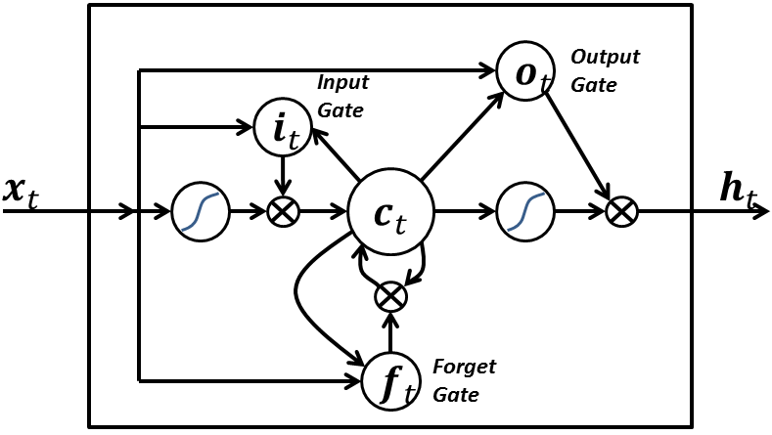
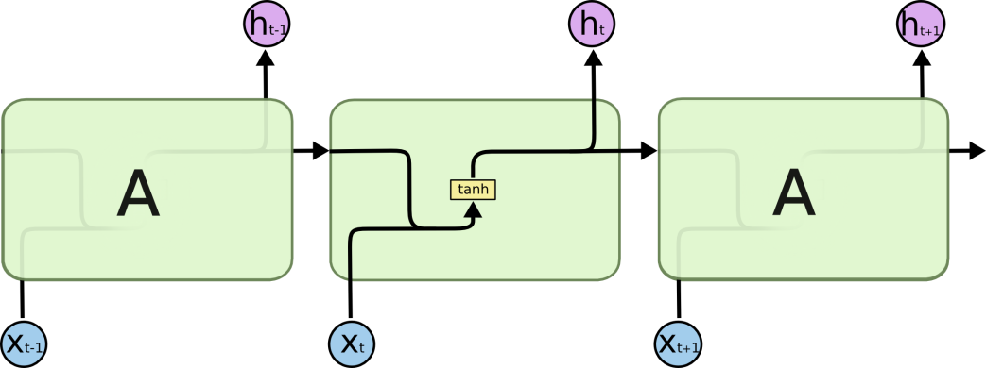
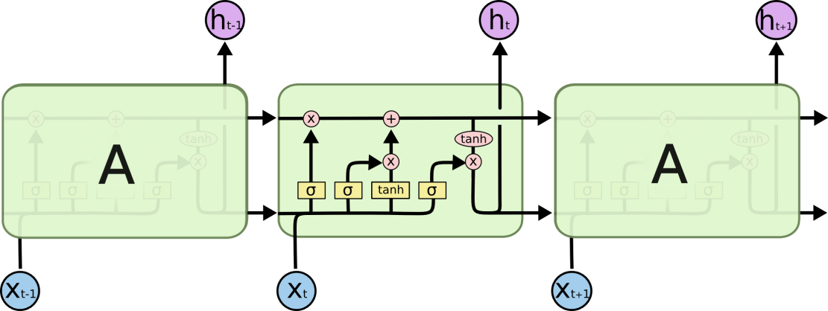
Long Short Term Memory networks (LSTMs)
A simple LSTM block with only input, output, and forget gates. [Wikipedia]
Long Short-Term Memory networks – usually just called “LSTMs” – are a special kind of RNN, capable of learning long-term dependencies. They were introduced by Hochreiter & Schmidhuber (1997). They work tremendously well on a large variety of problems, and are now widely used. LSTMs are explicitly designed to avoid the long-term dependency problem. Remembering information for long periods of time is practically their default behavior, not something they struggle to learn!
The repeating module in a standard RNN contains a single layer.
All recurrent neural networks have the form of a chain of repeating modules of neural network. In standard RNNs, this repeating module will have a very simple structure, such as a single tanh layer.
LSTMs also have this chain like structure, but the repeating module has a different structure. Instead of having a single neural network layer, there are four, interacting in a very special way.
The repeating module in an LSTM contains four interacting layers.

Slide 40
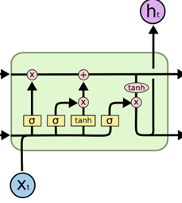
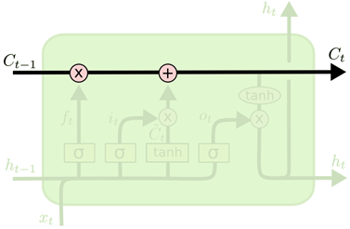
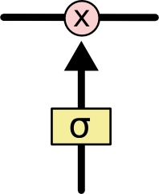
The core idea behind LSTM
The key to LSTMs is the cell state, the horizontal line running through the top of the diagram. The cell state is kind of like a conveyor belt. It runs straight down the entire chain, with only some minor linear interactions. It’s very easy for information to just flow along it unchanged.
The sigmoid layer outputs numbers between zero and one, describing how much of each component should be let through. A value of zero means “let nothing through,” while a value of one means “let everything through!”
An LSTM has three of these gates, to protect and control the cell state.
The LSTM does have the ability to remove or add information to the cell state, carefully regulated by structures called gates. Gates are a way to optionally let information through. They are composed out of a sigmoid neural net layer and a pointwise multiplication operation.

Slide 41
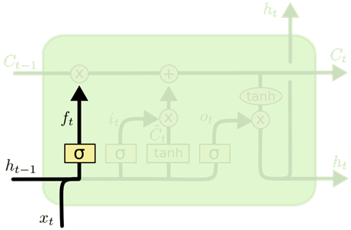
Step-by-Step LSTM Walk Through: “forget gate layer”
The first step in our LSTM is to decide what information we’re going to throw away from the cell state. This decision is made by a sigmoid layer called the “forget gate layer.” It looks at h_{t−1} and x_{t} , and outputs a number between 0 and 1 for each number in the cell state C_{t−1} . 1 represents “completely keep this” while 0 represents “completely get rid of this.”

Slide 42
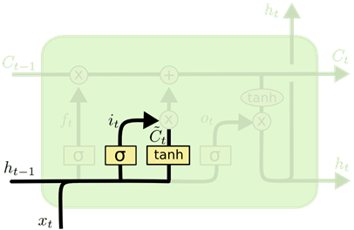
Step-by-Step LSTM Walk Through: “input gate layer” and tanh layer
The next step is to decide what new information we’re going to store in the cell state. This has two parts. First, a sigmoid layer called the “input gate layer” decides which values we’ll update. Next, a tanh layer creates a vector of new candidate values, ${\tilde{C}}_{t}$ , that could be added to the state. In the next step, we’ll combine these two to create an update to the state.

Slide 43
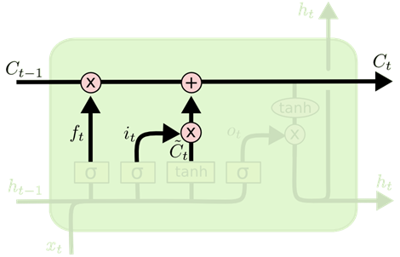
Step-by-Step LSTM Walk Through:
cell state update
It’s now time to update the old cell state, C_{t−1} , into the new cell state C_{t} . The previous steps already decided what to do, we just need to actually do it. We multiply the old state by f_{t} , forgetting the things we decided to forget earlier. Then we add $i_{t}∙{\tilde{C}}_{t}$. This is the new candidate values, scaled by how much we decided to update each state value.

Slide 44
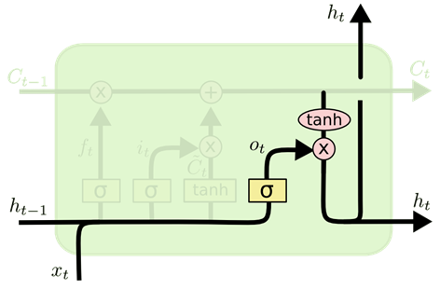
Step-by-Step LSTM Walk Through:
the “output layer”
Finally, we need to decide what we’re going to output. This output will be based on our cell state, but will be a filtered version. First, we run a sigmoid layer which decides what parts of the cell state we’re going to output. Then, we put the cell state through tanh (to push the values to be between −1 and 1 ) and multiply it by the output of the sigmoid gate, so that we only output the parts we decided to.

Slide 45
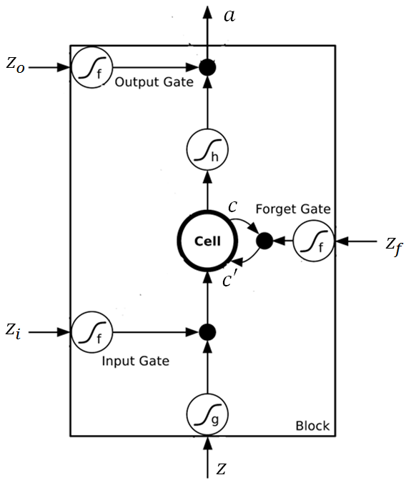
Lee draws a LSTM module in his slides as follows
×
×

Slide 46
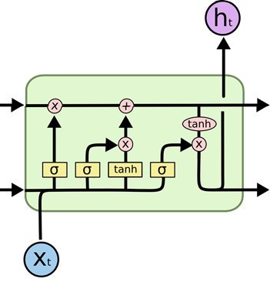
Merging two representations
×
C_{t-1}
C_{t}
×
×

Slide 47
Merging two representations
×
C_{t-1}
C_{t}
×
×

Slide 48
Merging two representations
×
C_{t-1}
C_{t}
×
×

Slide 49
Merging two representations
×
C_{t-1}
C_{t}
×
×

Slide 50
Merging two representations
×
C_{t-1}
C_{t}
×
×

Slide 51
LSTMs chain
(Olah representation)
The repeating module in an LSTM contains four interacting layers.

Slide 52
LSTMs chain component with “peephole connections”
ftp://ftp.idsia.ch/pub/juergen/TimeCount-IJCNN2000.pdf
One popular LSTM variant, introduced by Gers & Schmidhuber (2000), is adding “peephole connections.” This means that we let the gate layers look at the cell state.

Slide 53
LSTMs chain with “peephole connections”
y^{t}
y^{t+1}
c^{t-1}
c^{t}
c^{t+1}
$$×$$
$$＋$$
$$×$$
$$×$$
$$＋$$
$$×$$
$$×$$
$$×$$
z^{f}
z^{i}
z
zº
z^{f}
z^{i}
z
zº
c^{t-1}
h^{t-1}
x^{t}
c^{t}
h^{t}
x^{t+1}

Slide 54
LSTMs chain component with “coupled forget/input gates”
Another variation is to use coupled forget / input gates. Instead of separately deciding what to forget and what we should add new information to, we make those decisions together. We only forget when we’re going to input something in its place. We only input new values to the state when we forget something older.

Slide 55
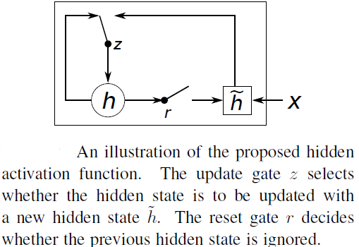
LSTM modification: “Gated Recurrent Unit” (GRU)
A slightly more dramatic variation on the LSTM is the Gated Recurrent Unit, or GRU, introduced by Cho, et al. (2014). It combines the forget and input gates into a single “update gate.” It also merges the cell state and hidden state, and makes some other changes. The resulting model is simpler than standard LSTM models, and has been growing increasingly popular. http://arxiv.org/pdf/1406.1078v3.pdf

Slide 56
Long Short-term Memory (LSTM)
Other part of the network
Special Neuron:
4 inputs,
1 output
Signal control the output gate
Output Gate
(Other part of the network)
Memory
Cell
Forget Gate
Signal control the forget gate
(Other part of the network)
Signal control the input gate
Input Gate
LSTM
(Other part of the network)
Other part of the network

Slide 57
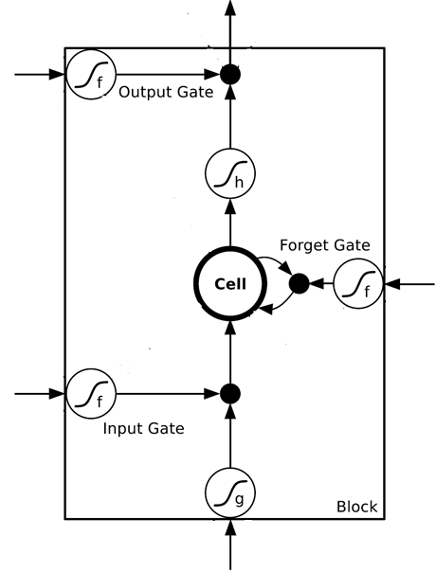
$$a$$
$$=h\left(c^{′}\right)f\left(z_{o}\right)$$
$$z_{o}$$
multiply
Activation function f is usually a sigmoid function
$$f\left(z_{o}\right)$$
$$h\left(c^{′}\right)$$
Between 0 and 1
Mimic open and close gate
$$c$$
$$f\left(z_{f}\right)$$
c
$$c^{′}$$
$$z_{f}$$
$$cf\left(z_{f}\right)$$
$$c^{′}=g\left(z\right)f\left(z_{i}\right)+cf\left(z_{f}\right)$$
$$f\left(z_{i}\right)$$
$$g\left(z\right)f\left(z_{i}\right)$$
$$z_{i}$$
multiply
$$g\left(z\right)$$
$$z$$

Slide 58
Original Network:
Simply replace the neurons with LSTM
……
……
$$a_{1}$$
$$a_{2}$$
$$z_{1}$$
$$z_{2}$$
x₁
x₂
Input

Slide 59
$$a_{1}$$
$$a_{2}$$
+
+
+
+
+
+
+
+
x₁
x₂
Input

Slide 60
LSTM - Example
0
0
3
3
7
7
7
0
6
$$x_{1}$$
1
0
0
3
1
0
2
0
0
4
1
0
2
0
0
1
0
1
3
-1
0
6
1
0
1
0
1
$$x_{2}$$
$$x_{3}$$
$$y$$
0
0
0
0
0
7
0
0
6
When x₂ = 1, sum the number of x₁ with the memory
When x₂ = -1, reset the memory to 0
When x₃ = 1, output the number from the memory.

Slide 61
x₁
0
y
$$y$$
0
0
0
7
0
x₂
0
+
x₃
100
0
x₁
1
-10
100
0
0
+
x₂
x₁
0
x₃
x₂
100
+
10
1
x₃
0
1
-10
+
$$x_{1}$$
3
1
0
4
1
0
2
0
0
1
0
1
3
-1
0
1
0
0
0
$$x_{2}$$
x₁
x₂
x₃
1
$$x_{3}$$

Slide 62
3
0
≈0
y
$$y$$
0
0
0
7
0
1
0
+
≈0
3
0
100
0
3
1
-10
0
100
0
3
+
1
3
≈1
0
0
100
≈1
3
1
+
10
1
3
0
0
1
-10
+
$$x_{1}$$
3
1
0
4
1
0
2
0
0
1
0
1
3
-1
0
1
0
0
0
$$x_{2}$$
3
1
0
1
$$x_{3}$$

Slide 63
4
0
≈0
y
$$y$$
0
0
0
7
0
1
0
+
≈0
7
0
100
0
4
1
-10
7
100
0
3
+
1
4
≈1
0
0
100
≈1
4
1
+
10
1
4
0
0
1
-10
+
$$x_{1}$$
3
1
0
4
1
0
2
0
0
1
0
1
3
-1
0
1
0
0
0
$$x_{2}$$
4
1
0
1
$$x_{3}$$

Slide 64
2
0
≈0
y
$$y$$
0
0
0
7
0
0
0
+
≈0
7
0
100
0
2
1
-10
7
100
0
+
0
2
≈1
0
0
100
≈0
0
0
+
10
1
2
0
0
1
-10
+
$$x_{1}$$
3
1
0
4
1
0
2
0
0
1
0
1
3
-1
0
1
0
0
0
$$x_{2}$$
2
0
0
1
$$x_{3}$$

Slide 65
1
0
≈7
y
$$y$$
0
0
0
7
0
0
0
+
≈1
7
1
100
0
1
1
-10
7
100
0
+
0
1
≈1
0
1
100
≈0
0
0
+
10
1
1
1
0
1
-10
+
$$x_{1}$$
3
1
0
4
1
0
2
0
0
1
0
1
3
-1
0
1
0
0
0
$$x_{2}$$
1
0
1
1
$$x_{3}$$

Slide 66
3
0
≈0
y
$$y$$
0
0
0
7
0
-1
0
+
≈0
0
0
100
0
3
1
-10
0
100
0
7
+
-1
3
≈0
0
0
100
≈0
0
-1
+
10
1
3
0
0
1
-10
+
$$x_{1}$$
3
1
0
4
1
0
2
0
0
1
0
1
3
-1
0
1
0
0
0
$$x_{2}$$
3
-1
0
1
$$x_{3}$$

Slide 67
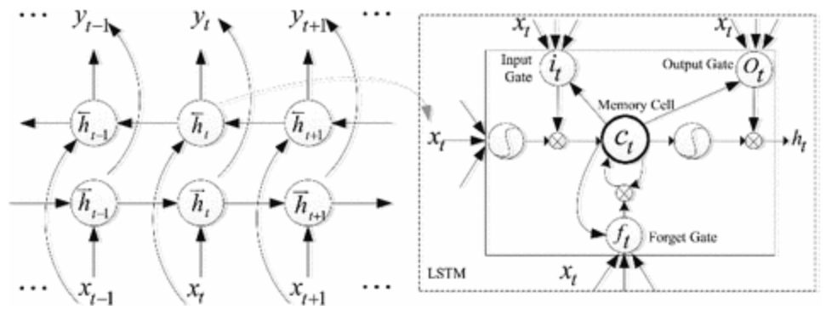
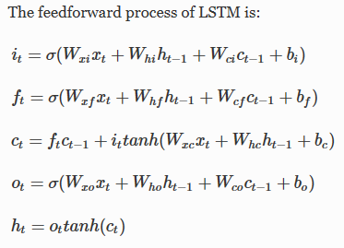
LSTM feedforward model
http://link.springer.com/chapter/10.1007/978-3-319-51814-5_23#Fig3

Slide 68
Language model and speech recognition with RNNs
Language model: Estimated the probability of word sequence
Word sequence: w₁, w₂, w₃, …., w_{n}
P(w₁, w₂, w₃, …., w_{n}) – joint probability
Useful in speech recognition
Different word sequence can have the same or very similar pronunciation
If P(recognize speech)
>P(wreck a nice beach)
recognize speech
or
wreck a nice beach
Output = “recognize speech”

Slide 69
Language model and speech recognition with RNNs
P(“wreck a nice beach”) =
= P(wreck | START) ∙ P(a | wreck) ∙
∙ P(nice | a) ∙ P(beach | nice)
How to estimate P(w₁, w₂, w₃, …., w_{n})
Collect a large amount of text data as training data
However, the word sequence w₁, w₂, …., w_{n} may not appear in the training data
N-gram language model: P(w₁, w₂, w₃, …., w_{n}) = P(w₁|START)∙P(w₂|w₁) ∙ … ∙ P(w_{n}|w_{n-1}) (from joint to conditional probabilities)
Estimate P(beach | nice) from training data
Count of “nice beach” in the training data
$$P\left(\text{beach}\text{|}\text{nice}\right)=\frac{C\left(nice beach\right)}{C\left(nice\right)}$$
Count of “nice” in the training data

Slide 70
Language model - Smoothing
Training data:
The dog ran ……
The cat jumped ……
This is called language model smoothing.
P( jumped | dog ) = 0
0.0001
Give some small probability
P( ran | cat ) = 0
0.0001
The probability is not accurate.
The phenomenon happens because we cannot collect all the possible text in the world as training data.

Slide 71
Neural-network based LM
P(“wreck a nice beach”)
=P(wreck|START)P(a|wreck)P(nice|a)P(beach|nice)
P(b|a): not from count, but the NN that can predict the next word.
P(next word is “wreck”)
P(next word is “a”)
P(next word is “nice”)
P(next word is “beach”)
Neural
Network
Neural
Network
Neural
Network
Neural
Network
1-of-N encoding of “START”
1-of-N encoding of “wreck”
1-of-N encoding of “a”
1-of-N encoding of “nice”

Slide 72
Neural-network based LM
The hidden layer of the related words are close.
……
h₂
Fully
connected
dog
rabbit
cat
h₁
……
If P(jump|dog) is large, then P(jump|cat) increase accordingly.
Fully
connected
(even there is not “… cat jump …” in the data)
……
Smoothing is automatically done.

Slide 73
RNN-based LM
The probability for each word as the next word w_{i}
RNN can also be used in predicting the next word
……
copy
……
……
……
1-of-N encoding of the word w_{i-1}

Slide 74
RNN-based LM
P(next word is “wreck”)
P(next word is “a”)
P(next word is “nice”)
P(next word is “beach”)
1-of-N encoding of “START”
1-of-N encoding of “wreck”
1-of-N encoding of “a”
1-of-N encoding of “nice”
Model long-term information
Can also consider LSTM

Slide 75
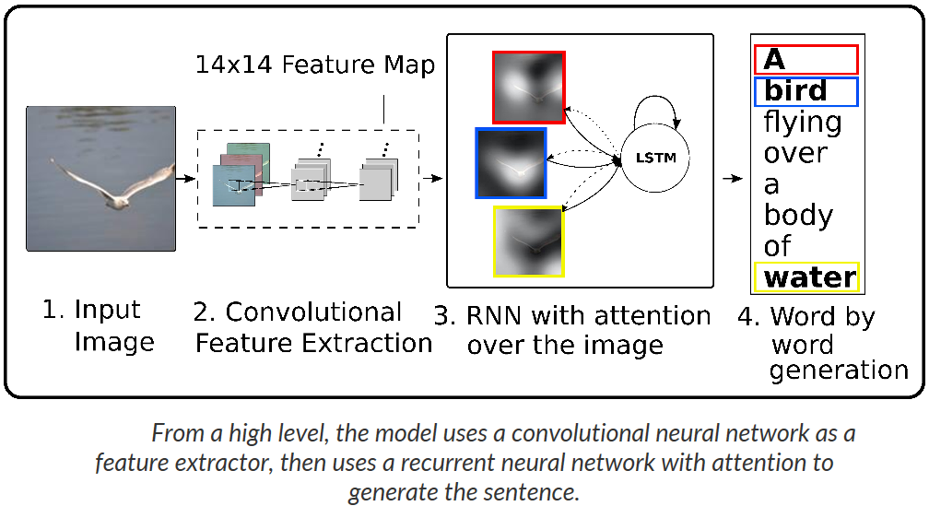
Beyond RNNs: Attention-based framework in NNs
http://kelvinxu.github.io/projects/capgen.html

Slide 76
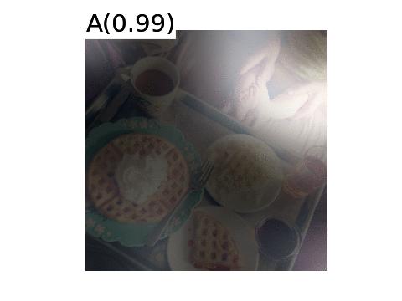
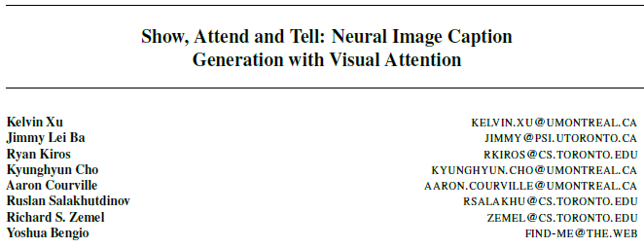
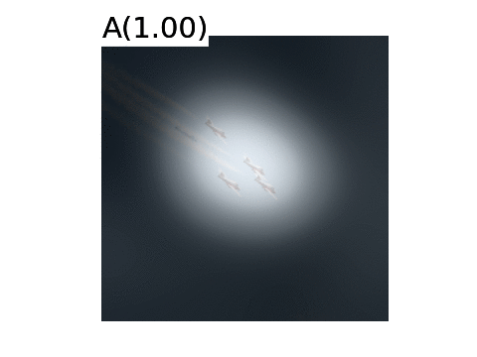
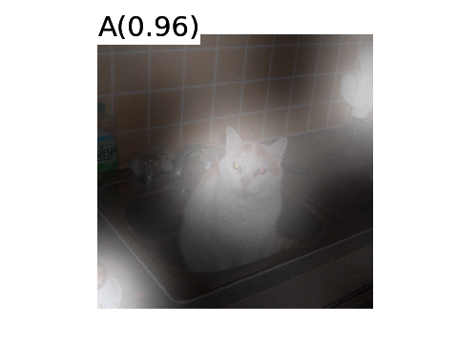
Beyond RNNs: Attention-based framework in NNs
http://kelvinxu.github.io/projects/capgen.html
https://arxiv.org/pdf/1502.03044.pdf
Code: https://github.com/kelvinxu/arctic-captions

Slide 77
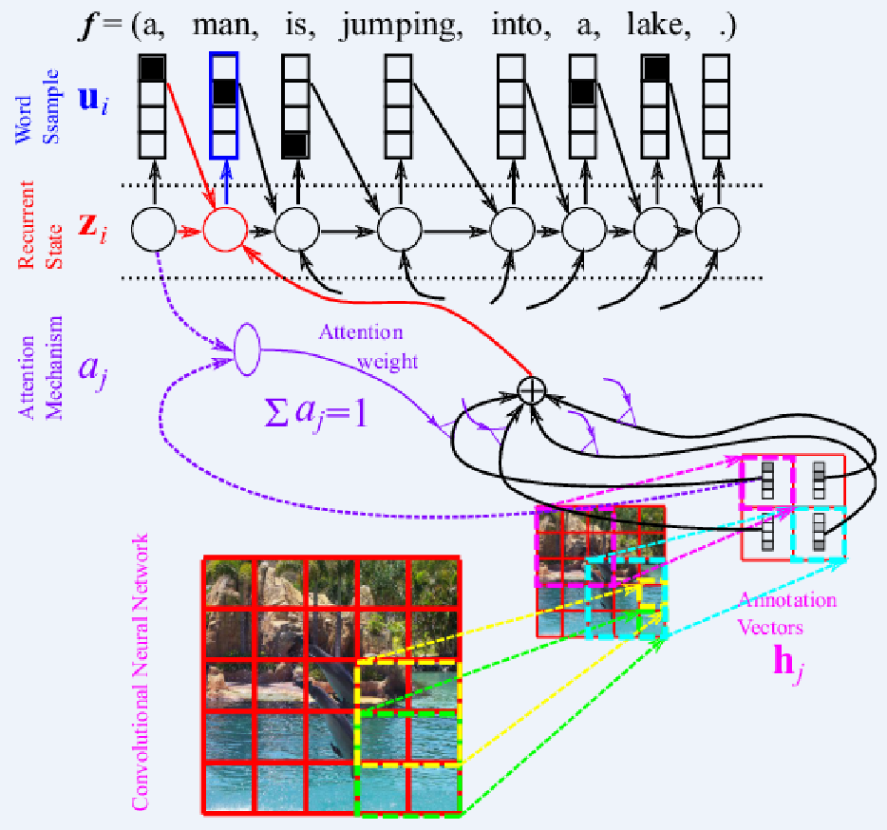
Beyond RNNs: Attention-based framework in NNs
https://devblogs.nvidia.com/parallelforall/introduction-neural-machine-translation-gpus-part-3/

Slide 78
Useful references on applications of RNNs
Speech recognition
http://www.cs.toronto.edu/~fritz/absps/RNN13.pdf
Composer
http://people.idsia.ch/~juergen/blues/
Sentence generation
http://www.cs.toronto.edu/~ilya/rnn.html
Language understanding
http://research.microsoft.com/pubs/210167/rcrf_v9.pdf

