Slide 1

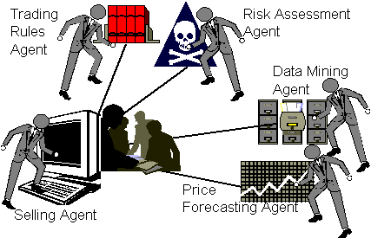
Agent Technologies
Based on tutorials and presentations: M. Wooldridge, G. Becerra, M. Calisti, A. Tveit, S. Green, L. Hurst, B. Nangle, P. Cunningham, F. Somers, R. Evans, P. Storms, D. Kotz, Picco, Murphy, Gray, Suri, Tschudin, Bradshaw, Rus, Harrison, Karjoth, Ranganathan, Suri, Singh, Huhns, Laamanen, D.B. Lange, M. Oshima, V. Terziyan and others

Slide 2


I am grateful to the anonymous photographers and artists, whose photos and pictures (or their fragments) posted on the Internet, have been used in the presentation.

Slide 3
Mobility and Self-Management, Abilities to Communicate, Cooperate, and Negotiate with others - are among the basic abilities of an Intelligent Agent

Slide 4
Multi-Agent System (MAS)
A network of problem solvers that work together to solve problems that are beyond their individual capabilities:
  - solve problems that may be too large for a centralised single agent,
  - provide better speed and reliability,
  - tolerate uncertain data and knowledge.

Slide 5
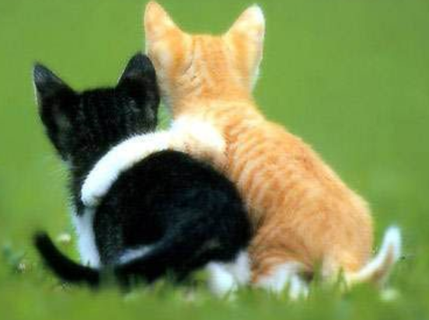

Two extremes of MAS
Cooperative Distributed Problem Solving or Cooperative Multi-Agent Systems (CMAS)
Agents that had all been designed by a single designer. Agents could be counted on to act for the greater good of the system, since they could all be programmed that way by the designer, who was only concerned with increasing the general system’s performance and not the performance of individual agents.
Self-Interested Multi-Agent Systems (SMAS)
Individually motivated agents, who had been designed by independent designers. Hence such agents are considered self-interested, competitive or non-cooperative and may exhibit antagonistic behaviour.
E.g., a set of personal meeting-scheduling agents where each agent tries to schedule a meeting at the best time for its particular owner.

Slide 6
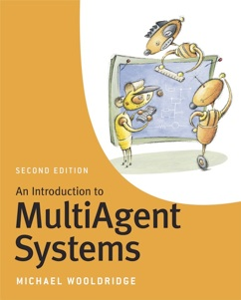
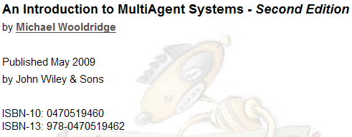
Recommended Literature
Details and handouts available in: http://www.cs.ox.ac.uk/people/michael.wooldridge/pubs/imas/IMAS2e.html

Slide 7
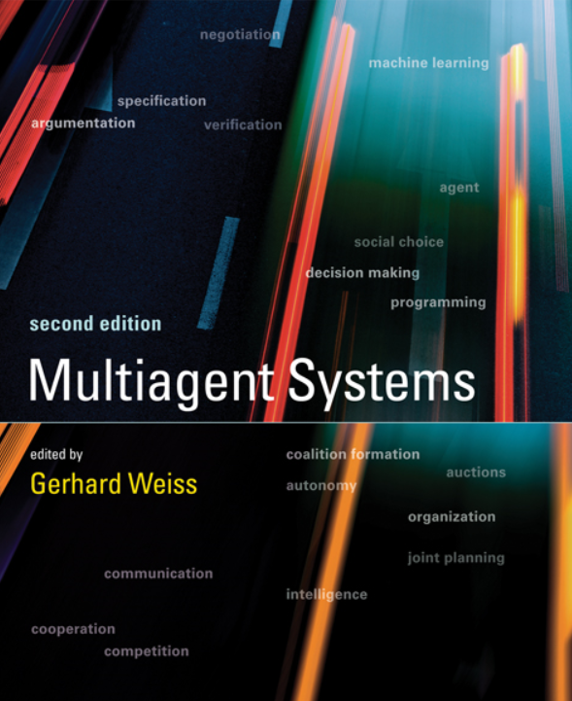
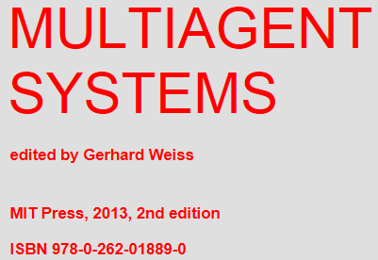
Fresh Recommended Literature
Handouts available in: http://www.the-mas-book.info/index-lecture-slides.html

Slide 8
Some fundamentals on Game Theory, Decision Making, Uncertainty, Utility, etc.
Neumann, John von & Morgenstern, Oskar (1944). Theory of Games and Economic Behavior. Princeton, NJ: Princeton University Press.
Fishburn, Peter C. (1970). Utility Theory for Decision Making. Huntington, NY: Robert E. Krieger.
Gilboa, Itzhak (2009). Theory of Decision under Uncertainty. Cambridge: Cambridge University Press.
…

Slide 9
Agents in a multi-agent system must:
be self-managed to automatically create suitable configuration for each new context;
move to be able to find each other and access environmental resources (mobility);
communicate amongst themselves;
coordinate their activities;
negotiate once they find themselves in conflict.

Slide 10
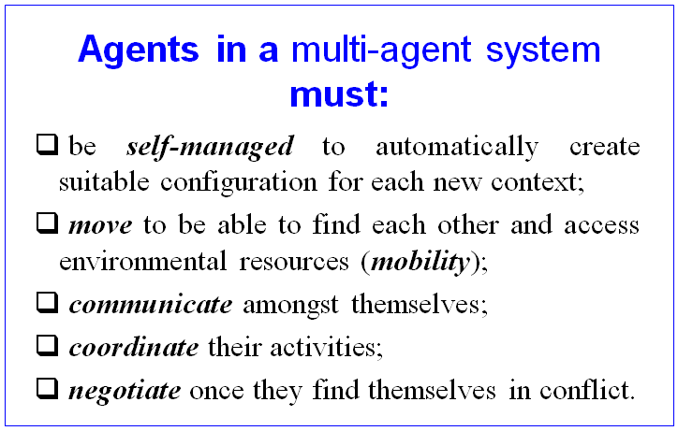
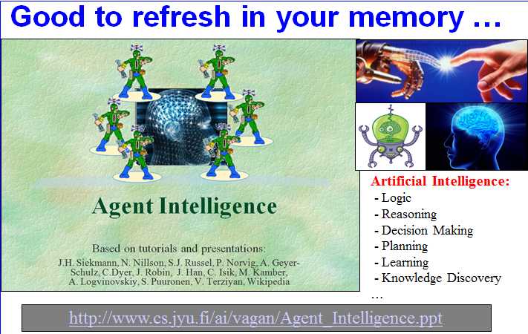
To achieve these agents must be intelligent
Our next lecture
https://ai.it.jyu.fi/vagan/Agent_Intelligence.pptx

Slide 11
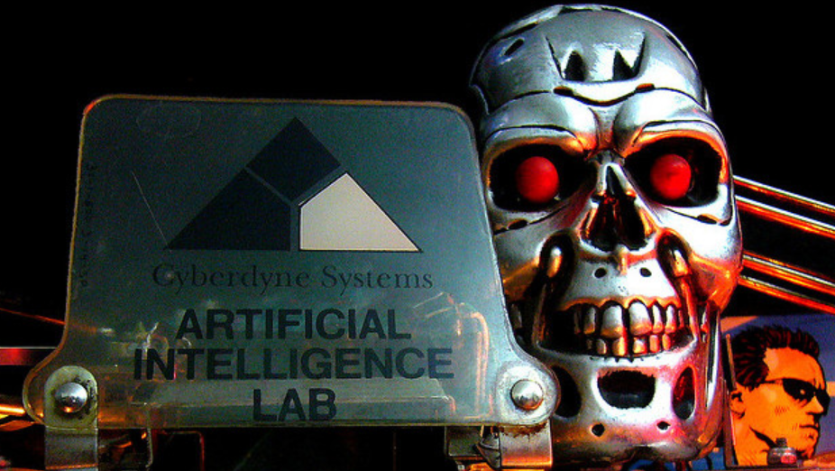
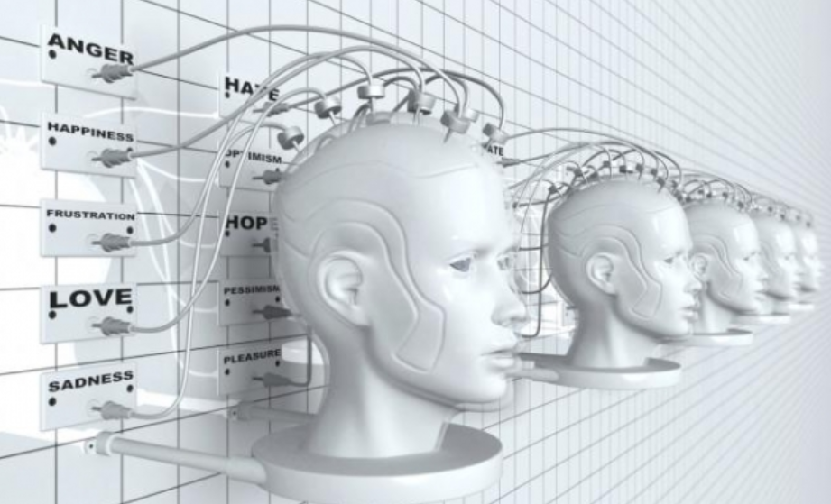
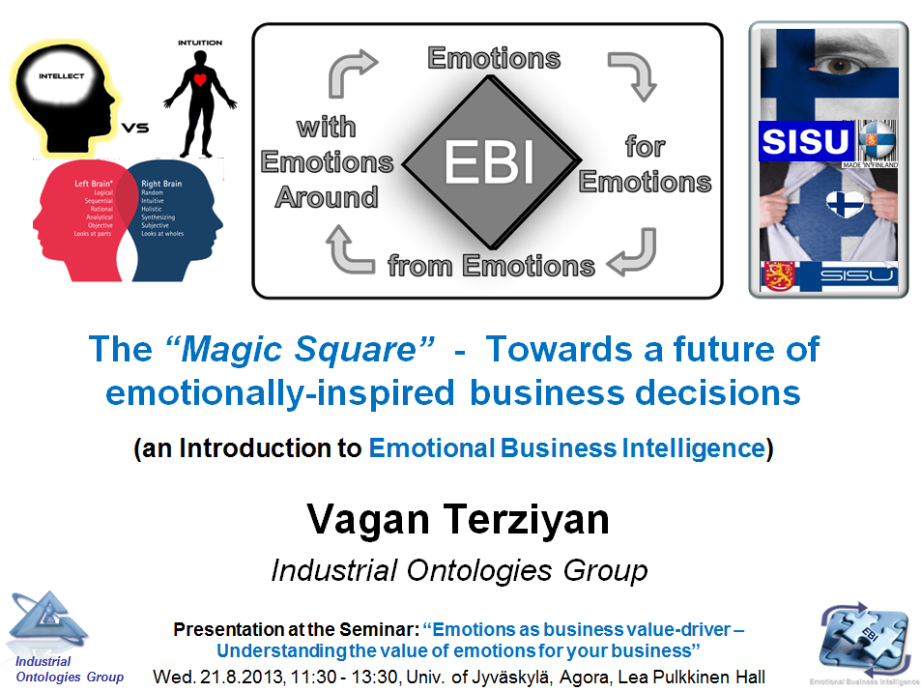

… and even emotionally intelligent!
https://ai.it.jyu.fi/EBI.ppt

Slide 12


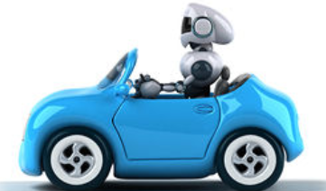

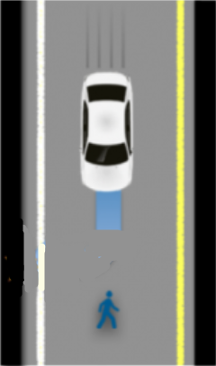
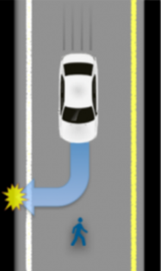
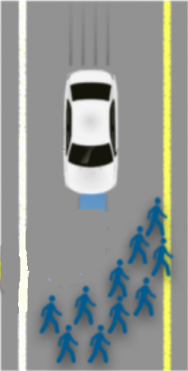
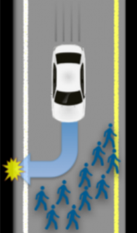
Emotional (Ethical / Moral) vs. Rational (Safe) Choice
Which option must be chosen by an autonomous driver ?
VS
VS
http://www.technologyreview.com/view/542626/why-self-driving-cars-must-be-programmed-to-kill/

Slide 13
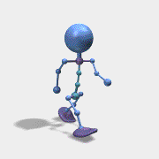
(Multi) Agent Technologies
Self-Management (next lecture)
Mobility
Communication
Coordination
Negotiation

Slide 14
Mobile Agents
“A mobile agent is a program that can migrate from machine to machine in a heterogeneous network. The program knows why and chooses when and where to migrate. It can suspend its execution at an arbitrary point, transport itself to another machine and resume execution.”

Slide 15


Mobile agent vs. virus
The agent can be categorized into two types; one is known as an intelligent agent and the second is malicious agent, called computer virus. These types of agents have some common characteristics; both are intelligent by nature and both have the properties of reproduction and transfer from one host to another host in the network, called mobility or transferability. The fundamental difference between these agents is that the mobile intelligent agent uses deliberate transport infrastructure while the malicious agent hijacks the resources. The intelligent agents are used in a distributed environment because they are not cumbersome for the network traffic; they overcome network latency, operate in heterogeneous environment and possess fault-tolerant behavior, on the other hand the malicious agents are designed to be inefficient and wasteful for computer network resources and beyond.
https://core.ac.uk/download/pdf/25901857.pdf

Slide 16
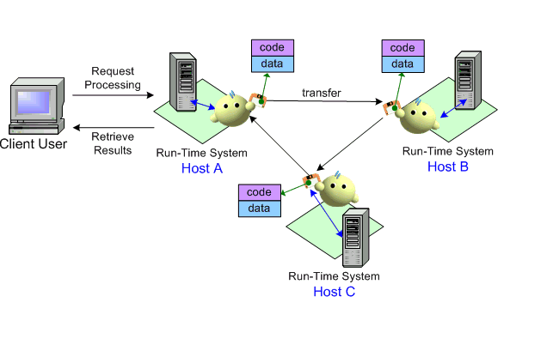
Mobile Agent : Conceptual Diagram
Mobile Computing Laboratory, Dept of IECS, FCU

Slide 17
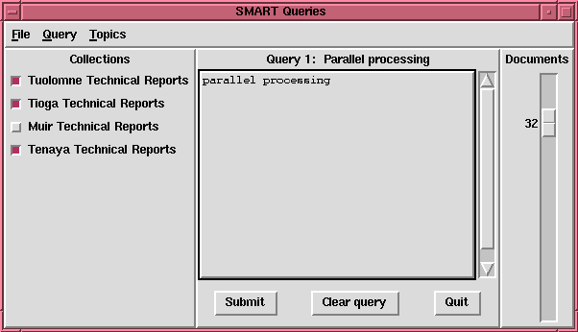

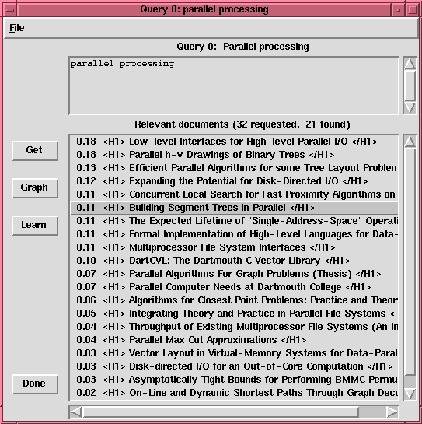

Mobile Agents
Machine 1
...
1. Send agent
2. Send child agents / collect partial results
3. Return merged and filtered results
Dynamically selected
proxy site
Machine n

Slide 18
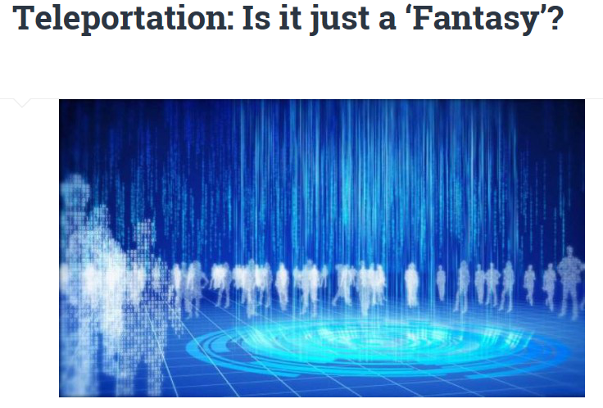
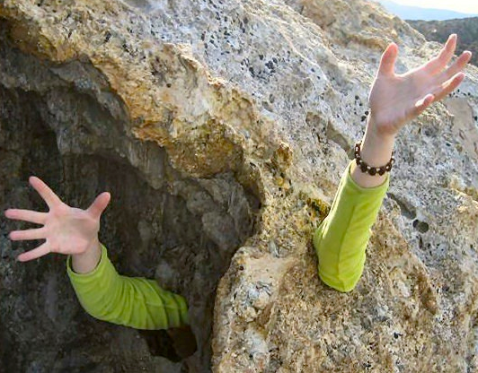
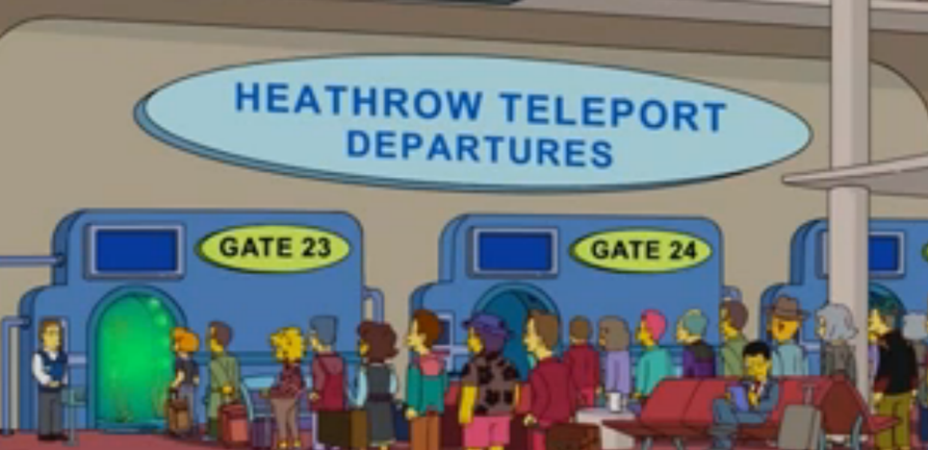
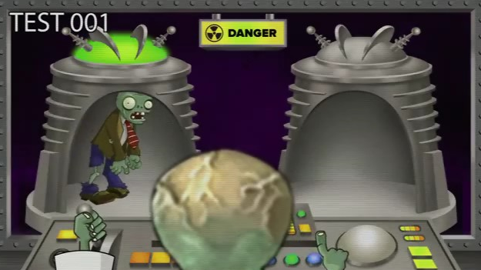
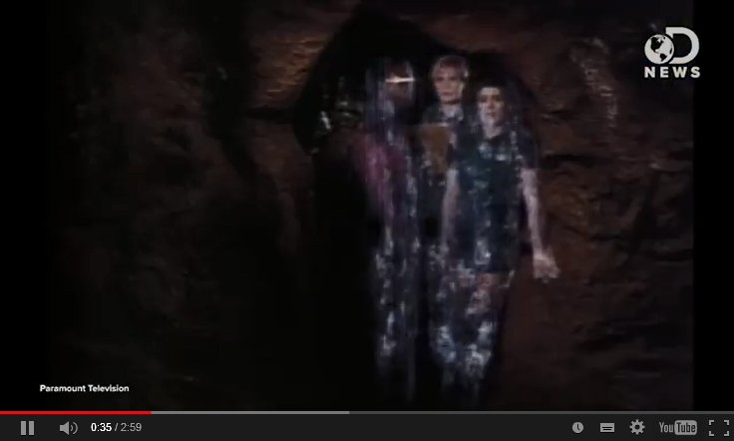

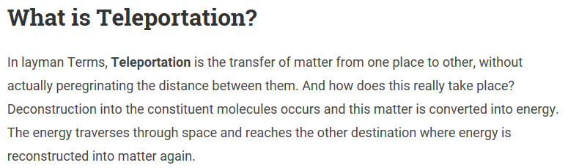

…humans cannot but agents can (?)
https://www.youtube.com/watch?v=yfePpMTbFYY
https://www.youtube.com/watch?v=VA9-R5X6Fkw

Slide 19

Never say “never” !
Matter → Energy → Matter
Matter → Data → Matter

Slide 20
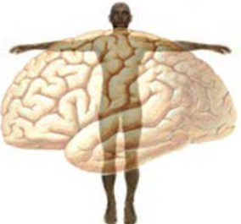


Humans and Agents: “Mind” vs. “Body”
Typically humans are characterized as having both a mind (nonphysical) and body/brain (physical). Agent as virtual copy of human must have also a kind of “mind” and a kind of “body”. Philosophy still concerns the questions: whether the mind and body are separate or the same thing; if separate then who controls whom and how do they interact… The models of humans’ and agents’ “mobility” depend on the vision chosen for the “body-mind” dilemma.
Materialism is the belief that nothing exists apart from the material world (i.e., the brain is a physical matter like all the body and the mind is just the function of the brain).
Subjective Idealism believes that physical objects and events are reducible to mental objects, properties, events. Ultimately, only mental objects (i.e. the mind) exist and that what we think of as our body is merely the perception of mind.
Dualism is the view that the mind and body both exist as separate entities.
Cognitive psychology has placed a new emphasis on this debate. They have taken the computer analogy of Artificial Intelligence and applied it to this debate as a new version of dualism. They argue that the brain can be compared to computer hardware that is "wired" or connected to the human body and the mind therefore is like software, allowing a variety of different software programs: to run. This can account for the different reactions people have to the same stimulus.
McLeod, S. A. (2007). Mind Body Debate. Retrieved from: www.simplypsychology.org/mindbodydebate.html
Mind
Body
Belongings
Agent Mobility:
What is moving: mind, body, “luggage” or all?

Slide 21
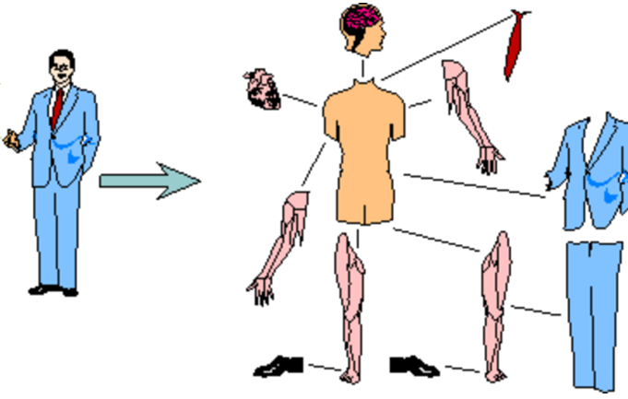
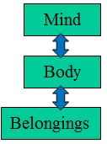
“Preparing for the trip”

Slide 22

“Full” mobility (before)
Home
Host
Distributed Agent Platform

Slide 23
“Full” mobility (during)
Home
Host
Distributed Agent Platform

Slide 24
“Full” mobility (after)
Home
Host
Distributed Agent Platform

Slide 25

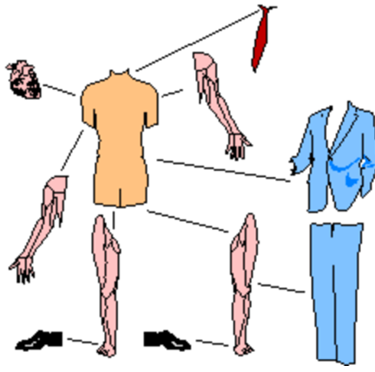
“Partial” or “Mind” mobility (before)
Home
Host
Distributed Agent Platform

Slide 26
“Partial” or “Mind” mobility (during)
Home
Host
Distributed Agent Platform

Slide 27
“Partial” or “Mind” mobility (after)
Home
Host
Distributed Agent Platform

Slide 28
“Telepresence” or mobility imitation
remote control by communication
Home
Host
Distributed Agent Platform

Slide 29

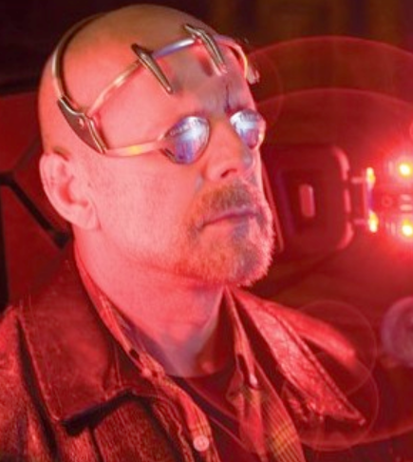
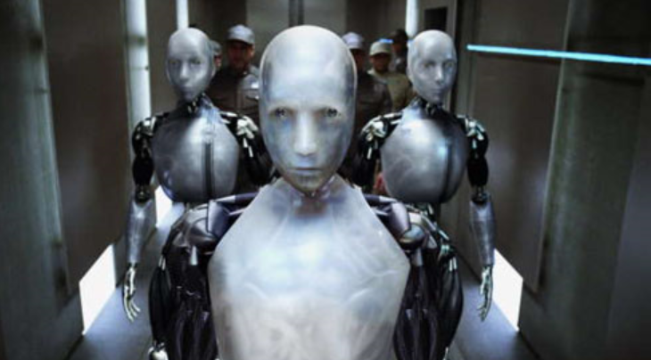
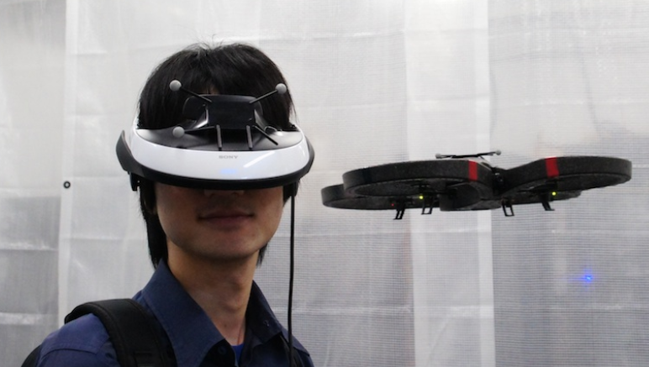
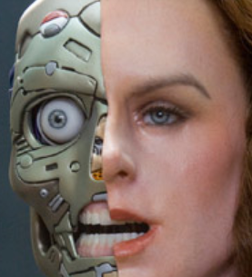
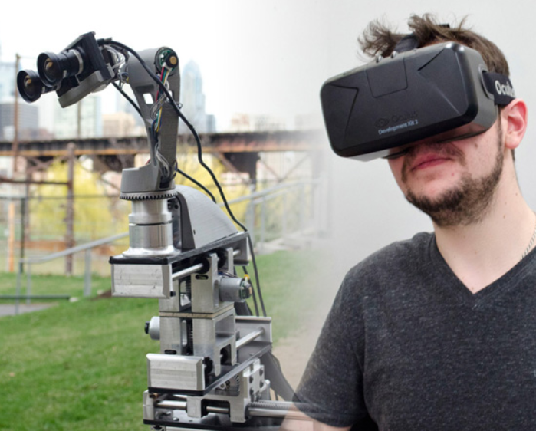
“Surrogates” and Telepresence
2009
Telepresence
http://spectrum.ieee.org/robotics/humanoids/the-reality-of-robot-surrogates

Slide 30
Why Mobile Agents?

Slide 31
Reason 1: Bandwidth conservation
Text documents,
numerical data, etc.
Dataset
Server
Client/Proxy
Dataset
Client/Proxy
Server

Slide 32


Reason 2: Reduce latency
Latency, a synonym for delay, is an expression of how much time it takes for a packet of data to get from one designated point to another
1. Observe high average latency to clients
2. Move to better location
If many distributed computational processes in the network need coordination, then move coordination entity (controller) closer to the computational processes.

Slide 33



Reason 3: Acting Autonomously and Asynchronously
1. Mobile client performing task
2. Mobile client moves to the network to perform task autonomously
task
expensive
cheap
task
task
task
Mobile devices often rely on expensive or fragile network connections. Tasks requiring a continuously open connection between a mobile device and a fixed network are probably not economically or technically feasible. To solve this problem, tasks can be embedded into mobile agents, which can then be dispatched into the network. After being dispatched, the agents become independent of the process that created them and can operate asynchronously and autonomously. The mobile device can reconnect at a later time to collect the agent.

Slide 34





Reason 4: They are robust and fault tolerant
Mobile agents ability to react dynamically to unfavorable situations and events makes it easier to build robust and fault-tolerant distributed systems. If a host is being shut down, all agents executing on that machine are warned and given time to dispatch and continue their operation on another host in the network.

Slide 35
Reason 5: Load balancing
Jobs/Load
Jobs/Load migrate in a heterogeneous
network of machines
Load balancing is distributing processing and communications activity evenly across a computer network so that no single device is overwhelmed.

Slide 36
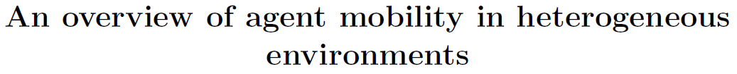





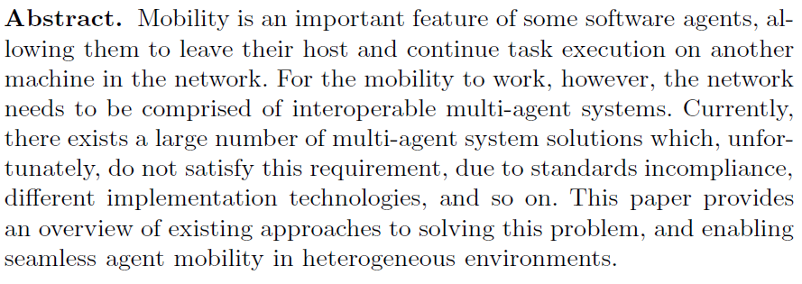


Agent Mobility in Heterogeneous Environments
http://ceur-ws.org/Vol-752/52-58mitrovicetal.pdf

Slide 37
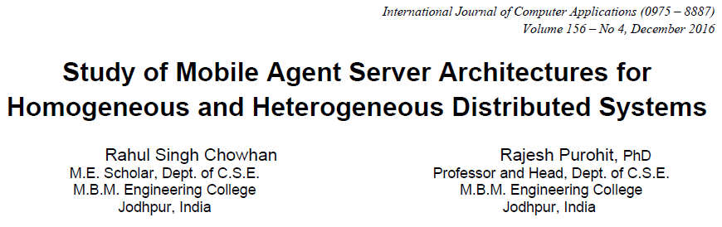
ABSTRACT
Mobile agents are becoming pre-eminent by not only outperforming in comparison with the conventional techniques such as RMI, RPC etc. but also by surpassing their loopholes. They promise to solve many major issues of high network bandwidth consumption during communication, bottleneck problem of centralized system, even can act as intrusion detection agents, and may also be used as monitoring of various nodes in multifarious domains like e-commerce services, for load balancing in cluster, health care monitoring systems, air traffic control systems, and many more. In this paper, the agent server required to allow mobile agents on any machine in network are compared for homogenous and heterogeneous nodes. The homogeneity and heterogeneity of nodes is defined at the hardware level and type of OS installation. Basically, a mobile agent is moving the code to data rather data to code. Agent and agent server are two different parts, in which agent is a computational, operational and communicative entity while the agent server takes care of fundamentals execution and security features. To all intents and purposes, these agent servers help mobile agents to interact and engage with the underlying system acting as an execution environment for them. Agent servers, also called as agency or agent runtime environment, may differ for different platforms and this contrast lies in the software architectural components which they contribute being a middle layer in between the mobile agents and system platform. This paper focuses on architectural dissimilitude between agencies of heterogeneous and homogeneous distributed systems.

Slide 38

(Multi) Agent Technologies
Self-Management
Mobility
Communication
Coordination
Negotiation

Slide 39
Agent-to-agent communication
Indirect communication (shared memory)
  information available for all
  no direct communication
  simple architecture
Message passing
  direct exchange
  common language
  conversation - sequences of messages
Agent
Agent
Blackboard
Agent
Agent A
(Sender)
Message
Agent B
(Receiver)
Agent
Agent
Agent

Slide 40
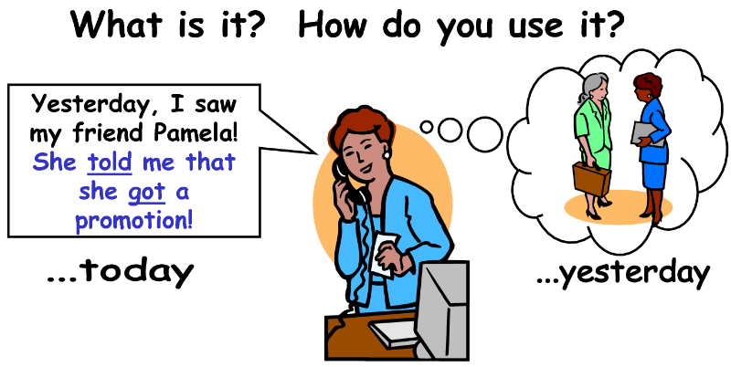
Communication is not just for fun; it is very pragmatic in agents’ world

Slide 41
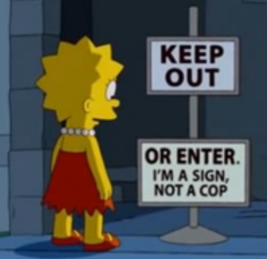


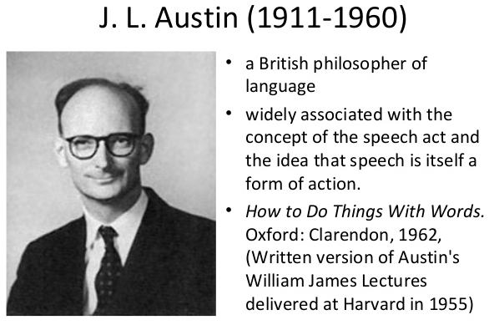

Speech Act Theory
High level framework for human communication
“Language as Action” (J.L. Austin)
Speakers do not just exchange true or false sentences;
Speakers perform speech acts:
  Requests, suggestions, promises, warnings, etc.

Slide 42
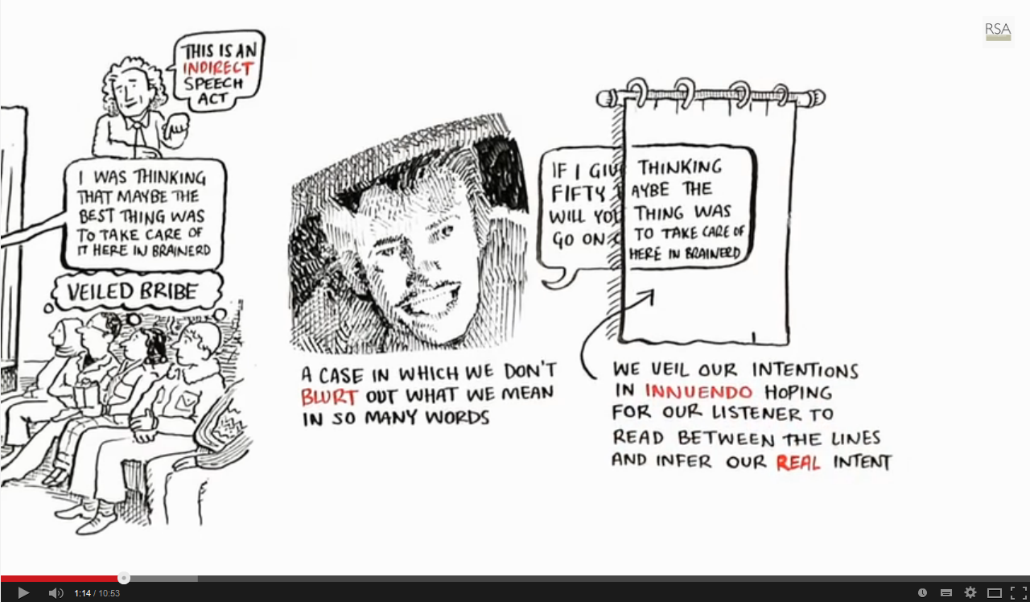
Watch this video to get the point of the Speech Act Theory
https://www.youtube.com/watch?v=3-son3EJTrU
Language as a Window into Human Nature

Slide 43
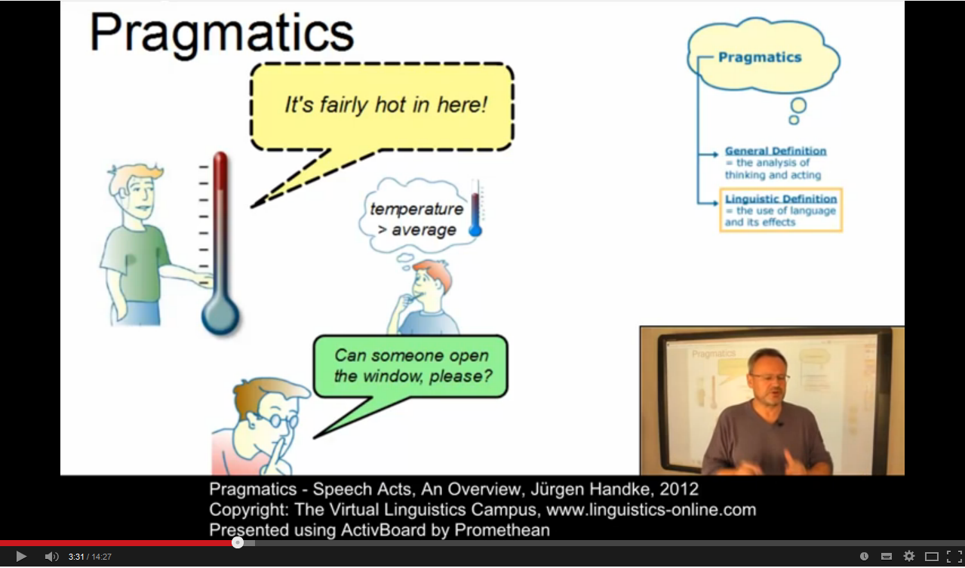
Watch also this one on Semantics and Pragmatics of Speech Act Theory
Semantics and Pragmatics - Speech Acts, An Overview
https://www.youtube.com/watch?v=rs6O77SkIOo

Slide 44
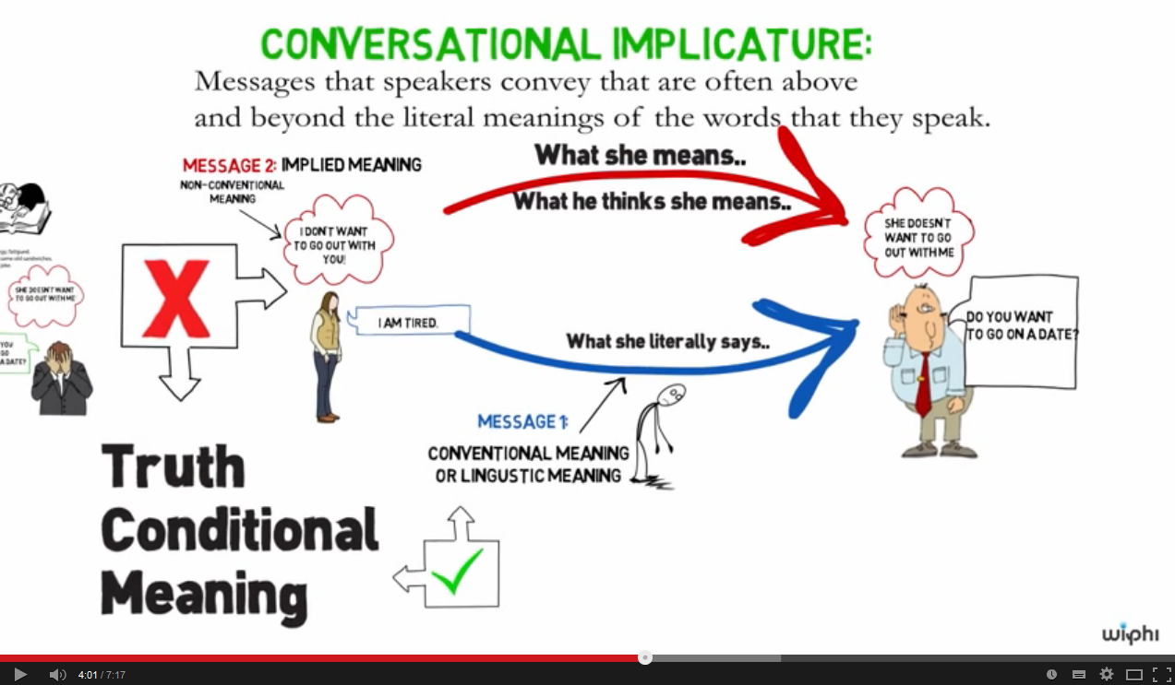
… and this one: Literal vs Conventional Meaning of Communication
Philosophy: Conventional Implicature https://www.youtube.com/watch?v=YD82l_bUhLc

Slide 45
SA Theory (cont)
Locution:
  Taking into account context and reference, i.e., who is the speaker and the hearer, which is the object, etc.
Illocution
  The act of transporting intentions, i.e., the speaker wants the hearer to do something or to think something as a consequence
Perlocutions
  Actions that occur as a result of the illocution
Example: „Open the window!“
  Locution: Monique is the speaker, Steve is the hearer, the window is the object
  Illocution: Monique wants Steve to open the window
  Perlocution: Steve opens the window

Slide 46
Semantics
What do we mean by `semantics´?
Providing semantics is the process of ascribing meaning. (Y. Labrou)
What do we mean by agents´states?
Which language to use for describing agents´states?
To describe the state of an agent before sending a
particular message and after having received it is a useful
way to ascribe meaning to communication primitives

Slide 47
Plan-Based Semantics
Here is their semantics for request:
request(s, h, φ)
pre:
  s believe h can do φ
  (you don’t ask someone to do something unless you think they can do it)
  s believe h believe h can do φ
  (you don’t ask someone unless they believe they can do it)
  s believe s want φ
  (you don’t ask someone unless you want it!)
post:
  h believe s believe s want φ
  (the effect is to make them aware of your desire)

Slide 48
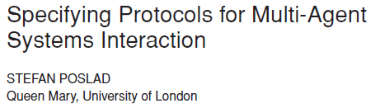


FIPA ACL
The standard FIPA Agent Communication Language is FIPA ACL
FIPA ACL is based on speech acts
To send and process messages corresponds to perform actions, i.e., communicative acts (CAs)
CAs are described a formal semantics based on modal logic
http://dl.acm.org/citation.cfm?doid=1293731.1293735
http://www.fipa.org/

Slide 49







FIPA ACL
INFORM
Basic structure :
  Performative (aka “function”)
  22 performatives in FIPA
  Housekeeping (aka “variables”)
  e.g., sender, receiver, subject, etc.
  Content (aka “data”)
  the actual content of the message
sender
John
receiver
Mary
language
English
in-reply-to
Query #7
YES ! I love you !!!

Slide 50
FIPA-ACL message elements
Element
Category of Elements
performative
Type of communicative acts
sender
Participant in communication
receiver
Participant in communication
reply-to
Participant in communication
content
Content of message
language
Description of Content
encoding
Description of Content
ontology
Description of Content
protocol
Control of conversation
conversation-id
Control of conversation
reply-with
Control of conversation
in-reply-to
Control of conversation
reply-by
Control of conversation

Slide 51
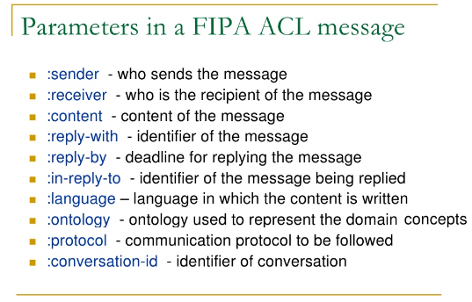

FIPA-ACL message elements
query
request
agree
inform
failure
refuse
subscribe
cfp
propose
propagate
proxy
not-understood
Element
Category of Elements
:performative
Type of communicative acts
sender
Participant in communication
receiver
Participant in communication
reply-to
Participant in communication
content
Content of message
language
Description of Content
encoding
Description of Content
ontology
Description of Content
protocol
Control of conversation
conversation-id
Control of conversation
reply-with
Control of conversation
in-reply-to
Control of conversation
reply-by
Control of conversation

Slide 52
FIPA CAs Examples
query
request
agree
inform
failure
refuse
subscribe
cfp
propose
propagate
proxy
not-understood
Is the door open?
Open the door (for me)
OK! I’ll open the door
The door is open
I am unable to open the door
I will not open the door
Say when the door becomes open
Anyone want to open the door?
I can open the door for you…at a price
Inform all others that the door is open
Inform your mother that the door is open
Door? What’s that? Don’t understand...
Communicative acts
Performatives
Full list of performatives is here:
http://www.fipa.org/specs/fipa00037/SC00037J.html#_Toc26729686

Slide 53

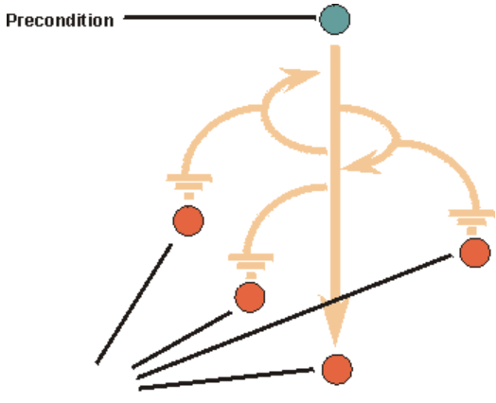
Semantics of CAs
Feasibility Precondition:
  The conditions (i.e., one or more propositions) which need to be true before an agent can plan to execute an action
Rational Effect:
  The rational effect of an action is a representation of the effect that an agent can expect to occur as a result of the action being performed.
Effect

Slide 54
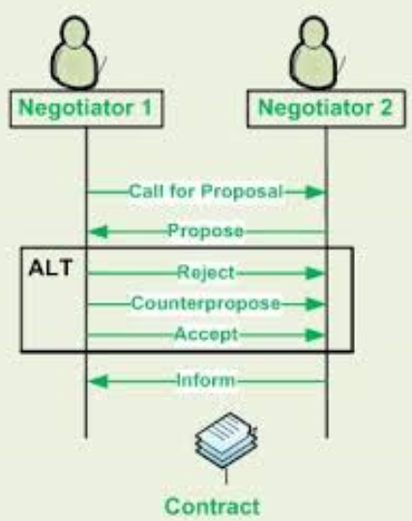
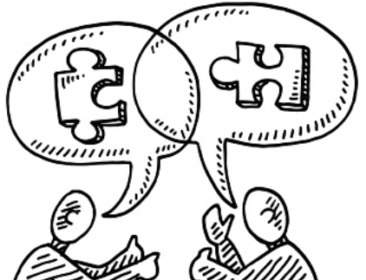

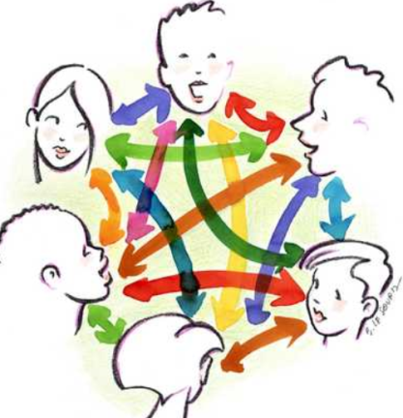

Agents’ Interactions
Ongoing conversations between agents have typical patterns. Certain message sequences are expected, and, at any point in the conversation, other messages are expected to follow. These typical patterns of message exchange are called interaction protocols (IP)
By their nature, agents can engage in multiple dialogues, perhaps with different agents (also humans), simultaneously. The term conversation is used to denote any particular instance of such a dialogue. Thus, the agent may be concurrently engaged in multiple conversations, with different agents, within different protocols.

Slide 55
FIPA standard IPs
fipa-query: the receiver agent is requested to perform some kind of inform action
fipa-request: the receiver is requested to perform some action.
fipa-contract-net: an agent (manager) solicits proposals from other agents (contractors) by specifying the task and the conditions placed by the manager upon the execution of the task. The contractor‘s proposal includes the preconditions that the contractor is setting out for the task (e.g., price, time, etc.)
..some more
(request :sender A
:receiver B
:content (some act)
:protocol fipa-request
)

Slide 56
The Contract Net Protocol
An important generic protocol
Manager announces tasks via a (possibly selective) multicast
Agents evaluate the announcement. Some submit bids
Manager awards a contract to the most appropriate agent
Manager and contractor communicate privately as necessary

Slide 57



Check how communication protocols are used in this “game”; this is interesting …
https://ebiquity.umbc.edu/project/html/id/14/TAGA
https://www.researchgate.net/profile/Tim-Finin/publication/220816027_TAGA_Travel_Market_Framework_in_Agentcities/links/0deec52d1871403ce2000000/TAGA-Travel-Market-Framework-in-Agentcities.pdf
TAGA game simulates a global travel market in the Agentcities environment. A customer from City A want to have a recreational tour in resort R, so he/she needs a round-trip flight ticket and corresponding hotel accommodation when he/she is in resort R. Moreover, the customer will be happy if his/her preferences are satisfied, e.g. living in good hotel, enjoy a concert or go to a famous restaurant. In TAGA, all such service providers can sell their services on the Web and thus form a Web Travel market. Travel agents will help the customer to buy the travel package from the Web travel market. All the TAGA agents are FIPA compliant and FIPA Interaction Protocols are used in agent communication. A marketing mechanism is defined as an big interaction protocol which embeds some sub-interaction protocols.

Slide 58






Watson Conversation Service: Interaction protocols for human-agent communication

Slide 59


(IBM) Watson Virtual Agent:
an example of communication agent (cognitive conversational self-service engine) designed to manage certain interaction protocols
https://www.ibm.com/products/watson-assistant
Watson Virtual Agent understands common customer service queries from day one because it has been pre-trained on frequently occurring customer intents, or the true purpose of the many different ways that a customer can ask a question. For example, intents to do with store information, payment requests and account management. Watson has been trained to answer these questions and you can quickly tailor Watson’s responses with no complicated coding or scripting required. [http://www.ibm.com/marketplace/cloud/cognitive-customer-engagement/us/en-us]
https://www.ibm.com/watson/developercloud/conversation.html
Watson Conversation combines a number of cognitive techniques to help you build and train a bot - defining intents and entities and crafting dialog to simulate conversation. The system can then be further refined with supplementary technologies to make the system more human-like or to give it a higher chance of returning the right answer. Watson Conversation allows you to deploy a range of bots via many channels, from simple, narrowly focused Bots to much more sophisticated, full-blown virtual agents across mobile devices, messaging platforms like Slack, or even through a physical robot.

Slide 60



Enjoy the performance of artificial agent in virtual banking conversation with a human on this video

Slide 61




A lot can be captured from you following the samples of your communications

Slide 62
Conclusions
Agent-to-agent communication is fundamental to realize the potential of agent paradigm
For agents´ interoperability standards are essential
  Agent Communication Language for defining which communicative acts to use
  Content languages to express the knowledge interchange format
  Ontologies to agree upon a common vocabulary and meanings to describe a subject domain
Predefined Interaction Protocols in order to define which sequence of messages is expected
The semantics approach can be oriented either to ascribe meaning to a single CA or to an IP (more pragmatic way of working)

Slide 63


Human-Agent communication and chatbots
(status of the conversational agents’ technology)
https://doi.org/10.1016/j.eswa.2021.115461
Chatbots or Conversational agents are the next significant technological leap in the field of conversational services, that is, enabling a device to communicate with a user upon receiving user requests in natural language. The device uses artificial intelligence and machine learning to respond to the user with automated responses. While this is a relatively new area of study, the application of this concept has increased substantially over the last few years. The technology is no longer limited to merely emulating human conversation but is also being increasingly used to answer questions, either in academic environments or in commercial uses, such as situations requiring assistants to seek reasons for customer dissatisfaction or recommending products and services. …
See also: https://hal.science/hal-03528673/document

Slide 64

(Multi) Agent Technologies
Self-Management
Mobility
Communication
 Coordination
Negotiation

Slide 65
Why is coordination needed?
Dependencies between agents actions
Handle global constraints
  E.g. Time, Money, or computational resources
No individual have sufficient competence or resources to solve the entire problem alone

Slide 66



Not the same but all important
Collaboration is working together towards a shared objective. Co-creation is collaboration towards joint production of a mutually valued outcome.
Coordination is sharing information and resources so that each party can accomplish their part in support of a mutual objective.
Cooperation assumes exchange of relevant information and resources in support of each other’s (possibly selfish) goals, rather than a shared objective.

Slide 67
Terminology of Coordination - I
Coordination
  An agents reasoning about its own and the behavior of other agents in order to ensure that the community acts in a coherent manner
Coherence
  Agents actions can be performed and that they do not conflict with one another
Notes:
(Carpenters, plumbers, electricians, masons)

Slide 68
Terminology of Coordination - II
Convention
  Means of monitoring commitments in changing circumstances
Commitment
  Agents promises to undertake a specified sequence of actions or/and to reach a specific state
Notes:
(Carpenters, plumbers, electricians, masons)

Slide 69
Example of Commitment
promise (A_{who}, B_{whom}, P_{what}) - a commissive act
y
A
1
x
2
3
4
5
B
6
promise (A, B, P1), where P1 =∀x(1 ≤ x ≤ 3),∀ y (¬ Dirt(x,y));
promise (B, A, P2), where P2 =∀x(4 ≤ x ≤ 6),∀ y (¬ Dirt(x,y)).

Slide 70

Example of Convention
dropCommitment (C_{commit}, Q_{if}) - a conventional act
A
B
dropCommitment (C1, Q1), where Q1 = ∃x(1 ≤ x ≤ 3), ∃ y (Monster(x,y));
C1 = promise (A, B, P1), where P1 =∀x(1 ≤ x ≤ 3),∀ y (¬ Dirt(x,y)).

Slide 71
Coordination Problem
Definition (Coordination Problem). Given two agents α and β with goals G_{α} and G_{β}, initial states I_{α} and I_{β}, and sets of actions D_{α} and D_{β} respectively;
Find a pair of plans (P_{α}, P_{β}) such that:
• P_{α} |=D_{α},I_{α} G_{α} and P_{β} |=D_{β},I_{β} G_{β}
• P_{α} and P_{β} are non-conflicting

Slide 72



Centralized Control

Slide 73
Coordination as a distributed Goal-Search Problem
Notes:
(Carpenters, plumbers, electricians, masons)

Slide 74

Coordination as a distributed Goal-Search Problem
A distributed goal search tree involving Agent1 and Agent2. The dotted arrows indicate interdependencies between goals and data in different agents, solid arrows dependencies within an agent. The superscripts associated with goals and data indicate the agent which contains them.
Notes:
(Carpenters, plumbers, electricians, masons)

Slide 75
Read more on coordination in:
“Commitments and Conventions: The Foundation of Coordination in Multi-Agent Systems”
by NICK R. JENNINGS
http://citeseerx.ist.psu.edu/viewdoc/download;jsessionid=B8559C8CAD36F066029B6DA5D9FF25DF?doi=10.1.1.65.5594&rep=rep1&type=pdf

Slide 76

Collaboration and Coordination for reaching a community goal
a
b
sin(x)
ln(x)
Community goal:
Input: a, b
x+y
Output: ln [sin(a) + sin(b)]
Notes:
(Carpenters, plumbers, electricians, masons)

Slide 77


Interesting challenge:
Agents + Robots + Humans Coordination
Read article here: http://www.ihmc.us/users/mjohnson/papers/070924-Coordination%20in%20Human-Robot%20Teamwork.pdf

Slide 78




Coordination and game theory
Collaborative MAS case (trying to make everyone as “happy” as possible):
  Pareto efficiency, or Pareto optimality, is a state of coordination process involving two or more collaborative agents, in which it is impossible to make any one individual better off without making at least one individual worse off.
Self-Interested MAS case (trying to make oneself “happier” than others):
  Nash equilibrium is a is a state of coordination process involving two or more self-interested agents, in which each agent is assumed to know the equilibrium strategies of the other agents, and no agent has anything to gain by changing only their own strategy.
  See also a “Prisoner's dilemma”: http://en.wikipedia.org/wiki/Prisoner's_dilemma

Slide 79
“Prisoner's dilemma"
"prisoner's dilemma" (Poundstone, 1992) : Two criminals are arrested and imprisoned. Each prisoner is in solitary confinement with no means of communicating with the other. The prosecutors lack sufficient evidence to convict the pair on the principal charge. They hope to get both sentenced to a year in prison on a lesser charge. Simultaneously, the prosecutors offer each prisoner a bargain. Each prisoner is given the opportunity either to: betray the other by testifying that the other committed the crime, or to cooperate with the other by remaining silent. The offer is:
  If A and B each betray the other, each of them serves 5 years in prison
  If A betrays B but B remains silent, A will be set free and B will serve 20 years in prison (and vice versa)
  If A and B both remain silent, both of them will only serve 1 year in prison (on the lesser charge)

Slide 80
“Prisoner's dilemma"
"prisoner's dilemma" (Poundstone, 1992) : Two criminals are arrested and imprisoned. Each prisoner is in solitary confinement with no means of communicating with the other. The prosecutors lack sufficient evidence to convict the pair on the principal charge. They hope to get both sentenced to a year in prison on a lesser charge. Simultaneously, the prosecutors offer each prisoner a bargain. Each prisoner is given the opportunity either to: betray the other by testifying that the other committed the crime, or to cooperate with the other by remaining silent. The offer is:
  If A and B each betray the other, each of them serves 5 years in prison
  If A betrays B but B remains silent, A will be set free and B will serve 20 years in prison (and vice versa)
  If A and B both remain silent, both of them will only serve 1 year in prison (on the lesser charge)
Because betraying a partner offers a greater reward than cooperating with them, all purely rational self-interested prisoners will betray the other, meaning the only possible outcome for two purely rational prisoners is for them to betray each other. The interesting part of this result is that pursuing individual reward logically leads both of the prisoners to betray when they would get a better reward if they both kept silent. In reality, humans display a systemic bias towards cooperative behavior in this and similar games despite what is predicted by simple models of "rational" self-interested action. [Wikipedia]

Slide 81

Coordination and practical applications
A typical application, which requires coordination, is the idea of spatially distributed “attractors” or “interest-points” (i.e., burning trees, geological features, delivery destinations) that evolve over time. The agents (robots) must collectively visit as many interest-points as possible over some bounded time-horizon. Two problems are presently intractable: the communication problem, in which robots share their local states and observations, and the control problem in which robots decide on a collective action to achieve the system objectives.
https://www.mdpi.com/2226-4310/9/9/488
Figure. A multi-UAV tracking scenario. (a) Burning trees and UAVs correspond to interest-points and agents respectively. (b) The system must coordinate to visit as many interest-points as possible in the shortest possible time. (c) The system state specifies the locations of agents and interest-points. The reward for a state is determined by the number of agents that coincide with interest-points. (d) Interest-points evolve over time so the UAVs must track their distribution.

Slide 82
Coordination challenges in practice
https://www.mdpi.com/2226-4310/9/9/488
An “agent” is a self-contained computational unit acting in some external environment (i.e., a robot, Unmanned Aerial Vehicle (UAV) or Autonomous Underwater Vehicle (AUV)).
In distributed systems, individual agents do not have direct access to the states of other agents. Direct communication between all agent pairs is often impossible. Instead, agents must discover their “neighbors” (i.e., agents in the geographic vicinity), their neighbors’ neighbors, and so on until they obtain a common view.
The agents communicate by routing messages in multi-hop fashion from one agent to the next. Their relative positions change as they move, which alters the underlying network topology and the implied communication routes. They must constantly update their views of the network topology and refresh their forwarding tables, all while sharing the local states required for coordination.
Only after the local states have been shared, are agents able to infer the global state and coordinate their actions. However, even with universal knowledge of the global state, the optimal control policy is still ambiguous.
Agents could behave selfishly (or “greedily”) to maximize their “take” of interest-points, or cooperatively, favoring the benefit to the collective over the individual. They could act strategically, to obtain future returns at the expense of the present.
The dynamics of the interest-points, initially unknown, also factor into these decisions. Ultimately, the decision space grows exponentially in size (or worse) with the number of agents, which makes the optimal solution unscalable.
Therefore, multi-agent systems with coordination present two distinct challenges:
  “control” problem caused by the exponential growth of the state space in the number of agents;
  “communication” problem of sharing all the local states so that the agents arrive at a common view of the global state.

Slide 83

Konar, A., & Sadhu, A. K. (2020). Multi-Agent Coordination: A Reinforcement Learning Approach. John Wiley & Sons.
Probably, the Reinforcement Learning would be the best way nowadays to address the Multi-Agent Coordination challenges …
Read also about the multi-agent coordination challenge with adversarial actors:
Asher, D. E., Basak, A., Fernandez, R., Sharma, P. K., Zaroukian, E. G., Hsu, C. D., ... & Fossaceca, J. (2022). Strategic Maneuver and Disruption with Reinforcement Learning Approaches for Multi-Agent Coordination. arXiv preprint arXiv:2203.09565. https://arxiv.org/pdf/2203.09565.pdf

Slide 84
Conclusions
Coordination – four main structures
  Commitments
    Agree on doing something in a MAS
  Convention
    When to do something about commitments
  Social Conventions
    Team-oriented Conventions
  Local Reasoning
    Intelligence needed to fulfill conventions and commitments

Slide 85

(Multi) Agent Technologies
Self-Management
Mobility
Communication
Coordination
 Negotiation

Slide 86
Intra-agent negotiation model
Buyer (service requestor):
  The main goal is to get the good (or service) s maximizing the utility expressed as:
    U(s) = Value – Price
    An offer is considered unacceptable if U(s) < 0
    An offer can be considered acceptable when U(s) > 0
Seller (service provider):
  The main goal is to maximize the profit expressed as:
    ∏(s) = Price – Cost

Slide 87

I VALUE cleaned room as much as 100 Euro. Therefore, I should buy service from a cleaning agent for a PRICE cheaper than that …
Buyer’s logic:
U(Cleaned_Room) =
= 100 – PRICE > 0
Service consumer agent

Slide 88

To clean the room, I need to spend resources which COST me as much as 45 Euro. Therefore, I must sell my service for a PRICE higher than that …
Seller’s logic:
П(Cleaned_Room) =
= PRICE - 45 > 0
Service provider agent
“Window” for negotiations: 45 < PRICE < 100

Slide 89
Negotiation Protocols
A specification of the possible valid actions (how the interaction can take place)
  Possible participants
    Buyers, sellers, mediators, etc.
  Negotiation states
    Offering, accepting proposal, negotiation closed, etc.
  Events that determine state transitions
    No more offers, timeout expiration, etc.
  Valid actions of the participants
    Accept, reject, counter-propose, etc.

Slide 90
Agreements
Negotiation to agree about what?
  Price
  Quality
  Quantity, volume, number, etc.
  Payment modality
  Delivery process
  Delivery date
  Maintenance
  .....
More than one issue can
be negotiated
at the same time.

Slide 91

What is an auction?
„Auction are popular, distributed and autonomy preserving ways of allocating items among agents.“ [Sandholm 1999]
„An auction is a method of allocating scarce goods, a method that is based upon competition“. [Agorics, 1996]
Auctions provide an efficient way to
  Quickly find partner with highest valuations
  Run one-to-many interaction
  Determine fair prices
  Allocate resources
An auction is a mechanism to find prices that allow commitments

Slide 92
Auction Principles
An auction protocol establishes the rules governing an auction:
  how bids and offers can be done
  The order in wich prices are quoted
  how to determine the winner
Auction Protocols:
  FPSB (First-Price Sealed Bid)
  Vickrey or SPSB (Second-Price Sealed Bid)
  English
  Dutch
An auction strategy is used to determine the bid to be offered

Slide 93
FPSB, Vickrey
In FPSB and Vickrey (or SPSB) auctions the main three phases are:
    Bidding phase: every participant can submit only one secret bid per auction.
    Winner determination phase: the auctionner evaluates the highest (or the lowest one when appropriate) bid. The bidder who offered the highest (or the lowest one when appropriate) bid is the winner.
    Auction ending: the winner and the seller are notified about the results and about each other identity.
In FPSB auctions the winner pays the highest (or the lowest one when appropriate) bid.
In Vickrey (SPSB) auctions the winner pays the second highest (or the second lowest one when appropriate) bid.
Advantages: one-round bid, no information revealed, the buyers do not need to be present.
FPSB: First-Price Sealed-Bid
SPSB: Second-Price Sealed-Bid

Slide 94








50
FPSB auction example
(First-Price Sealed Bid)
Service consumer agent
60
70
80
The “winner” will get 50 Euro for his job

Slide 95
50
SPSB (Vickrey) example
(Second-Price Sealed Bid (SPSB) Auction)
Service consumer agent
60
70
80
The “winner” will get 60 Euro for his job

Slide 96





90
FPSB example (other way around)
(First-Price Sealed Bid)
80
Service provider agent
70
The “winner” will pay 90 Euro for the service

Slide 97
90
SPSB (Vickrey) example
(other way around)
(Second-Price Sealed Bid)
80
Service provider agent
70
The “winner” will pay 80 Euro for the service

Slide 98
English
In an English auction there are three main phases:
    Bidding phase: every participant submits bids. Every bidder can submit several bids up to a pre-fixed maximum amount. A new bid has to be greater (lower when appropriate) than the highest current bid in the market.
    Winner determination phase: the auctionner evaluates the highest (lowest when appropriate) bid. The bidder who offered the highest (or lowest when appropriate) bid is the winner.
    Auction ending: the winner and the seller are notified about the results and about each other identity.
All auction participants have to be informed about the current highest (lowest when appropriate) bid
Delays in delivering bids can change auctions results: buyers should be present
Advantage: no counterspeculation, but long process
Art auctions, etc.

Slide 99


English auction example
1
2
3
4
5
6
7

Slide 100

Dutch
In a Dutch auction the main phases are:
    Bidding phase: every participant can submit one bid.
    Winner determination phase: the auctionner continuosly lowers (increases when appropriate) the price until a bidder accepts the price.
    Auction ending: the seller is notified about the results and about each other identity.
All auction participants have to be informed about the current price
Delays in delivering bids can change auctions results
Advantage: efficient, reveals only information about the winner
Dutch flower market, fish markets

Slide 101

More Auctions
http://www.swdsi.org/swdsi06/proceedings06/Papers/MIS15.pdf

Slide 102




Bored and tired
from the abstractions?
You, probably, wonder:
“How on earth all these
will help me during my everyday work in a company?”
answers
the question:
PAAMS 2019 : 17th International Conference on Practical Applications of Agents and Multi-Agent Systems
How abstract agent approaches, methods, and tools help system designers to accomplish the mapping between available agent technology and application needs?
PAAMS 2018
https://www.paams.net/

Slide 103



Topics:
PAAMS 2019 : 17th International Conference on Practical Applications of Agents and Multi-Agent Systems
https://www.paams.net/

Slide 104







Slide 105



Can we involve and trust artificial agents to tinker with our mental problems?
Rasouli, S., Ghafurian, M., & Dautenhahn, K. (2022, December). Students’ Views on Intelligent Agents as Assistive Tools for Dealing with Stress and Anxiety in Social Situations. In: Proceedings of the 10th International Conference on Human-Agent Interaction (pp. 23-31).
https://dl.acm.org/doi/pdf/10.1145/3527188.3561932
Mental health problems are on the rise among university students. Many students face overwhelming stress and anxiety when participating in different activities and interacting with peers, which can affect their performance and mental well-being. However, many are unlikely to seek or receive help. Intelligent agents can offer the possibility of delivering health and mental well-being interventions with the aim of extending and complementing mental health interventions and increasing accessibility. To provide efficient interventions for students, it is imperative to identify design elements and functionalities that are most effective for engaging students. In this paper, we conducted an online survey with 85 participants (undergraduate and graduate students) to investigate preferences for using intelligent agents (e.g., conversational agents, social robots, etc.) to support their mental well-being, specifically to deal with feelings of stress and anxiety in social situations that are common in academic contexts. We asked students to complete a questionnaire in order to explore students’ experience of anxiety and their perceptions of different aspects of intelligent agents in the context of managing anxiety. The results provide insights on different social and technical capabilities as well as design elements that need to be considered when developing intelligent agents to help address stress and anxiety among university students.

Slide 106





ABSTRACT: Deep neural networks have achieved impressive successes in fields ranging from object recognition to complex games such as Go. Navigation, however, remains a substantial challenge for artificial agents, with deep neural networks trained by reinforcement learning failing to rival the proficiency of mammalian spatial behaviour, which is underpinned by grid cells in the entorhinal cortex. Grid cells are thought to provide a multi-scale periodic representation that functions as a metric for coding space and is critical for integrating self-motion (path integration) and planning direct trajectories to goals (vector-based navigation). Here we set out to leverage the computational functions of grid cells to develop a deep reinforcement learning agent with mammal-like navigational abilities. We first trained a recurrent network to perform path integration, leading to the emergence of representations resembling grid cells, as well as other entorhinal cell types. We then showed that this representation provided an effective basis for an agent to locate goals in challenging, unfamiliar, and changeable environments - optimizing the primary objective of navigation through deep reinforcement learning. The performance of agents endowed with grid-like representations surpassed that of an expert human and comparison agents, with the metric quantities necessary for vector-based navigation derived from grid-like units within the network. Furthermore, grid-like representations enabled agents to conduct shortcut behaviours reminiscent of those performed by mammals. Our findings show that emergent grid-like representations furnish agents with a Euclidean spatial metric and associated vector operations, providing a foundation for proficient navigation. As such, our results support neuroscientific theories that see grid cells as critical for vector-based navigation, demonstrating that the latter can be combined with path-based strategies to support navigation in challenging environments.
Check this article related to your assignment …

Slide 107



https://en.wikipedia.org/wiki/Simultaneous_localization_and_mapping
http://ieeexplore.ieee.org/document/1638022/
http://ieeexplore.ieee.org/document/1678144/
In robotic mapping and navigation, simultaneous localization and mapping (SLAM) is the computational problem of constructing or updating a map of an unknown environment while simultaneously keeping track of an agent's location within it. Published approaches are employed in self-driving cars, unmanned aerial vehicles, autonomous underwater vehicles, planetary rovers, newer domestic robots and even inside the human body. [Wikipedia]
Check SLAM approach related to your assignment …

Slide 108
https://en.wikipedia.org/wiki/Simultaneous_localization_and_mapping
http://ieeexplore.ieee.org/document/1638022/
http://ieeexplore.ieee.org/document/1678144/
In robotic mapping and navigation, simultaneous localization and mapping (SLAM) is the computational problem of constructing or updating a map of an unknown environment while simultaneously keeping track of an agent's location within it. Published approaches are employed in self-driving cars, unmanned aerial vehicles, autonomous underwater vehicles, planetary rovers, newer domestic robots and even inside the human body. [Wikipedia]
… However, within your assignment,
I expect you being capable to suggest
(“invent”) something of your own,
which will be simpler and more
elegant than SLAM …
Check SLAM approach related to your assignment …

Slide 109




Some reports on our industrial experience with agent technology:
Khriyenko, O., & Terziyan, V. (Eds.). (2010). UBIWARE (Smart Semantic Middleware for Ubiquitous Computing) Final Project Report. Technical Report (50 pp.). UBIWARE Project: University of Jyvaskyla.
(Brief presentation of the UBIWARE Final Report is here).
(UBIWARE platform documentation and UBIWARE download package).
Terziyan, V. (Ed.). (2007). Smart Resource (Proactive Self-Maintained Resources in Semantic Web) Final Project Report. Technical Report (98 pp.). SmartResource Project: University of Jyvaskyla.
(Presentation of the SmartResource Final Report is here).
(Download SmartResource platform here).
All reports, presentations and downloads from SmartResource and UBIWARE projects

Slide 110
Predicting Agent Future
„Who the hell wants to hear actors talk“, H.M. Warner, Warner Bros, 1927
„I think there is a world market for maybe 5 computers“, Thomas Watson, IBM chairmain, 1943
„We don‘t like their sound and guitar music is on their way out“, Decca Recording Co, rejecting Beatles, 1962
„There is no reason anyone would want a computer at home“, Ken Nelson, DEC, president, chairman, 1977
„640K ought to be enough for anybody“, Bill Gates, 1981
Do agents have any future? … Try to guess …

