Slide 1






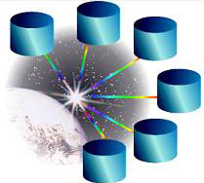



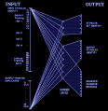
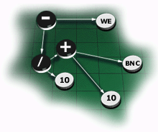





UBIWARE Project
“Smart Semantic Middleware for Ubiquitous Computing”
Deliverable 3.3: UBIWARE 3.0 Platform
Resource Agent
“Expert”
“Device”
Resource Agent
Resource Agent
“Service”
PI
&
GB
shared services
SC
Industrial Ontologies Group
University of Jyväskylä

Slide 2


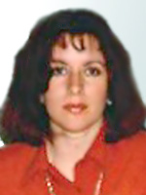


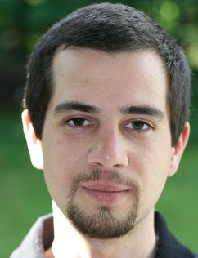

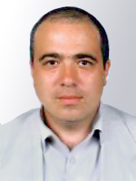
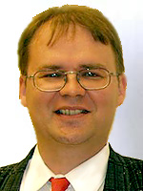




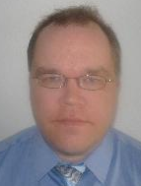


Industrial Ontologies Group
UBIWARE Team
University of Jyväskylä
Researchers
  Vagan Terziyan (Head)
  Olena Kaykova
  Oleksiy Khriyenko
  Sergiy Nikitin
  Michal Nagy
Contact Person:
Timo Tiihonen
  e-mails:
    timo.tiihonen@jyu.fi
    vagan.terziyan@jyu.fi
  phone: +358 14 260 2741
  Joonas Kesäniemi
  Michael Cochez
  Atte Pulkkis
  Toni Piirainen
URL: http://www.mit.jyu.fi/ai/OntoGroup

Slide 3
What is UBIWARE ?
Just a reminder or short Introduction

Slide 4
What is UBIWARE (in short)
UBIWARE is a tool to support:
  design and installation of…,
  autonomic operation of… and
  interoperability among…
… complex, heterogeneous, open, dynamic and self-configurable distributed industrial systems;…
… and to provide following services for system components:
  adaptation;
  automation;
  centralized or P2P organization;
  coordination, collaboration, interoperability and negotiation;
  self-awareness, communication and observation;
  data and process integration;
  (semantic) discovery, sharing and reuse.

Slide 5





Current UBIWARE Agent Architecture
Behavior Engine
Beliefs storage
Data
Rules
RAB
RAB
RAB
RAB
Blackboard
RAB: Reusable Atomic Behaviors
c
Pool of Atomic Behaviours
S-APL Repository
S-APL
S-APL – Semantic Agent Programming Language (RDF-based)
S-APL – is a hybrid of semantics (metadata / ontologies/ rules) specification languages, semantic reasoners, and agent programming languages. It integrates the semantic description of domain resources with the semantic prescription of the agents' behaviors
Ontology
http://users.jyu.fi/~akataso/sapl.html

Slide 6



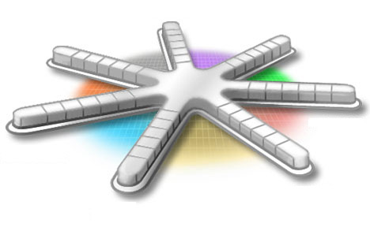



Why do you need UBIWARE ?
University of Jyväskylä
Industrial Ontologies Group

Slide 7




What the companies usually want to get from us?
They want to see technology applied to their problems, allegorically they want a ready-to-use product, let us say, coffee,
but…

Slide 8

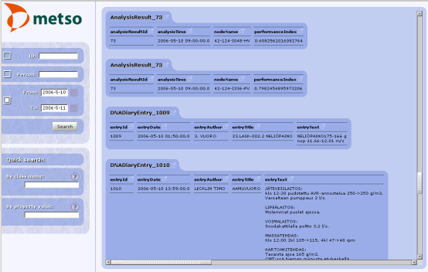

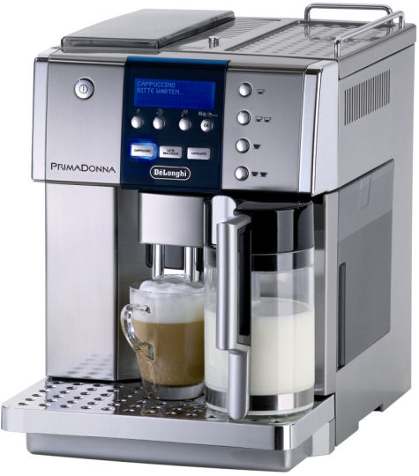
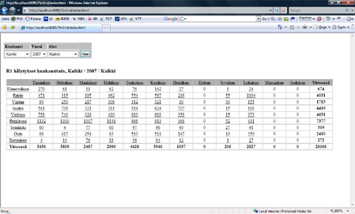




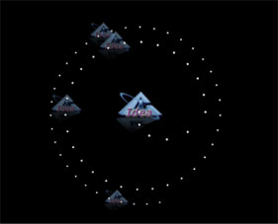
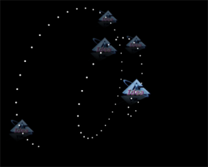
UBIWARE allegoric view
S-APL script
UBIWARE
IOG
But we are providing much more than just a coffee, we are providing a coffee maker !

Slide 9
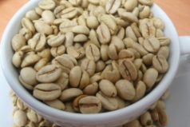
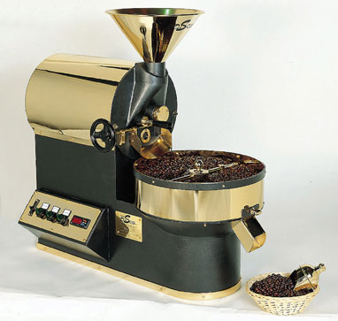


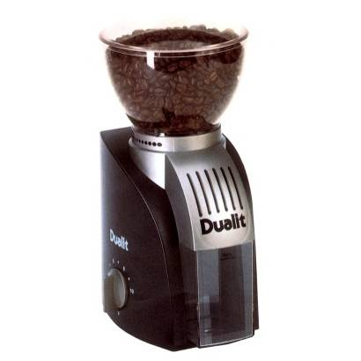

UBIWARE allegoric view (2)
Coffee
Roaster
Unroasted beans
1.
2.
Roasted beans
S-APL script
UBIWARE
IOG
Roasted beans
3.
Coffee
Grinder
4.
Ground coffee
UBIWARE is also about orchestrating external resources to achieve a goal!

Slide 10

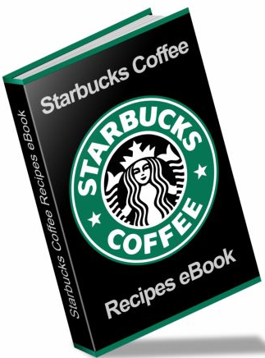

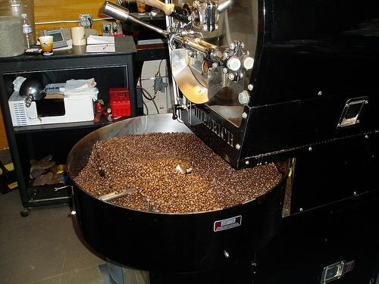
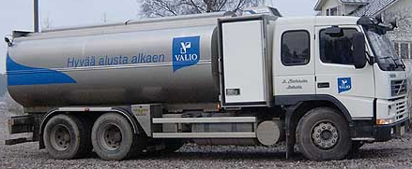
Outsourced external resources can be both: information and service providers
S-APL script
UBIWARE
IOG

Slide 11



You may say however: “I still want my coffee, not a coffee maker !”
Coffee-Making-as-a-Service
Order
and instructions
S-APL script
UBIWARE
IOG
UBIWARE-Driven Cloud:
PRIME / GERI
Coffee
You may still get your coffee made by our coffee maker, hosted “within the cloud”, and even have possibility to take part in making your coffee every time you need it and every way you like it!

Slide 12
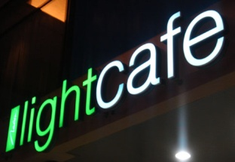









You may serve the coffee made by our “Cloud-Coffee-Maker” to others
Coffee-Making-as-a-Service
for service providers
Order
and instructions
S-APL script
UBIWARE
IOG
UBIWARE-Driven Cloud:
PRIME / GERI
Coffee

Slide 13
Message to the UBIWARE partners
Do not loose the opportunity, save your resources – select UBIWARE (“make coffee yourself (using your or our kitchen infrastructure) easily and cheaper whenever you need it and not buy it every time”);
Help us to develop the basis of UBIWARE first of all, then you will be able to manage you future (even more sophisticated) cases by yourself.

Slide 14
UBIWARE Project
“Smart Semantic Middleware for Ubiquitous Computing”
(2007-2010)
Deliverable: D 3.3
UBIWARE Platform Prototype v. 3.0

Slide 15
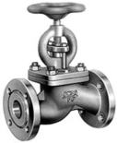
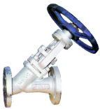
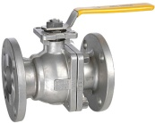













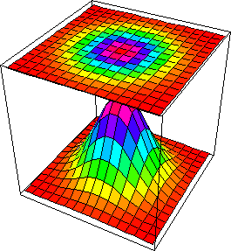






UBIWARE 3.0 (2009-2010) vision of future platform (3-rd project year plan)
UBIWARE 3.0 supposed to be a platform for creating and executing configurable distributed systems based on generalized and reusable business scenarios, which heterogeneous components (actors) are not predefined but can be selected, replaced and configured in runtime.
C
C
C
C
C
C
C
SmartComments

Slide 16
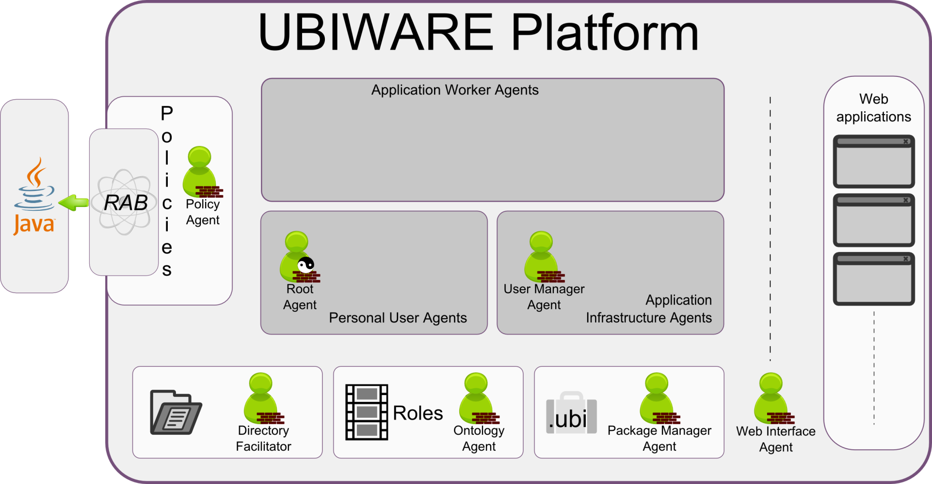
UBIWARE 3.0 platform architecture
The UBIWARE 3.0 platform now combines the features of the application server, the semantic web platform and the agent-driven platform, where agent-driven semantic applications can serve to the end customers with the high quality web-based GUIs, enhanced user-friendliness and responsiveness. The platform has become an application-independent runtime environment, where special infrastructure agents take care of the platform itself, not of the applications being run on it. At the same time, we introduce personal user agents, thus making the platform user-oriented.

Slide 17
UBIWARE 3.0 One-click startup

Slide 18
UBIWARE 3.0 Action Script
:action1 rdf:type com:Action ;
com:hasActionName soc:getAllMessages ;
com:hasActionParams {
com:sender sapl:hasValue “agentPeter” .
soc:profileID sapl:hasValue “54981618” .
soc:fromDate sapl:hasValue “01-06-2010 00-00-00 EEST”.
soc:toDate sapl:hasValue “10-06-2010 12-00-00 EEST” .
} .
: getAllMessagesHandler rdf:type com:Handler ;
com:handles soc:getAllMessages ;
com:params {
com:sender sapl:hasValue “agentPeter” .
soc:profileID sapl:hasValue “54981618” .
soc:fromDate sapl:hasValue “01-06-2010 00-00-00 EEST”.
soc:toDate sapl:hasValue “10-06-2010 12-00-00 EEST” .
} ;
com:code {// . . . code . . . }

Slide 19
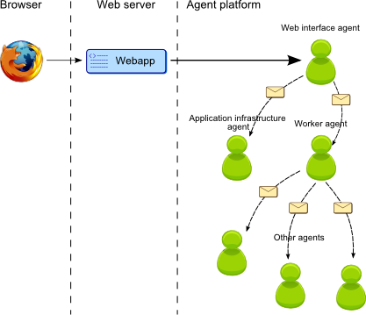
UBIWARE 3.0 Towards modern web

Slide 20
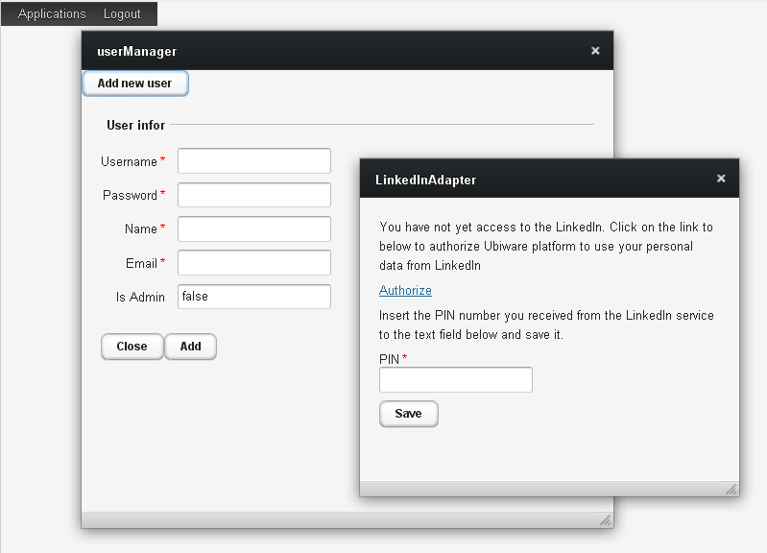
UBIWARE 3.0 Web desktop

Slide 21
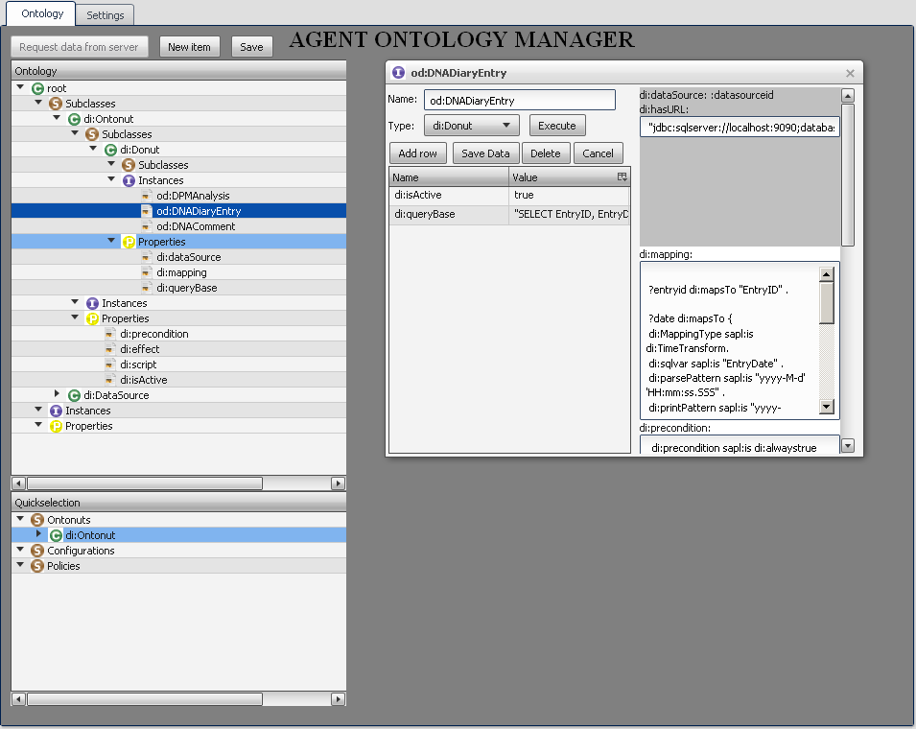
UBIWARE 3.0 Agent Ontology Manager

Slide 22
























Presentation Case for UBIWARE 3.0
User
UBIWARE 3.0

Slide 23






















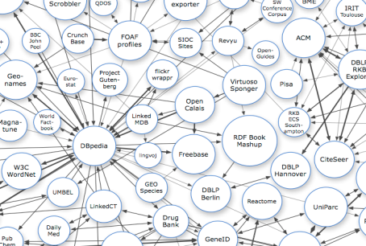




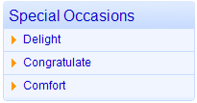


Presentation Case for UBIWARE 3.0
User
UBIWARE 3.0
Linked Data
Capabilities

Slide 24
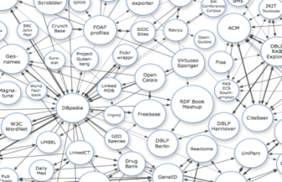
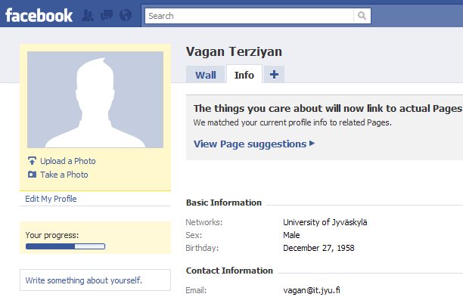
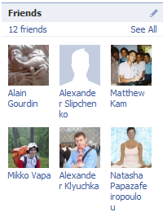
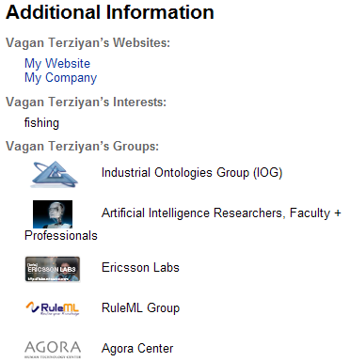
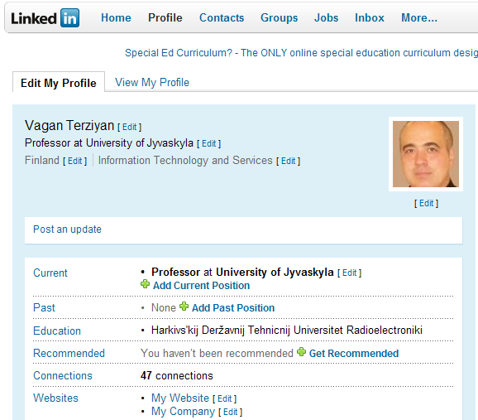
Linked Data
Linked Data
X1 :firstName :Vagan
X1 :lastName :Terziyan
X1 :sex :Male
X1 :birthday :27/12/1958
X1 :email :vagan@it.jyu.fi
X1 :interest :fishing
X1 :hasPhoto #vagan.jpg
X1 :group :IOG
X1 :group :RuleML
…
X1 :education :KNURE
X1 :position :professor
X1 :hasFriend X2
X2 :firstName :Alain
X2 :lastName :Gourdin
…
X1 :hasFriend X3
X3 :firstName :Mikko
X3 :lastName :Vapa
…

Slide 25
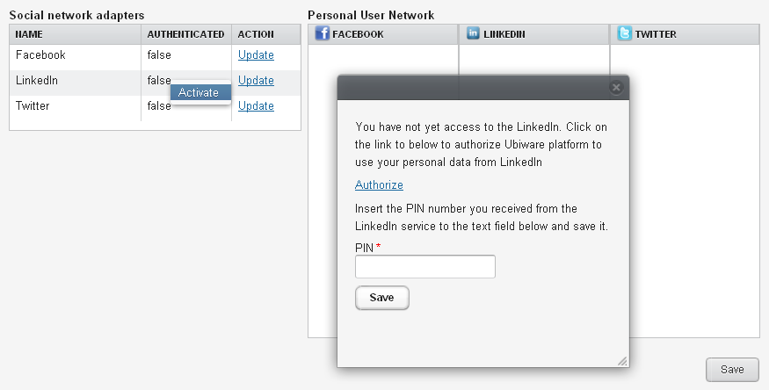
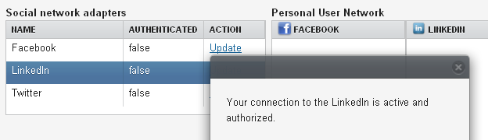
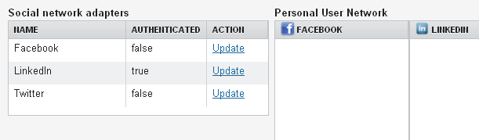
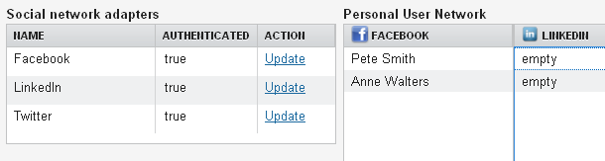
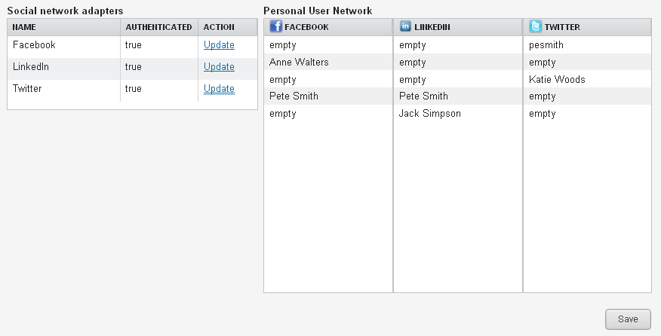
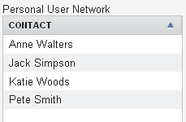
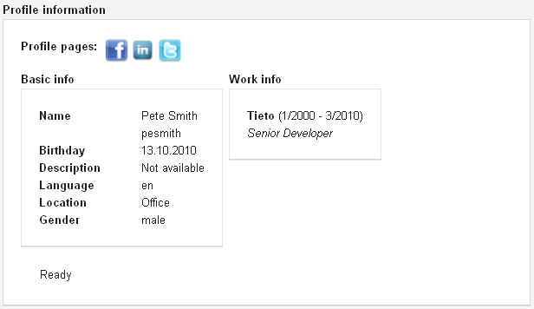
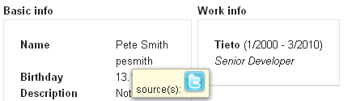
“Mashupper” and GUI for the Ontonuts Activation
A Mashupper is a mashup application that focuses on the concept of Personal User Network (PUN), which is defined as the combination of different kinds of human connections one particular user has in the social web. PUN is used to link the different online identities or profiles into one and same connection, through which the user can observe the integrated presence of that connection in the current web2.0 landscape.

Slide 26
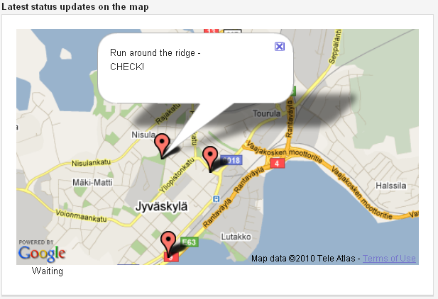
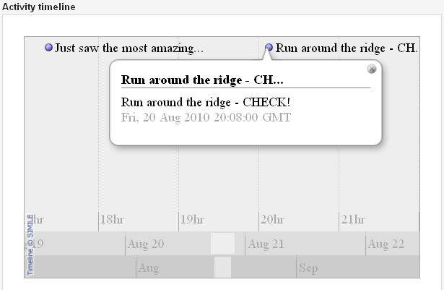
Samples of mashups generated

Slide 27
Mashupper: Social Ontology

Slide 28
Mashupper: Agent architecture

Slide 29
Mashupper: Agent communication

Slide 30
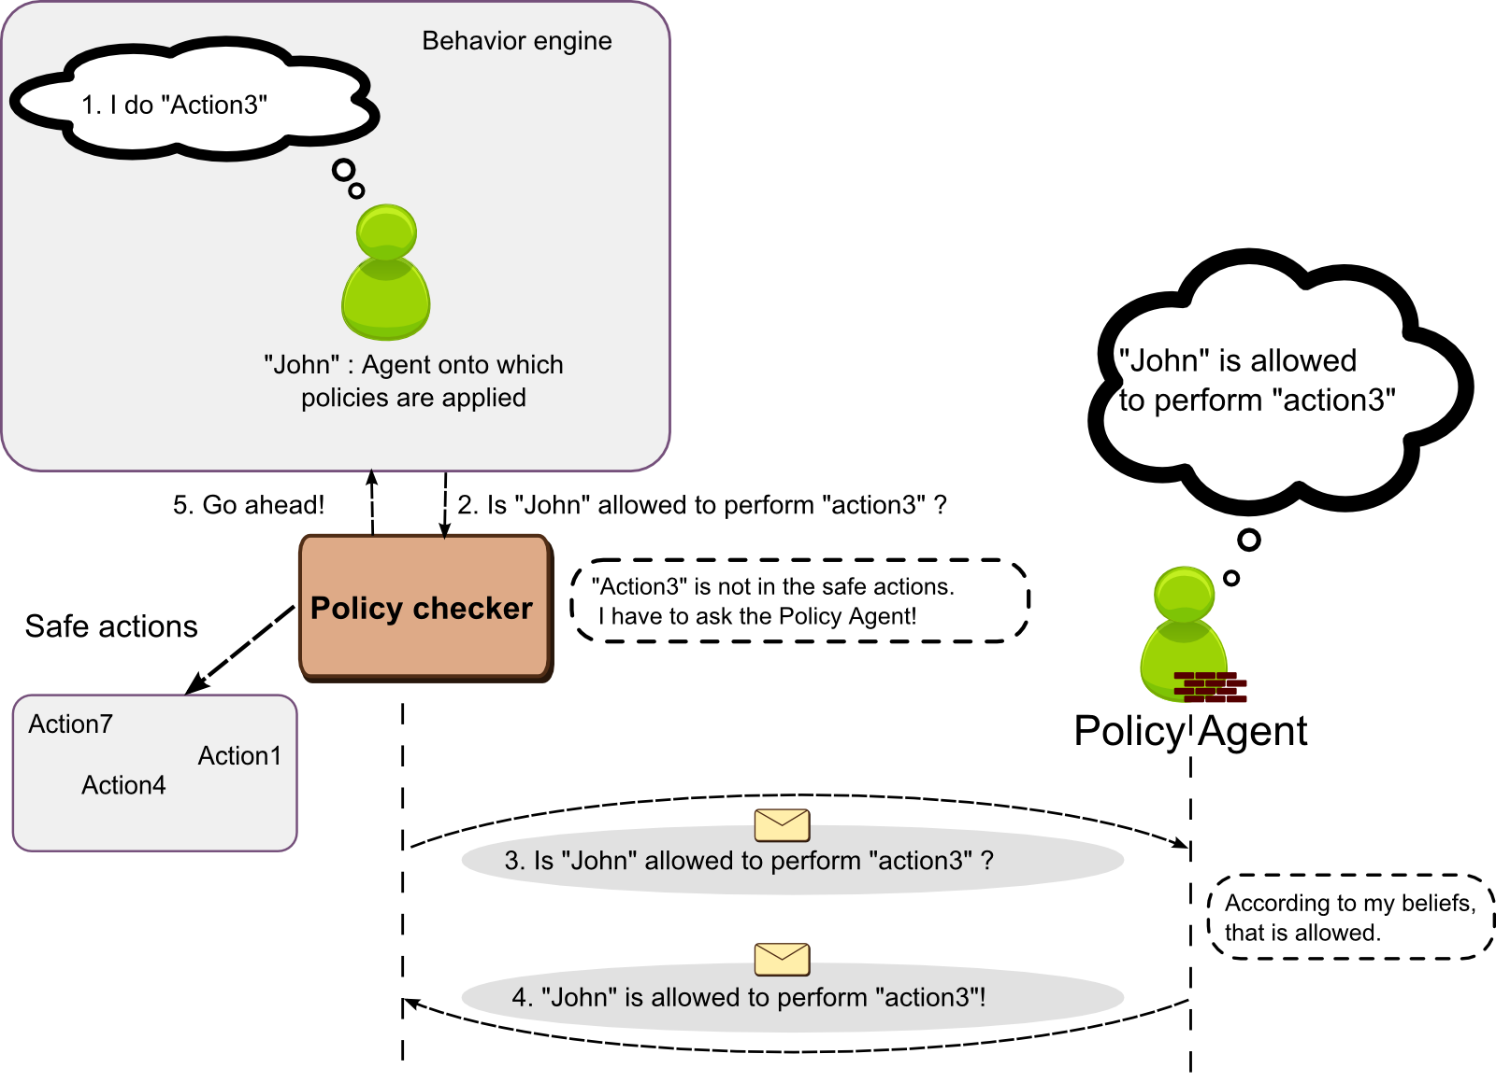
Policies in UBIWARE 3.0

Slide 31
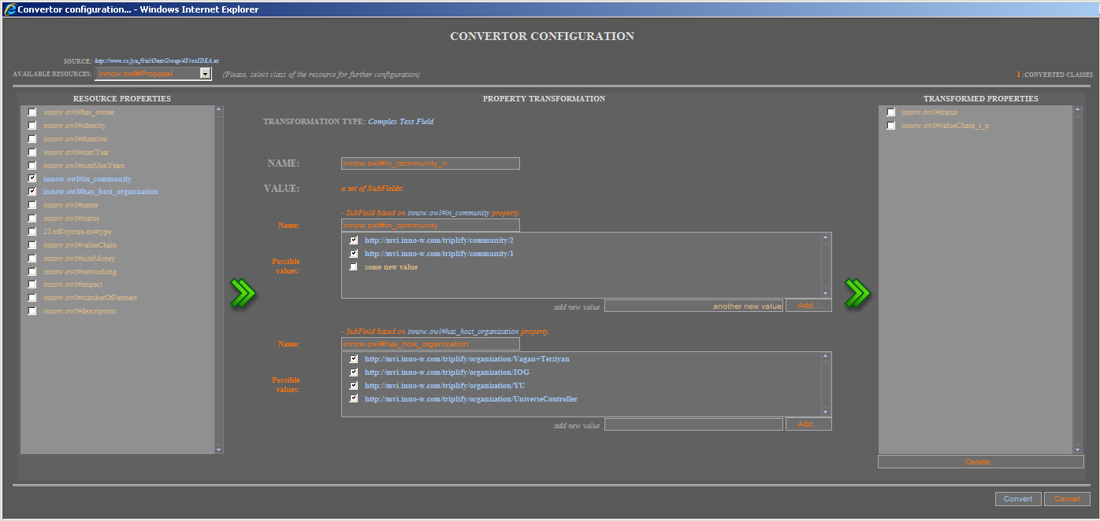
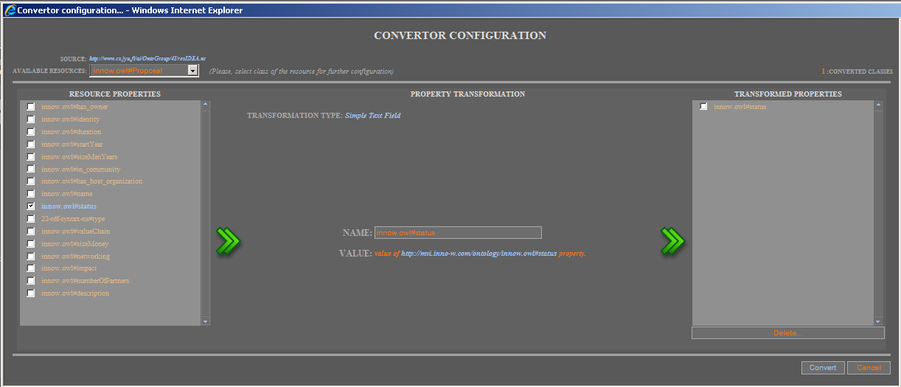
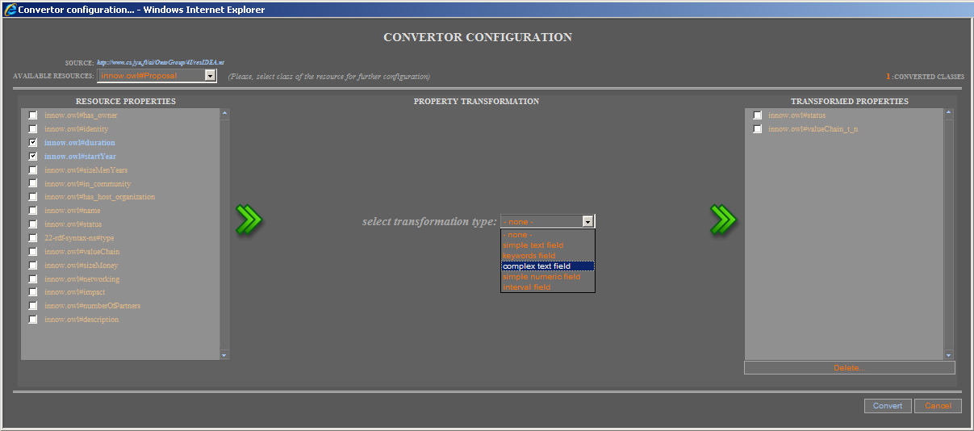


4i Browser: RDF Convertor
Regarding to the 4I (FOR EYE) Browser extension and with a purpose to allow user to import any repository (in RDF or N-triple format) him(she)self, we elaborated general adapter. Adapter is supplied with a graphical interface that helps user to configure adapter with a respect to supported data fields of internal format to be browsed through 4I Browser in the context of close/similar resources.

Slide 32
UBIWARE 3.1 platform
(ready in December 2010)
UBIWARE 3.1 will be based on Cloud Computing architecture and will provide both ontology-driven component- and scenario-based application design and configuration environment for the end-users and also platform-as-a-service to enable continuous run of the applications.
C
C
C
C
C
C
C
SmartComments

Slide 33
UBIWARE: Future
UBIWARE Oy
GERI (new Tekes application)
  GERI: Global Enterprise Resource Integration based on UBIWARE-driven Cloud Architecture
PRIME (FP7)
Academy

Slide 34


GERI: Global Enterprise Resource Integration
with case study on:
(a) Mobile-Ecosystem-as-a-Service;
(b) Enhancement of industrial systems with public/social context and services.
New Tekes Proposal:
According to IOG roadmap towards GUN:
SmartResource-UBIWARE-GERI-GUN
Industrial Ontologies Group

Slide 35
GERI objectives
“Ecosystems Factory”: Ontology-Driven Ecosystem (InterCloudWare) and Web-Based Application Development Platform on top of various heterogeneous and distributed ecosystems and application development platforms provided by different vendors;
APIaaS: API-as-a-Service
ESaaS: EcoSystem-as-a-Service;
INTaaS: Integration-as-a-Service;
Integrating Cloud Computing and SOA architectures;
Utilizing Semantic and Agent Technologies;
Providing solution, which will break the borders between competing technology platforms and provide to the end-users seamless access to a variety of services worldwide.

Slide 36
GERI impact
The concept of GERI, which allows utilization of functionality of several different existing ecosystems as virtually one to connect heterogeneous components.
Essentially extended view to the Enterprise Application Integration towards Global Enterprise Resource Integration which can be seen as:
  Global Enterprise (globally distributed units, partners and operations);
  Global Resource (highly heterogeneous and massively distributed);
  Global Integration (intra- and inter-enterprise integration and networking, where each component resource is autonomous, proactive, cooperative and aware of own and others descriptions of basic functionality, goals, behaviours and roles in different scenarios).
Extending the Service-Oriented Architecture concept by exposing Web-services as resources managed by proactive agents, and therefore able to co-ordinate, participate as components in several business processes, and negotiate their roles and settings in appropriate scenarios.
GERI is a cloud of proactive (agent-driven) Semantic Web -enabled API-as-a Service(s)

Slide 37




GERI as a Cloud of Ontonuts to External Ecosystems
GERI
SmartComments
UBIWARE-driven
API-as-a-Service
Service = Proactive Semantic Web Enabled Service

Slide 38


















S-APL as a language for “Linked Capabilities”
OS
Software Application
User
Interface
Business
Logic
Data
Environment
S-APL

Slide 39














Linked Capabilities ⇒
Linked Data & Linked Business Logic & Linked User Interfaces & Linked APIs & Linked Environments
OS
OS
S-APL

Slide 40


























Enhancement of Industrial Systems with Public/Social Context and Services
Industrial
Systems
Public/social
content and services
GERI
SmartComments
UBIWARE-driven

Slide 41
GERI vs. EAI
Enterprise Application Integration (EAI) is based on Linked Data;
Global Enterprise Resource Integration (GERI) is based on Linked Capabilities

Slide 42
Use cases for GERI
Mobile Ecosystem-as-a-Service
Social Enhancement of Industrial Systems
Connecting via GERI the following emerging platforms/ecosystems/environments:
  MeeGo (Intel + Nokia);
  Android (Google);
  Techila GRID (Techila)
  Smarter Planet (IBM);
  OBIEE Plus (Oracle);
  XXXX (SAP);
  ERP (Digia);
  Social Content Providers (Facebook, Twitter, Google, LinkedIn etc.)
  Other industrial systems (Fingrid, Metso, Inno-W, ABB, Kone, Ruukki etc.)

Slide 43





Companies to be contacted as possible GERI partners
IBM
Intel
Digia
Ixonos
Nokia
Techila
Tieto
UBIWARE group

Slide 44
















Example of GERI Cloud
User
User application
Ecosystem (OS, Platform, Storage, Software, etc.) as a Service
SmartComments
GERI
UBIWARE-driven
!
Infrastructure and Computation as a Service
Techila Grid
Ecosystem (OS, Platform, Storage, Software) as a Service

Slide 45
UBIWARE
Project Related Publications
B
International Book Chapters
6
J
International Journal Papers
2
C
International Conference Papers
23
T
3
PhD and MSc Theses

Slide 46
UBIWARE publications up to 31.08.2010 (1)
B
Terziyan V., Katasonov A., Cardoso J., Hauswirth M., Majumdar A., PRIME: Proactive Inter-Middleware for Global Enterprise Resource Integration, In: E. Õunapuu (ed.), Agile and Self-Organizing Enterprise Information Systems: Developing a Cloud Platform, IGI Global, 2011, 22 pp. (book chapter submitted).
Terziyan V., Kaykova O., Zhovtobryukh D., UbiRoad: Semantic Middleware for Cooperative Traffic Systems and Services, In: International Journal on Advances in Intelligent Systems, Vol. 3, No 34, 2010, 14 pp. (to appear).
Kesäniemi J., Resources-Oriented Infrastructure for MAS Environment, Multi-Agent Systems, IN-TECH Publishing, Vienna, Austria, ISBN 978-953-7619-X-X (to be submitted).
Nagy M., Katasonov A., Khriyenko O. Nikitin S., Szydlowski M., Terziyan V., Challenges of Middleware for the Internet of Things, In: A. Rodić (ed.), Automation and Control – Theory and Practice, IN-TECH Publishing, Vienna, Austria, December 2009, ISBN 978-953-307-039-1, pp. 247-270 (Chapter XIV).
Katasonov A., Terziyan V., Using Semantic Technology to Enable Behavioural Coordination of Heterogeneous Systems, In: Gang Wu (ed.), Semantic Web, IN-TECH Publishing, Vienna, Austria, January 2010, ISBN 978-953-7619-54-1, pp. 135-156 (Chapter VIII).
J
B
B
B

Slide 47
UBIWARE publications up to 31.08.2010 (2)
Terziyan V., Kaykova O., Zhovtobryukh D., UbiRoad: Semantic Middleware for Context-Aware Smart Road Environments, In: G.O. Bellot, H. Sasaki, M. Ehmann and C. Dini (Eds.), Proceedings of the Fifth International Conference on Internet and Web Applications and Services (ICIW-2010), May 9-15, 2010, Barcelona, Spain, IEEE CS Press, pp. 295-302. (best paper award!).
Khriyenko O., Nikitin S., Terziyan V., Context-Policy-Configuration: Paradigm of Intelligent Autonomous System Creation, In: J. Filipe and J. Cordeiro (Eds.), Proceedings of the 12th International Conference on Enterprise Information Systems (ICEIS-2010), Vol. 2, Funchal, Madeira, Portugal, 8-12 June, 2010, pp. 198-205.
Nikitin S., Terziyan V., Nagy M., Mastering Intelligent Clouds: Engineering Intelligent Data Processing Services in the Cloud, In: J. Gilipe, J. Andrade, and J.-L. Ferrier (Eds.), Proceedings of the 7th International Conference on Informatics in Control, Automation and Robotics (ICINCO-2010), Vol.1, Funchal, Madeira, Portugal, 15-18 June, 2010, pp. 174-181.
Nikitin S., Terziyan V., Lappalainen M., SOFIA: Agent Scenario for Forest Industry, In: J. Filipe and J. Cordeiro (Eds.), Proceedings of the 12th International Conference on Enterprise Information Systems (ICEIS-2010), Vol. 1, Funchal, Madeira, Portugal, 8-12 June, 2010, pp. 15-22.
Khriyenko O., Terziyan V., Similarity/Closeness-Based Resource Browser, In: J.J. Zhang (Ed.), Proceedings of the Ninth IASTED International Conference on Visualization, Imaging and Image Processing (VIIP-2009), July 13-15, 2009, Cambridge, UK, ACTA Press, ISBN: 978-0-88986-800-7, pp. 184-191.
C
C
C
C
C

Slide 48
UBIWARE publications up to 31.08.2010 (3)
C
Kesäniemi J., Katasonov A., Terziyan V., An Observation Framework for Multi-Agent Systems, In: Proceedings of the Fifth International Conference on Autonomic and Autonomous Systems (ICAS 2009), April 21-25, 2009, Valencia, Spain, IEEE CS Press, pp. 336-341.
Katasonov A., Terziyan V., Semantic Approach to Dynamic Coordination in Autonomous Systems, In: Proceedings of the Fifth International Conference on Autonomic and Autonomous Systems (ICAS 2009), April 21-25, 2009, Valencia, Spain, IEEE CS Press, pp. 321-329. (best paper award!) .
Terziyan V., Zhovtobryukh D., Katasonov A., Proactive Future Internet: Smart Semantic Middleware for Overlay Architecture, In: Proceedings of the Fifth International Conference on Networking and Services (ICNS-2009), April 21-25, 2009, Valencia, Spain, IEEE CS Press pp. 149-154.
Nikitin S., Katasonov A., Terziyan V., Ontonuts: Reusable Semantic Components for Multi-Agent Systems, In: Proceedings of the Fifth International Conference on Autonomic and Autonomous Systems (ICAS 2009), April 21-25, 2009, Valencia, Spain, IEEE CS Press, pp. 200-207.
Khriyenko O., Adaptive Semantic Web based Environment for Web Resources, In: Jyvaskyla Studies in Computing, PhD Thesis, Volume 97, Jyvaskyla University Printing House, 192 pp., December 13, 2008.
Bleier A., A Framework for Market-Based Coordination in Multi-Agent Systems, MSc Thesis, University of Osnabrück, September 30, 2008.
C
C
C
T
T

Slide 49
UBIWARE publications up to 31.08.2010 (4)
Terziyan V., Semantic Web Services for Smart Devices Based on Mobile Agents, In: D. Taniar (Ed.), Mobile Computing: Concepts, Methodologies, Tools, and Applications (6 volumes), IGI Global, November 2008, ISBN: 978-1-60566-054-7, Vol. II, Chapter 2.22, pp. 630-641.
Terziyan V. and Katasonov A. (2008) Global Understanding Environment: Applying Semantic and Agent Technologies to Industrial Automation, In: Lytras, M. and Ordonez De Pablos, P. (eds) Emerging Topics and Technologies in Information Systems, IGI Global , 2009, ISBN: 978-1-60566-222-0, pp. 55-87 (Chapter III).
Katasonov A. and Terziyan V. (2008) Semantic Agent Programming Language (S-APL): A Middleware Platform for the Semantic Web, In: Proc. 2nd IEEE Conference on Semantic Computing, August 4-7, 2008, Santa Clara, CA, USA, pp.504-511.
Khriyenko O., Context-sensitive Visual Resource Browser, In: Proceedings of the IADIS International Conference on Computer Graphics and Visualization (CGV-2008), Amsterdam, The Netherlands, 24-26 July 2008.
Katasonov A., Kaykova O., Khriyenko O., Nikitin S., Terziyan V., Smart Semantic Middleware for the Internet of Things, In: Proceedings of the 5-th International Conference on Informatics in Control, Automation and Robotics, 11-15 May, 2008, Funchal, Madeira, Portugal, ISBN: 978-989-8111-30-2, Volume ICSO, pp. 169-178.
Terziyan V., SmartResource - Proactive Self-Maintained Resources in Semantic Web: Lessons learned, In: International Journal of Smart Home, Special Issue on Future Generation Smart Space, Vol.2, No. 2, April 2008, SERSC Publisher, ISSN: 1975-4094, pp. 33-57.
Katasonov A. and Terziyan V. (2007) SmartResource Platform and Semantic Agent Programming Language (S-APL), In: Proceedings of the 5th Conference on Multi-Agent Technologies (MATES’07), September 24-26, 2007, Leipzig, Germany, LNAI 4687, pp.25-36.
B
B
C
C
C
J
C

Slide 50
UBIWARE publications up to 31.08.2010 (5)
Terziyan V., Predictive and Contextual Feature Separation for Bayesian Metanetworks, In: B. Apolloni et al. (Eds.), Proceedings of KES-2007 / WIRN-2007, Vietri sul Mare, Italy, September 12-14, Vol. III, Springer, LNAI 4694, 2007, pp. 634–644.
Khriyenko O., Context-sensitive Multidimensional Resource Visualization, In: Proceedings of the 7th IASTED International Conference on Visualization, Imaging, and Image Processing (VIIP 2007), Palma de Mallorca, Spain, 29-31 August 2007.
Khriyenko O., 4I (FOR EYE) Multimedia: Intelligent semantically enhanced and context-aware multimedia browsing, In: Proceedings of the International Conference on Signal Processing and Multimedia Applications (SIGMAP-2007), Barcelona, Spain, 28-31 July 2007.
Khriyenko O., 4I (FOR EYE) Technology: Intelligent Interface for Integrated Information, In: Proceedings of the 9th International Conference on Enterprise Information Systems (ICEIS-2007), Funchal, Madeira – Portugal, 12-16 June 2007.
Salmenjoki K., Tsaruk Y., Terziyan V., Viitala M., Agent-Based Approach for Electricity Distribution Systems, In: Proceedings of the 9-th International Conference on Enterprise Information Systems, 12-16, June 2007, Funchal, Madeira, Portugal, ISBN: 978-972-8865-89-4, pp. 382-389.
Nikitin S., Terziyan V., Pyotsia J., Data Integration Solution for Paper Industry - A Semantic Storing, Browsing and Annotation Mechanism for Online Fault Data, In: Proceedings of the 4th International Conference on Informatics in Control, Automation and Robotics (ICINCO), May 9-12, 2007, Angers, France, INSTICC Press, ISBN: 978-972-8865-87-0, pp. 191-194.
C
C
C
C
C
C

Slide 51
UBIWARE publications up to 31.08.2010 (6)
C
Naumenko, A., Srirama, S., Secure Communication and Access Control for Mobile Web Service Provisioning, In: Proceedings of International Conference on Security of Information and Networks (SIN2007), 8-10th May, 2007.
Naumenko A., Semantics-Based Access Control in Business Networks, In: Jyvaskyla Studies in Computing, PhD Thesis, Volume 78, Jyvaskyla University Printing House, 215 pp., June 28, 2007.
Naumenko A., Katasonov A., Terziyan V., A Security Framework for Smart Ubiquitous Industrial Resources, In: R. Gonzalves, J.P. Muller, K. Mertins and M. Zelm (Eds.), In: Enterprise Interoperability II: New challenges and Approaches, Proceedings of the 3rd International Conference on Interoperability for Enterprise Software and Applications (IESA-07), March 28-30, 2007, Madeira Island, Portugal, Springer, pp. 183-194.
Naumenko A., SEMANTICS-BASED ACCESS CONTROL - Ontologies and Feasibility Study of Policy Enforcement Function, In: Proceedings of the 3rd International Conference on Web Information Systems and Technologies (WEBIST-07), Barcelona, Spain - March 3-6, 2007, Volume Internet Technologies, INSTICC Press, pp. 150-155.
Khriyenko O., Coordination of the Distributed Proactive Smart Resource, In: Proceedings of the IASTED International Conference on Parallel and Distributed Computing and Networks (PDCN 2007) as part of the 25th IASTED International Multi-Conference on APPLIED INFORMATICS, Innsbruck, Austria, 13-15 February, 2007, 7 pp.
T
C
C
C

Slide 52
Next Meeting
Mid December 2010 – Final Checkpoint: D3.4: “UBIWARE 3.1. (based on Cloud Computing Architecture)”

Slide 53
Obtain More Information about UBIWARE from:
Head of UBIWARE Industrial Consortium (Steering Committee Head) Dr. Jouni Pyötsiä, Metso Automation Oy.
Jouni.Pyotsia@metso.com , Tel.: 040-548-3544
UBIWARE Contact Person Prof. Timo Tiihonen, Vice-Rector, University of Jyväskylä
tiihonen@cc.jyu.fi , Tel.: 014-260-2741
UBIWARE Project Leader Prof. Vagan Terziyan, Agora Center, University of Jyväskylä
vagan@cc.jyu.fi , Tel.: 014-260-4618

