Slide 1
4th International Conference on Industry 4.0 and Smart Manufacturing – ISM 2022
Upper Austria University of Applied Science – Hagenberg Campus – Linz, Austria
Blended Conference | 2-4 November 2022
The Truth is Out There:
Focusing on Smaller to Guess Bigger in Image Classification
Vagan Terziyan ª, Olena Kaikova ^{b}, Diana Malyk ^{c}, & Vladyslav Branytskyi ^{d}
^{a,b} Faculty of Information Technology, University of Jyväskylä, Jyväskylä, Finland
^{c,d} Department of Artificial Intelligence, Kharkiv National University of Radio Electronics, Kharkiv, Ukraine
https://www.jyu.fi/en/
https://nure.ua/en/

Slide 2
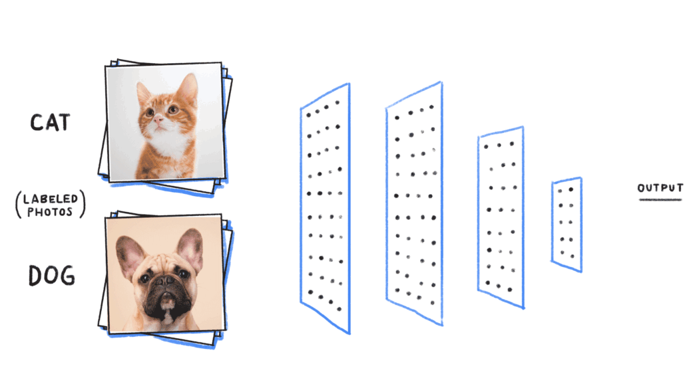
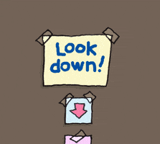
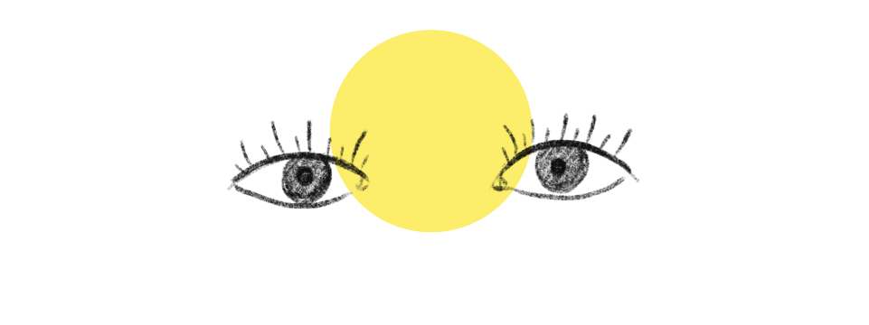
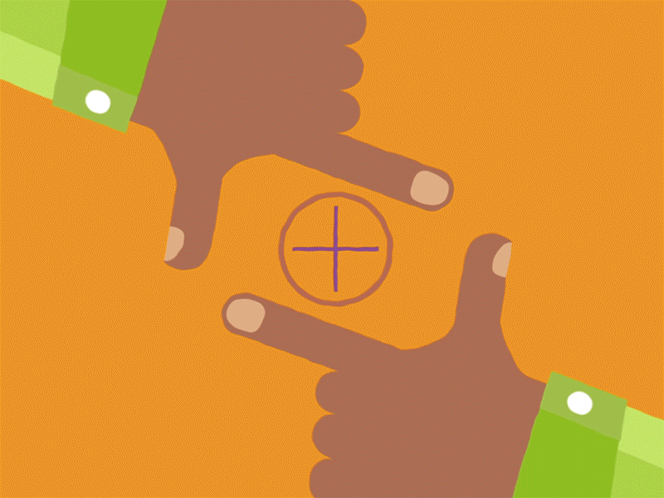
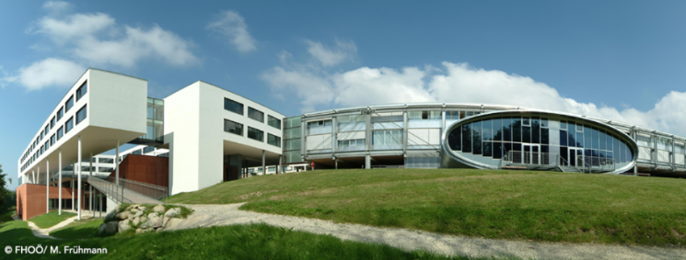
“The Truth is Out There: Focusing on Smaller to Guess Bigger in Image Classification”
Paper # 7939
Vagan Terziyan, Olena Kaikova, Diana Malyk, & Vladyslav Branytskyi
University of Applied Science, Linz, Austria
4 November, 2022, 17:40 - 18:00
ISM 2022
International Conference on Industry 4.0
and Smart Manufacturing
Section/Room:
S 2.4 - IMAGE / Room: HS₃

Slide 3
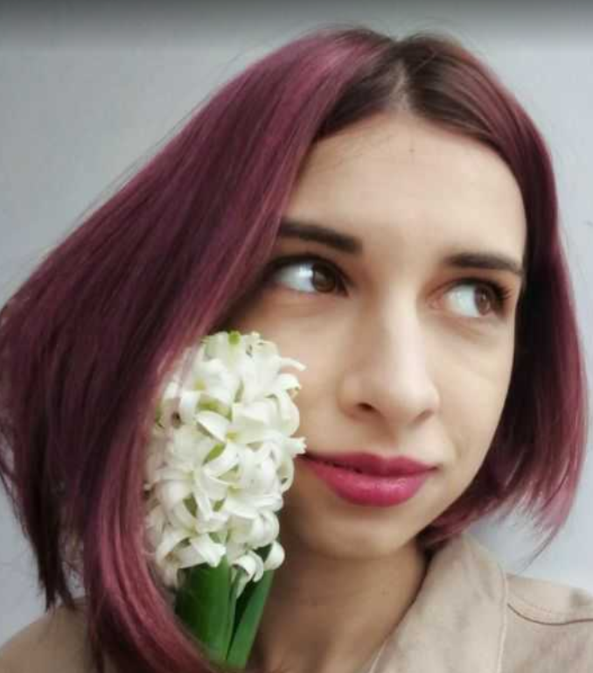
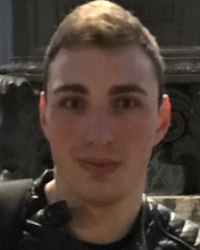
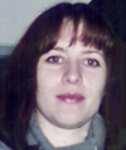
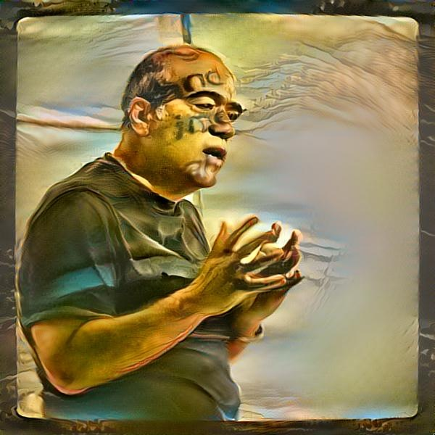
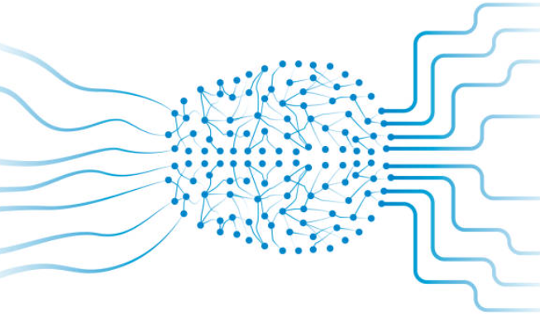
Authors
Diana Malyk
Vladyslav Branytskyi
“The Truth is Out There:
Focusing on Smaller to Guess Bigger in Image Classification”
Olena Kaikova
Vagan Terziyan
vagan.terziyan@jyu.fi
https://nure.ua/en/
https://www.jyu.fi/en/

Slide 4
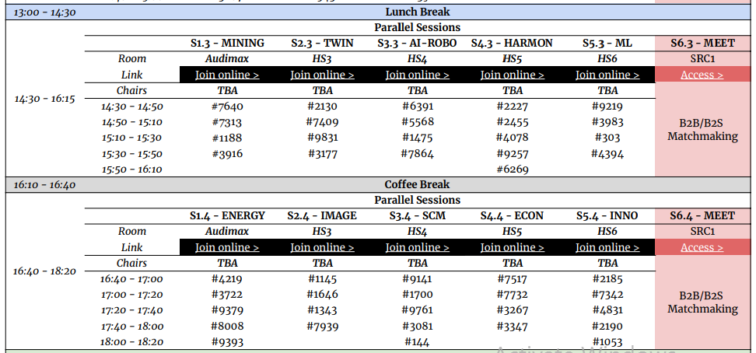
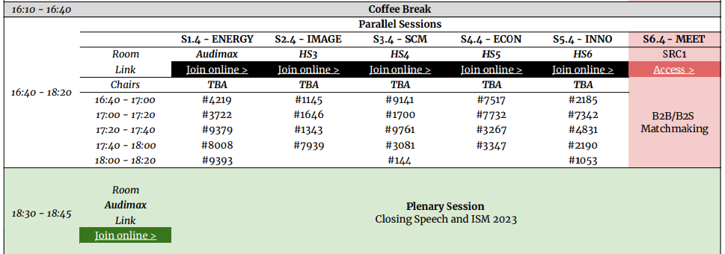
https://www.msc-les.org/conf/ism2022/ISM2022_ProgramAtAGlance.pdf
https://www.msc-les.org/ism2022/program-at-a-glance/
https://teams.microsoft.com/l/meetup-join/19%3a9b435349a7404e4998b14385638430bc%40thread.tacv2/1665006794870?context=%7b%22Tid%22%3a%227519d0cd-2106-47d9-adcb-320023abff57%22%2c%22Oid%22%3a%229f6efedb-1e10-4496-942f-92bdb2ba849d%22%7d
“The Truth is Out There: Focusing on Smaller to Guess Bigger in Image Classification”
ISM-2022_7939_Uncertainty
https://teams.microsoft.com/dl/launcher/launcher.html?url=%2F_%23%2Fl%2Fmeetup-join%2F19%3A9b435349a7404e4998b14385638430bc%40thread.tacv2%2F1665006794870%3Fcontext%3D%257b%2522Tid%2522%253a%25227519d0cd-2106-47d9-adcb-320023abff57%2522%252c%2522Oid%2522%253a%25229f6efedb-1e10-4496-942f-92bdb2ba849d%2522%257d%26anon%3Dtrue&type=meetup-join&deeplinkId=99b66ce6-7980-4b35-8a42-8fba6d04abe0&directDl=true&msLaunch=true&enableMobilePage=true&suppressPrompt=true
https://teams.microsoft.com/dl/launcher/launcher.html?url=%2F_%23%2Fl%2Fmeetup-join%2F19%3A9b435349a7404e4998b14385638430bc%40thread.tacv2%2F1665006794870%3Fcontext%3D%257b%2522Tid%2522%253a%25227519d0cd-2106-47d9-adcb-320023abff57%2522%252c%2522Oid%2522%253a%25229f6efedb-1e10-4496-942f-92bdb2ba849d%2522%257d%26anon%3Dtrue&type=meetup-join&deeplinkId=b64dfc14-ce7a-4656-ae03-32ecb70a1860&directDl=true&msLaunch=true&enableMobilePage=true&suppressPrompt=true

Slide 5
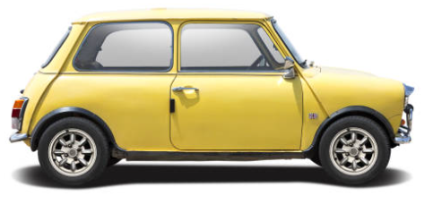
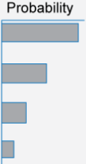
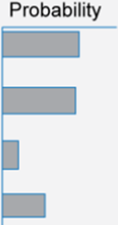
Image classification problem and our study assumption
Quality and quantity of relevant information in the input for classification decision.
Machine Learning Model (Classifier)
Strength of the bias towards correct class label within the output probability distribution
Car

Slide 6
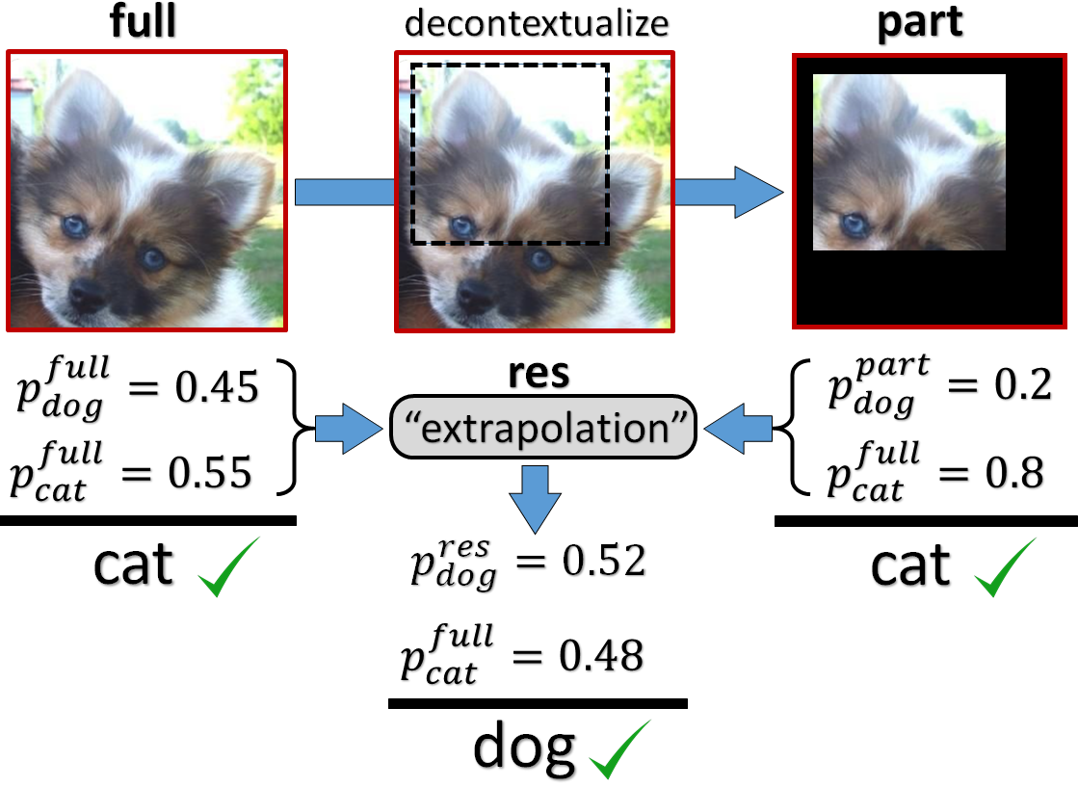
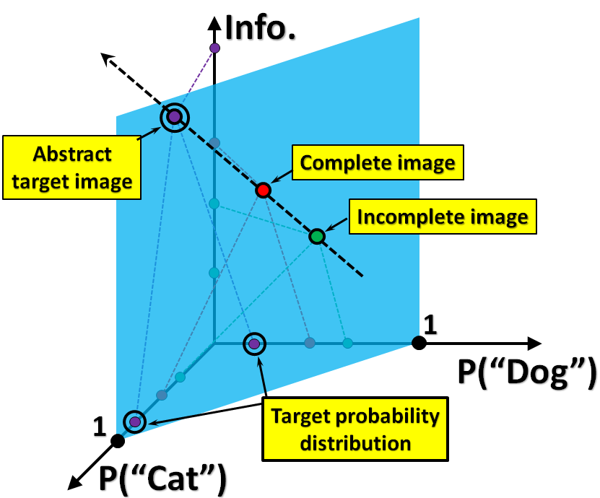
Intuition behind the “decontextualize-and-extrapolate” approach to classification
The input image “full” is classified separately from its chosen and decontextualized “part”. Results of classification for both “full” and “part” images give preference to the “cat” label. However, the study of the “part-to-full” tendencies (extrapolation) gives the grounds to assume that some potential and more informative (unknown, abstract) image “res” of the same object may have another classification label, i.e., “dog”, which makes it reasonable to prefer the “dog” over the “cat” as a classification label also for the original image in spite of the classifier preference.

Slide 7
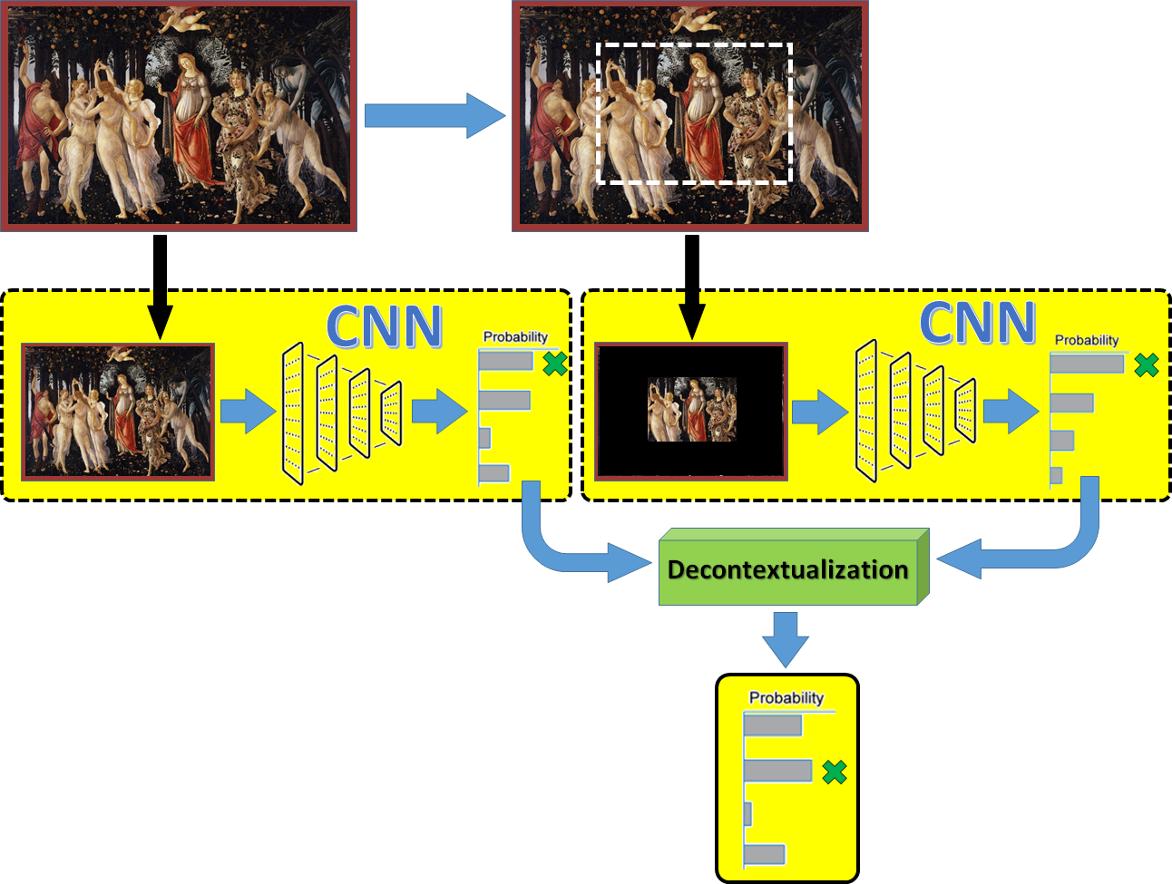
Generic schema of the “decontextualize-and-extrapolate” approach as an attempt to improve (refine) image classification
The entire input image and its chosen part go through the same Convolutional Neural Network (CNN) for classification. Both outcomes are integrated into one following an appropriate computation schema. Such refinement of the classification outcome is expected to provide useful corrections and improve the classification accuracy on the test set.

Slide 8
Naïve computational schema (“pixel-wise” and “just-one-part”)
$$∀i\left[ω_{full},p_{i}^{full},ω_{part},p_{i}^{part}→ω_{res},p_{i}^{res}\right]$$
Assume that we have some Convolutional Neural Network (CNN) classifier already trained to classify images into one of $C$ classes. Assume that we are testing this classifier on a test image “full” taken entirely as an input. Assume the amount of information ($ω_{full}$) within an image, is the number of pixels in it. For the full image we have:
$\left\{p_{1}^{full},p_{2}^{full},…,p_{C}^{full}\right\}$, where $∀p_{i}^{full}\left(p_{i}^{full}≥0\right);p_{1}^{full}+p_{2}^{full}+…+p_{C}^{full}=1$.
If we apply the CNN classifier to the chosen “part” as a separate image, we will get another probability distribution as a result:
$\left\{p_{1}^{part},p_{2}^{part},…,p_{C}^{part}\right\}$, where $∀p_{i}^{part}\left(p_{i}^{part}≥0\right);p_{1}^{part}+p_{2}^{part}+…+p_{C}^{part}=1$.
We assume that there could be some (yet unknown) abstract image (named “res”) wider than the original “full” and such that:
$ω_{full}=\frac{ω_{part}+ω_{res}}{2}$, which means that $ω_{res}=2∙ω_{full}−ω_{part}$.
Now we want to estimate the following probability distribution:
$\left\{p_{1}^{res},p_{2}^{res},…,p_{C}^{res}\right\}$, where $∀p_{i}^{res}\left(p_{i}^{res}≥0\right);p_{1}^{res}+p_{2}^{res}+…+p_{C}^{res}=1.$
Weighted average schema as a heuristics:
$p_{i}^{full}=\frac{ω_{part}∙p_{i}^{part}+ω_{res}∙{\tilde{p}}_{i}^{res}}{ω_{part}+ω_{res}}$, and, therefore, the preliminary (not normalized) estimate ${\tilde{p}}_{i}^{res}$ for $p_{i}^{res}$:
${\tilde{p}}_{i}^{res}=\frac{2∙ω_{full}∙p_{i}^{full}−ω_{part}∙p_{i}^{part}}{2∙ω_{full}−ω_{part}}$.
We need to normalize the above to guarantee that $∀p_{i}^{res}\left(p_{i}^{res}≥0\right);p_{1}^{res}+p_{2}^{res}+…+p_{C}^{res}=1$ :
(A) The SoftMax option, which will use the SoftMax function:
$p_{i}^{res}=SoftMax\left({\tilde{p}}_{i}^{res}\right)=\frac{e^{{\tilde{p}}_{i}^{res}}}{\sum_{j=1}^{C}{{\tilde{p}}_{j}^{res}}}$;
(B) Shift-and-normalize option:
$p_{i}^{res}=\frac{2∙ω_{full}∙p_{i}^{full}+ω_{part}∙(1−p_{i}^{part})}{2∙ω_{full}+ω_{part}∙(C−1)}$.

Slide 9
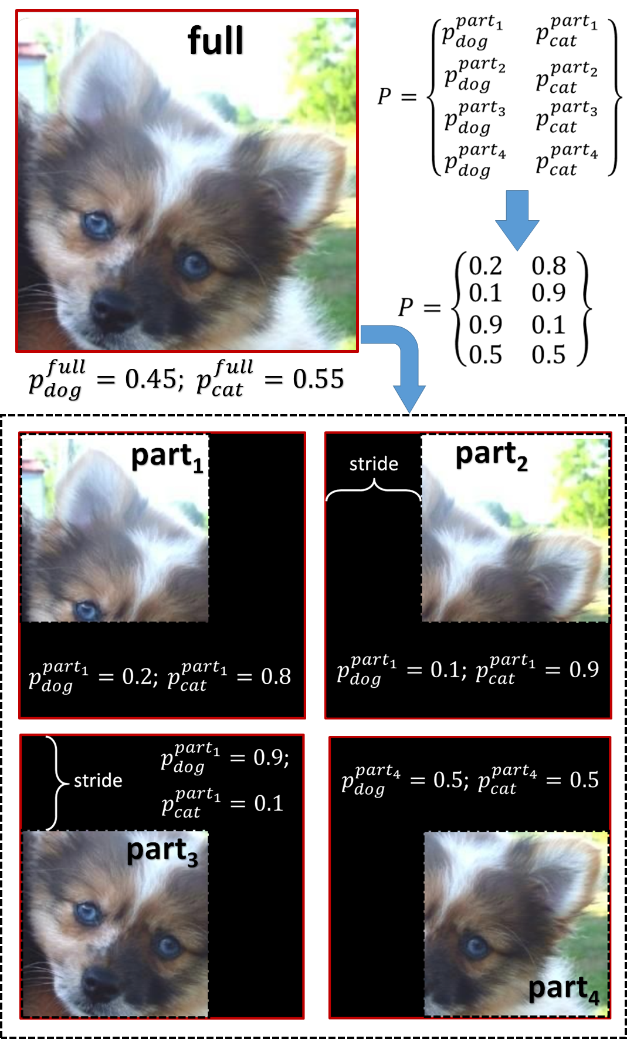
“Sliding focus” computational schema
Example of applying the “sliding focus” schema, which is intended to take into account several different parts (same size) of the original image to get an unbiased evaluation for the “part” component for the “decontextualize-and-extrapolate” refinement approach. In this example, the results of classification (got separately for each of the four parts of the original image) are collected into matrix P, which will be used for further refinement of the CNN classifier outcome obtained separately for the whole image.
$[3×m×n]$ – original image size, i.e., $ω_{full}=3∙m∙n$;
$[3×\tilde{m}×\tilde{n}]$ – each image part size, i.e., $ω_{part}=3∙\tilde{m}∙\tilde{n}$;
$\tilde{m}<m,\tilde{n}<n$; $g=\left\lfloor \frac{\left(m−\tilde{m}\right)∙\left(n−\tilde{n}\right)}{{stride}^{2}}\right\rfloor$.
For each $i$-th “part” within the frame during sliding process, we get classification result (probability distribution) and collect it into the following matrix:
$P=\left\{\begin{matrix}p_{1}^{{part}_{1}}, & p_{2}^{{part}_{1}},…, & p_{C}^{{part}_{1}} \\ \begin{aligned}p_{1}^{{part}_{2}} \\ …\end{aligned} & \begin{aligned}p_{2}^{{part}_{2}},…, \\ …\end{aligned} & \begin{aligned}p_{C}^{{part}_{2}} \\ …\end{aligned} \\ p_{1}^{{part}_{g}} & p_{2}^{{part}_{g}},…, & p_{C}^{{part}_{g}}\end{matrix}\right\}$; $p_{k}^{part}=\frac{1}{g}∙\sum_{i=1}^{g}{p_{k}^{{part}_{i}}}$.
Compute $p_{i}^{res}$ as defined before: $∀i\left[ω_{full},p_{i}^{full},ω_{part},p_{i}^{part}→ω_{res},p_{i}^{res}\right]$.

Slide 10
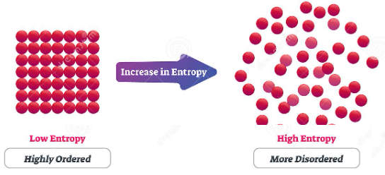
“Entropy-aware” computational schemas
Information entropy: $H\left(X\right)=−\sum_{i=1}^{v}{\left[p(x_{i})∙\log_{2}{p(x_{i})}\right]}$,
where the sum is taken over all variable's possible values.
Let us adapt this definition to the case of image entropy. We have an “alphabet” of 256 intensity levels for the pixels. To compute the entropy for the color image, we can average the entropies of each RGB channel computed separately. Therefore, the entropy of a color image $X$ will be as follows:
Once we know the way to compute an image entropy and, therefore, to have better estimates for $ω_{full}$ and $ω_{part}$, we can adapt the previous computational schemas (“just-one-part” and “sliding focus”) accordingly.
Entropy-aware “just-one-part” computational schema:
Discovering “part” with the highest density of information and with the fixed proportion of entropy with the entire image.
Entropy-aware “sliding focus” computational schema:
$ω_{full}=H\left(full\right)=H(X)$; $p_{k}^{part}=\frac{\sum_{i=1}^{g}{ω_{{part}_{i}}∙p_{k}^{{part}_{i}}}}{\sum_{i=1}^{g}{p_{k}^{{part}_{i}}}}$, where $ω_{{part}_{i}}=H\left({part}_{i}\right)$; $ω_{part}=\frac{1}{g}∙\sum_{i=1}^{g}{ω_{{part}_{i}}}$.
$H\left(X\right)=\frac{1}{3}∙\sum_{r=1}^{3}{\left\{−\sum_{s=0}^{255}{\left[p_{s}(X_{r})∙\log_{2}{p_{s}(X_{r})}\right]}\right\}}$, $p_{s}\left(X_{r}\right)=\frac{Number of occurences of the intensity level s within the r^{th} RGB channel of image X}{Number of pixels \left(size\right) within the the r^{th} RGB channel of image X}$.

Slide 11
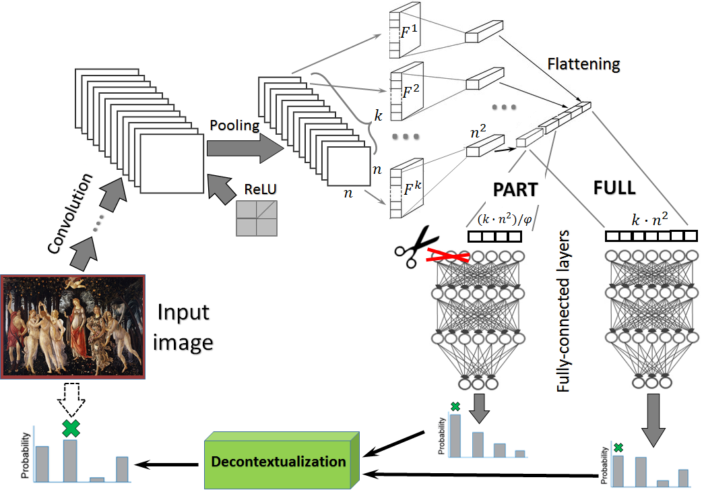
From pixels to features (“Semantic Refinement” schema)
A generic schema of “semantic refinement” (at the level of features) of image classification within a CNN architecture. The full discovered feature content (after convolutional layers) goes as usual through the fully-connected layers of the already trained CNN and gives one probability distribution as a result. The pruned feature content (after cutting away the features outside the chosen part(s)) goes through the same layers and gives another probability distribution as a result. Finally, both computed distributions go through the “Decontextualization” component of the analytics, which will compute the resulting and refined probability distribution as the final outcome of the input image classification.

Slide 12
Preliminary experiments:
For fast check of the suggested analytics, we did image classification experiments with the public and popular image dataset Kaggle (“Cats and Dogs” Dataset: www.microsoft.com/en-us/download/details.aspx?id=54765), which contains 50K colored images of various cats and dogs. For fair comparison, we have not used any pre-trained models. We have trained the baseline CNN model and we have tested it without and with different refinement enhancements to compare various approaches. The Table contains examples of our experiments. We may see that refinement improves classification in all the refinement cases, even for such a relatively simple dataset for ML. As expected, unbiased refinement performed a bit better than a biased one and the semantic (feature) refinement shows the best test accuracy. However, processing time, especially for entropy-aware computing, is essentially higher than for the baseline model (subject of optimization).

Slide 13
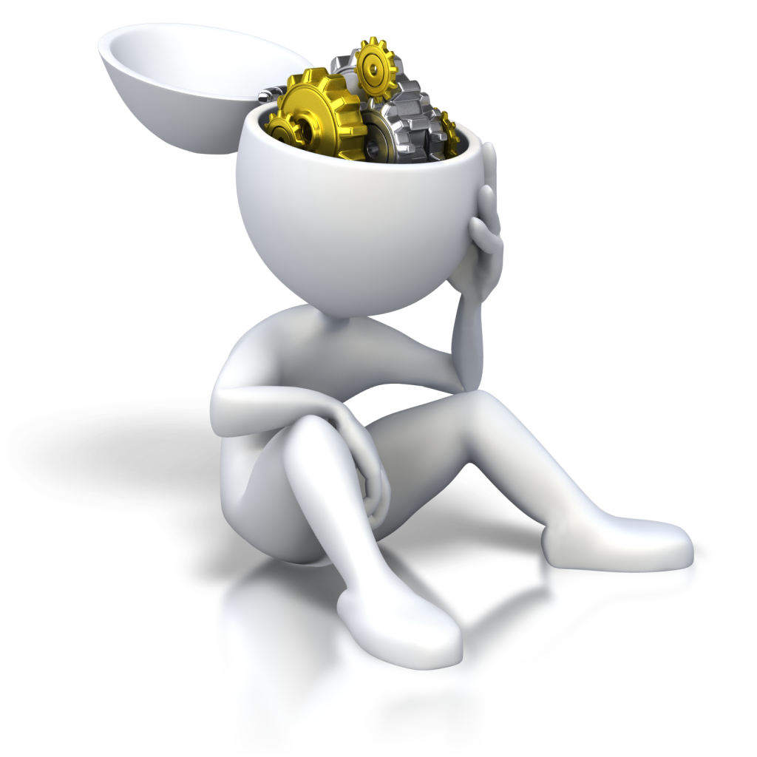
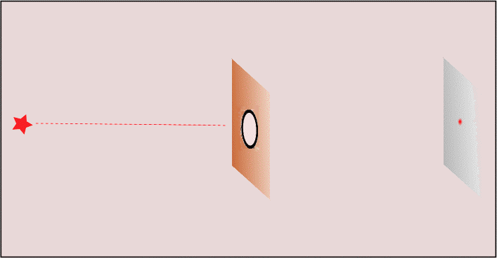
Conclusions
The intuition behind our approach was as follows: if you assume that Outcome (entire image) = FULL; Outcome (part of the image) = PART, then the refined classification result Outcome (Abstract image, wider than the original one) = RES, will not be a value between FULL and PART, but it can be obtained as extrapolation of these two. This means that our method assumes that any object to be classified does not contain all the information for perfect classification and, therefore:
there is no way to get more information from outside the object; we take some part(s) of the available information (“decontextualize” them from the rest of the image) to classify the same object even having less information available for that;
we discover the trend of the classification result change from less to more information;
finally, we use the trend to guess (“extrapolate”) what would be the classification result if we have even more information that the original object has. Suggested refinement analytics provides different options for making such an extrapolation at different layers of information about the object to be classified: from the “surface” layer (e.g., pixels of an image) to the “semantic” layer (e.g., discovered feature maps from an image);
Our preliminary experiment on a public dataset provides certain optimism towards the validity of the suggested refinement techniques. However, many more experiments are still foreseen to discover the full hidden potential or the suggested approach.

Slide 14
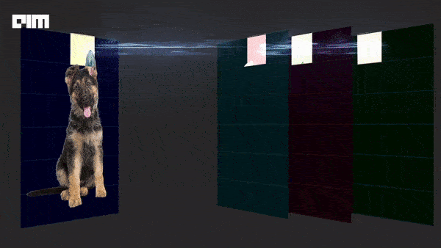
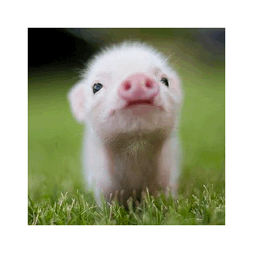
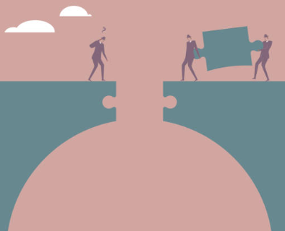
Future work …
Convolutional Transformers /
Representation Learning /
Self-Attention /
Contrastive Predictive Coding …
… to find and study connection for mutual enhancement …
“Decontextualize-and-Extrapolate”

Slide 15
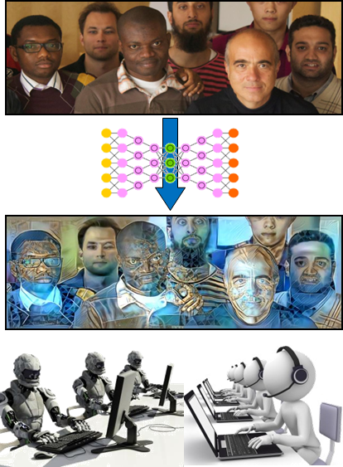
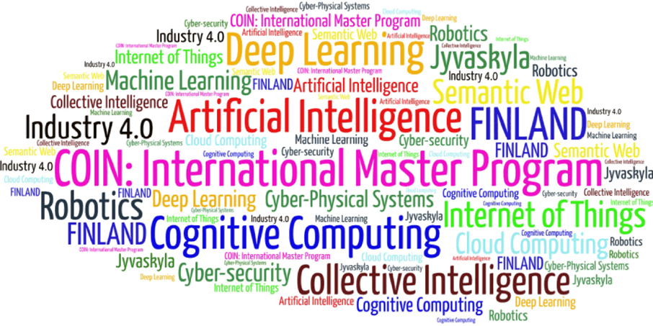
Come to study at our International Master Program
COIN: Cognitive Computing and Collective Intelligence …
… the first university program for collective intelligence, where humans learn together with their digital clones and autonomous digital assistants …
http://www.jyu.fi/ai
COIN

Slide 16
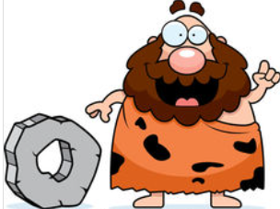
Link to the presentation: https://ai.it.jyu.fi/ISM-2022-Uncertainty.pptx
Contact: vagan.terziyan@jyu.fi

Slide 17
4th International Conference on Industry 4.0 and Smart Manufacturing – ISM 2022
Upper Austria University of Applied Science – Hagenberg Campus – Linz, Austria
Blended Conference | 2-4 November 2022
Thank you!
“The Truth is Out There:
Focusing on Smaller to Guess Bigger in Image Classification”
Vagan Terziyan ª, Olena Kaikova ^{b}, Diana Malyk ^{c}, Vladyslav Branytskyi ^{d}
^{a,b} Faculty of Information Technology, University of Jyväskylä, Jyväskylä, Finland
^{c,d} Department of Artificial Intelligence, Kharkiv National University of Radio Electronics, Kharkiv, Ukraine
Contacts
ª vagan.terziyan@jyu.fi , ^{b} olena.kaikova@jyu.fi, ^{c} diana.malyk@nure.ua, ^{d} vladyslav.branytskyi@nure.ua
Link to complete slide-set:
https://ai.it.jyu.fi/ISM-2022-Uncertainty.pptx
https://www.jyu.fi/en/
https://nure.ua/en/

