Slide 1
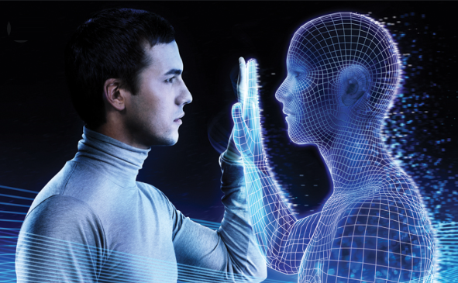
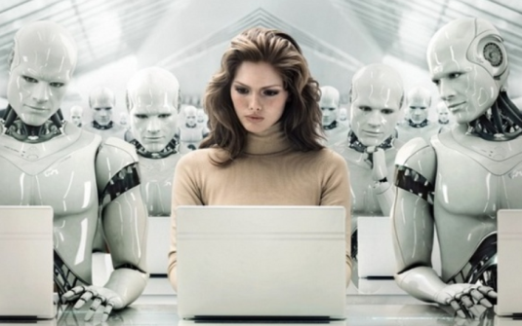
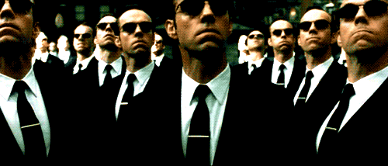
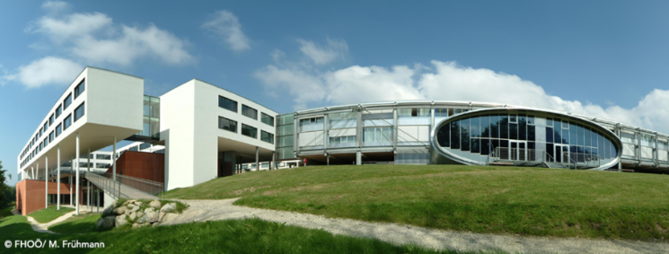
“TOWARDS DIGITAL COGNITIVE CLONES FOR THE DECISION-MAKERS: ADVERSARIAL TRAINING EXPERIMENTS”
Paper # 27
Vagan Terziyan,
Mariia Golovianko, Svitlana Gryshko & Tuure Tuunanen
University of Applied Science, Linz, Austria
25 November, 2020, 9:00 - 10:30
ISM 2020
International Conference on Industry 4.0
and Smart Manufacturing
Room 3: Digital Twin-Driven Smart Manufacturing

Slide 2
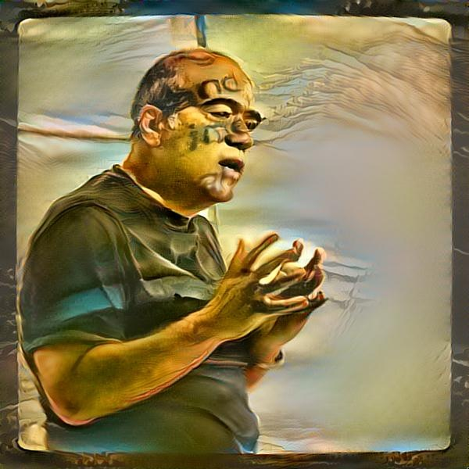
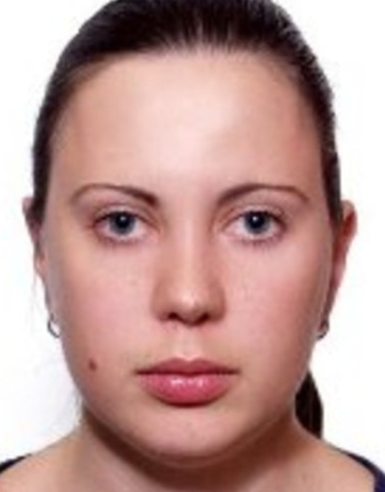
Authors
Vagan Terziyan
vagan.terziyan@jyu.fi
“TOWARDS DIGITAL COGNITIVE CLONES FOR THE DECISION-MAKERS: ADVERSARIAL TRAINING EXPERIMENTS”
https://www.jyu.fi/en/
Mariia Golovianko
Svitlana Gryshko
Tuure Tuunanen
https://nure.ua/en/

Slide 3
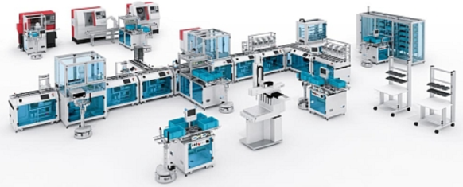
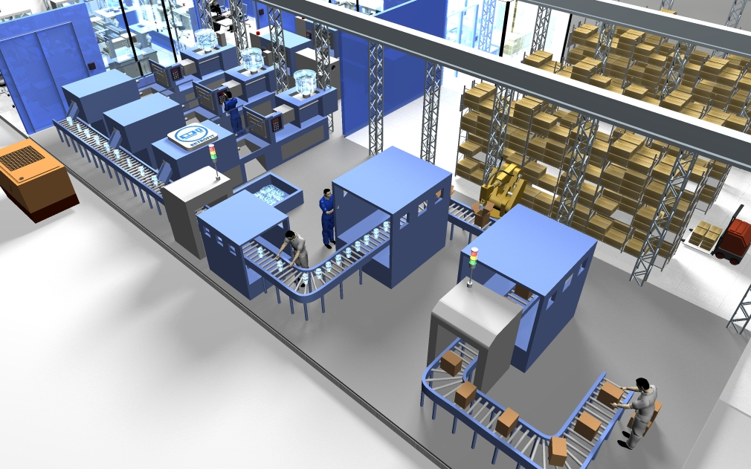
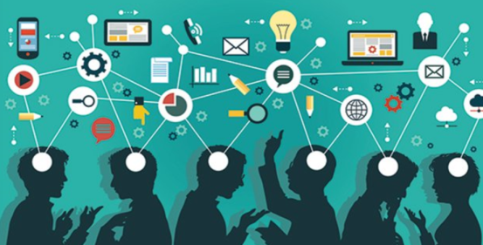
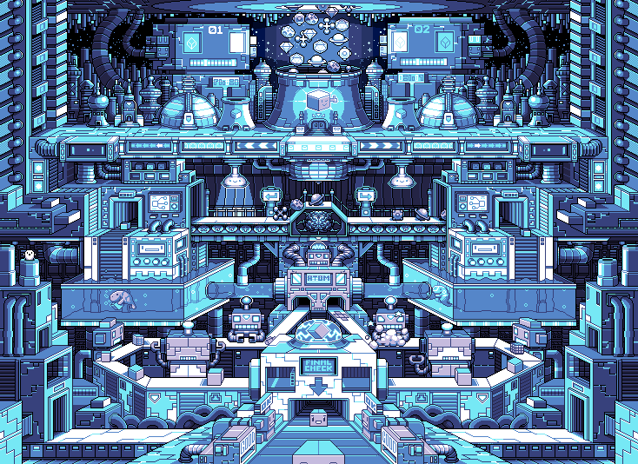
Cyber-Physical Systems
Collective Intelligence
Industry 4.0 is about Cyber-Physical Systems populated and controlled by the Collective Intelligence for the smart and autonomous manufacturing purposes
Industry 4.0
Flexible infrastructure
Humans and artificial decision makers …
… where the latter ones could be artificial autonomous digital cognitive clones of humans
What we think about the Industry 4.0 ?
https://bt3gl.github.io/index.html

Slide 4
Digital Clones vs. Digital Twins: Potential Use-Case
Workers (managers / operators)
Digital experiments
with customer
experience
Digital
clones
Customers
Digital clones
Product /
Service
Digital
Twin
COLD platform
Industry 4.0

Slide 5
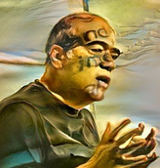
Triangle of important concepts
Human
Agent
Cognitive cloning of humans involves cloning of their cognitive capabilities
Capability

Slide 6
Agents as proxy to external capabilities
… not yet cloning but step ahead …
Enhancing a human or a system (process) with some external capabilities-as-such

Slide 7
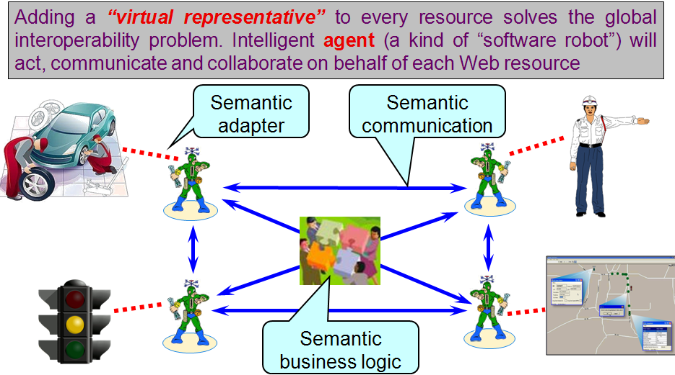
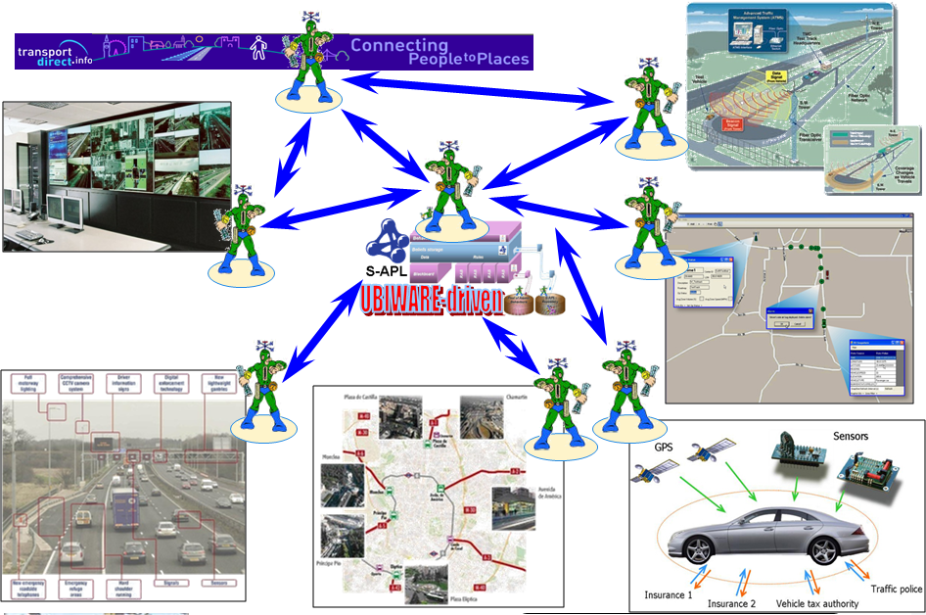
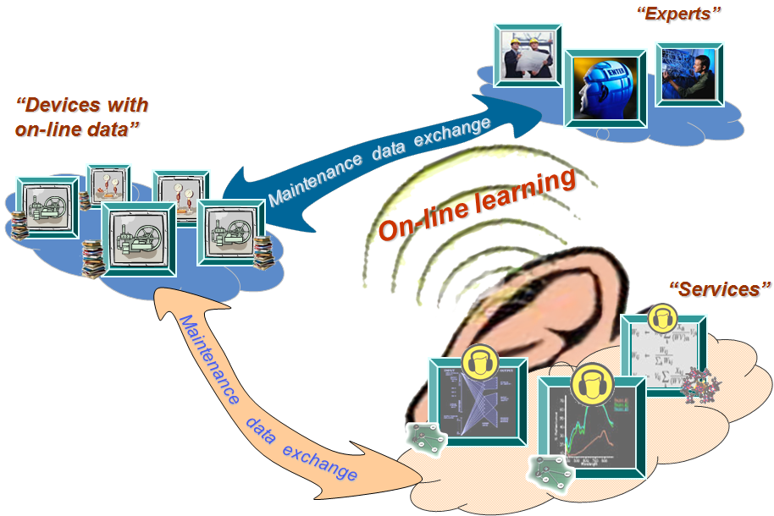
I.
Read about agent-as-a-proxy in our SmartResource and UBIWARE projects
(Tekes, 2004-2010)
Autonomous agent
(software robot) as a proxy
Process
Component
(participant)
Process

Slide 8
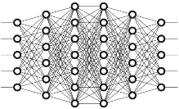
Agents as smart, autonomous,
personalized, trainable capabilities
… not yet cloning but closer …
Enhancing a human or a system (process) with personalized, trainable and evolving autonomous capabilities

Slide 9
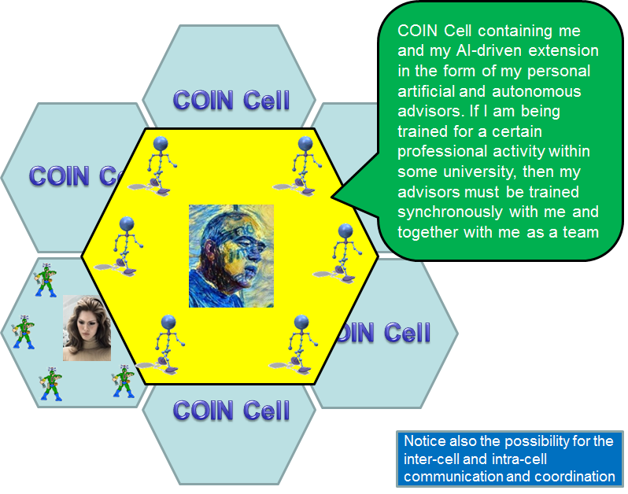
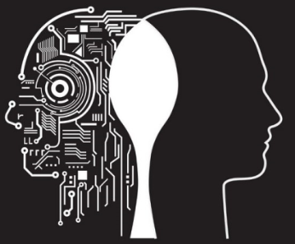
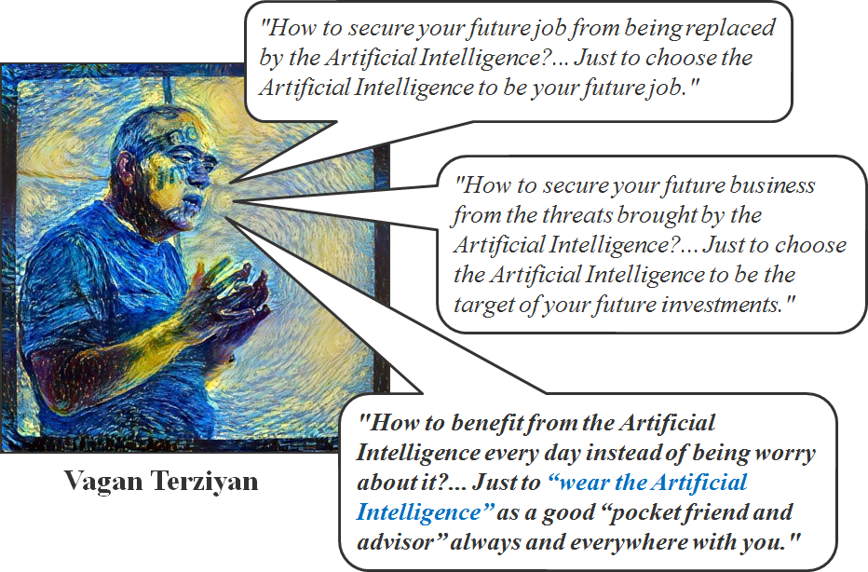
II.
Autonomous agent (software robot) as a
“pocket advisor”
or digital enhancement of human intelligence
Cellular Collective Intelligence
(“me” and “my” “pocket advisors”)
Digitally Enhanced
human
Process
Personal advisors must be trained synchronously with the human host.
Gavriushenko, M., Kaikova, O., & Terziyan, V. (2020). Bridging Human and Machine Learning for the Needs of Collective Intelligence Development. Procedia Manufacturing, 42, 302-306. Elsevier. doi:10.1016/j.promfg.2020.02.092

Slide 10
Agents as autonomous “clones” of human capabilities
Enhancing a human (or a system!) by making him or her ubiquitous and omniscient due to multiple autonomous clones capable to be present, self-develop and decide on human’s behalf synchronously within many processes

Slide 11
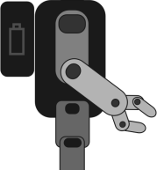
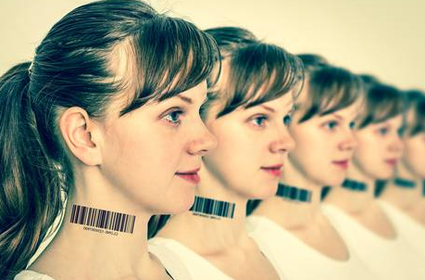
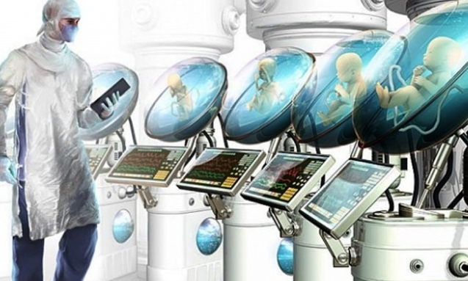
III.
Autonomous agent (software robot) as a
“clone”
or digital copy (twin) of human intelligence
Patented Intelligence
(Pi-Mind)
Digital clone
Of a human
Process
human
Terziyan, V., Gryshko, S., & Golovianko, M. (2018). Patented Intelligence: Cloning Human Decision Models for Industry 4.0. Journal of Manufacturing Systems, 48 (Part C), 204-217. Elsevier. doi:10.1016/j.jmsy.2018.04.019

Slide 12
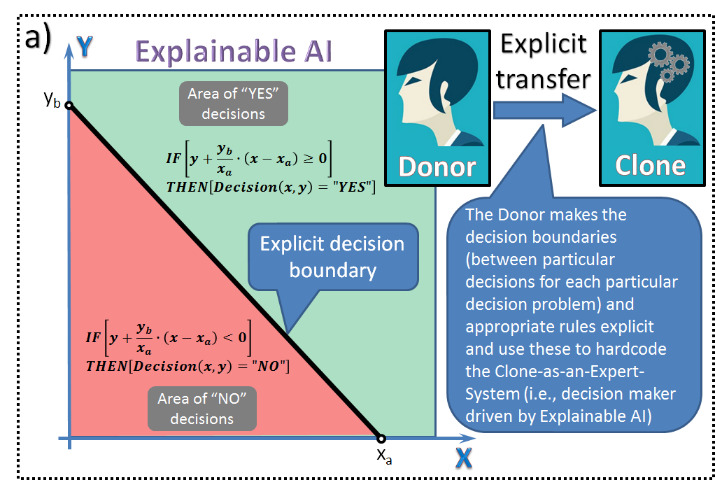
XAI Cloning: Explicit Knowledge Transfer

Slide 13
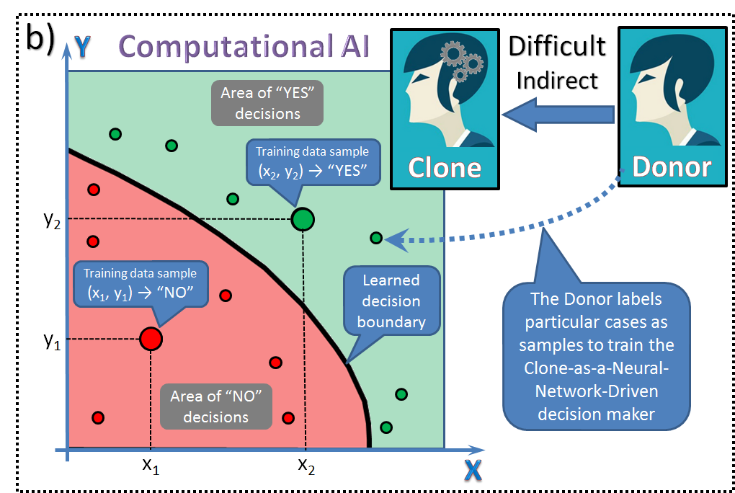
Cloning as Supervised Machine Learning

Slide 14
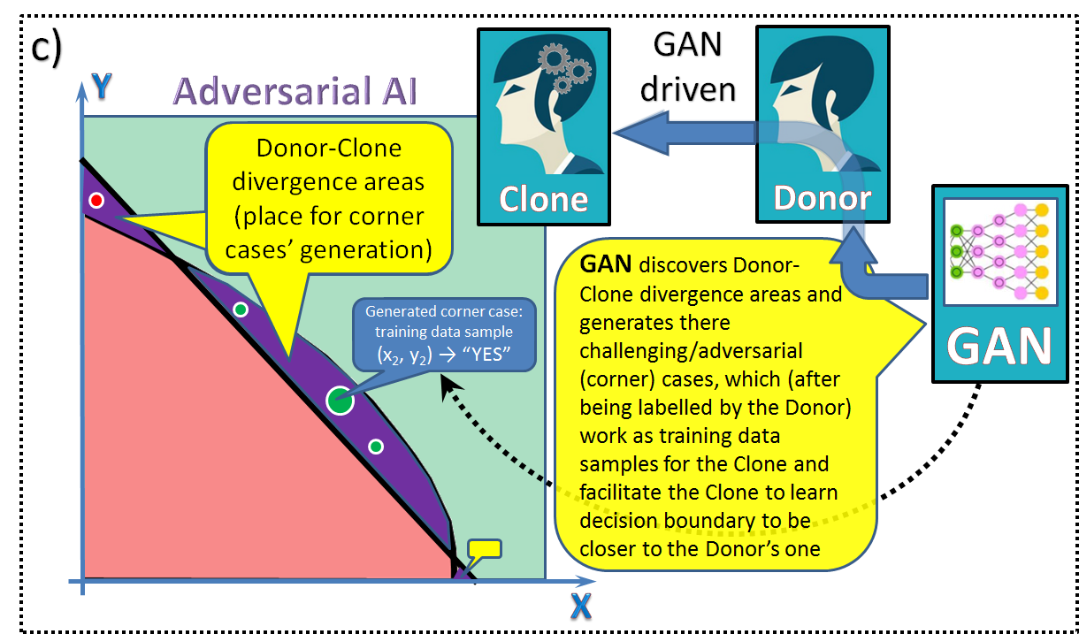
Cloning as Adversarial Learning
(with Generative Adversarial Networks)

Slide 15
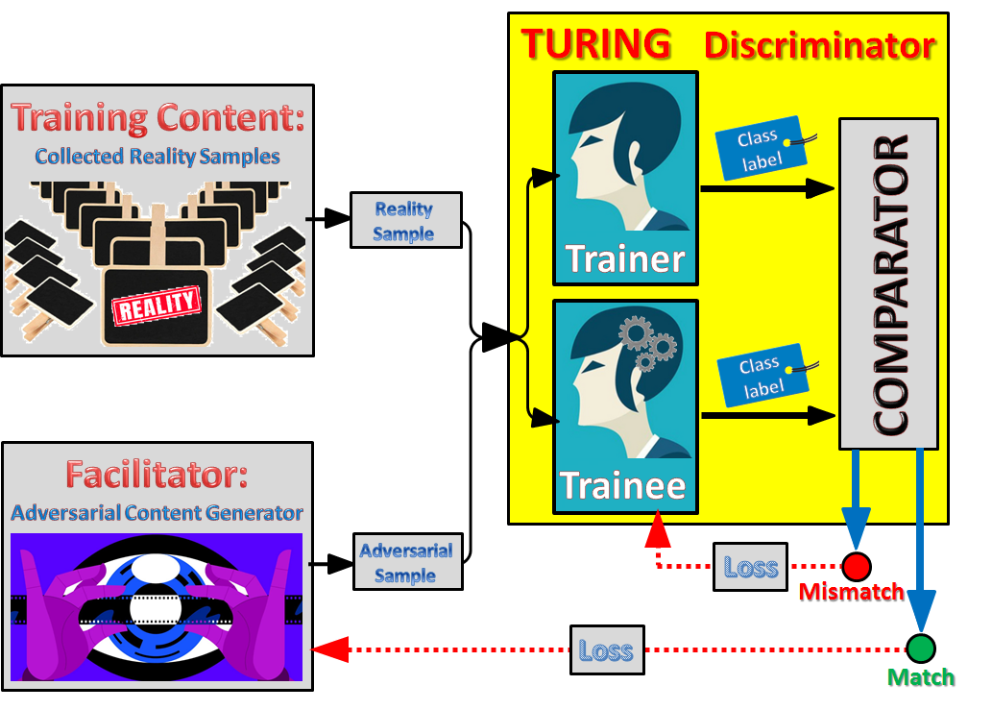
Special GAN architecture for cognitive cloning
(with the “Turing” Discriminator)

Slide 16
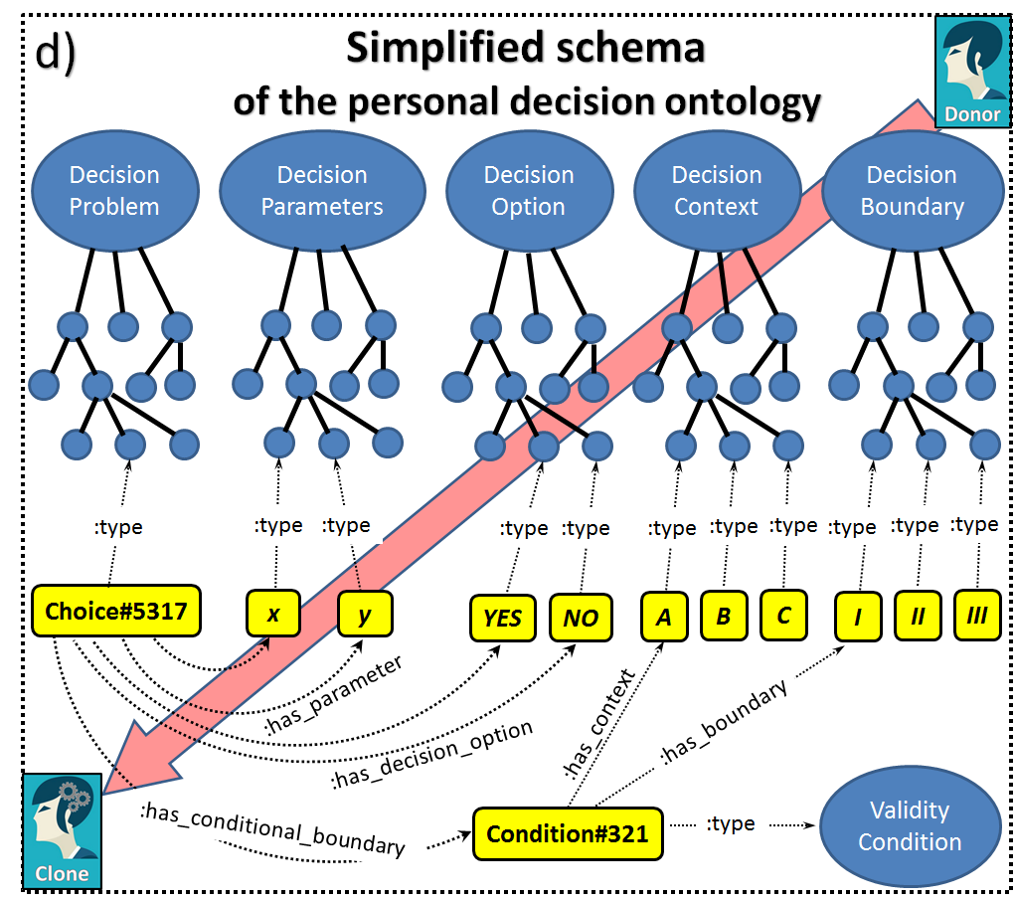
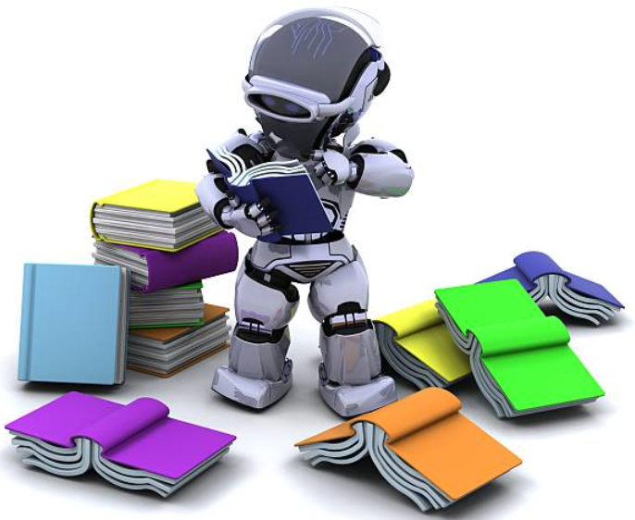
Cloned skills as
a structured semantic graph (aka personal decision ontology)

Slide 17
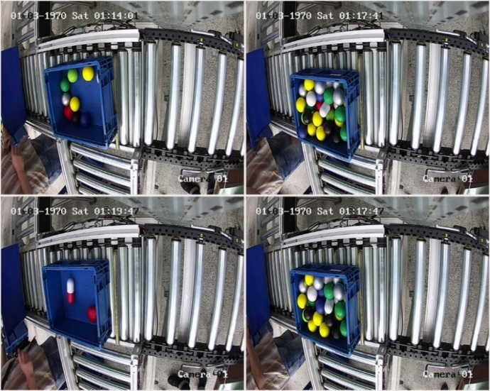
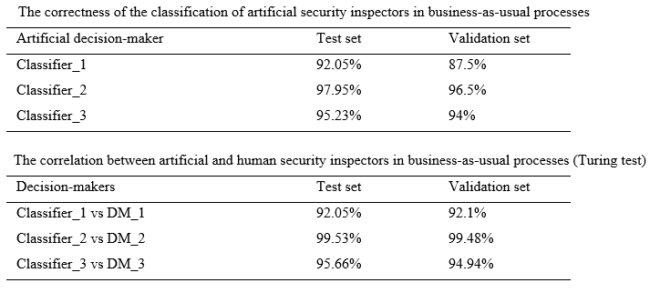
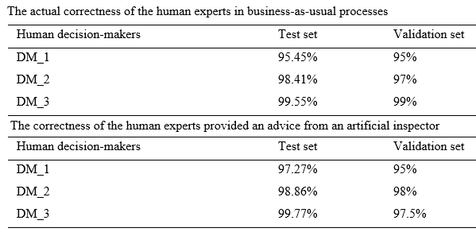
Adversarial training experiments (mimicking humans during business-as-usual)
… within the NATO SPS Project “Cyber Defence for Intelligent Systems”
http://recode.bg/natog5511/
Experiment Set 1
Three classifiers based on a deep convolutional neural architecture mimic decision behavior of human inspectors. The transfer learning technique is used for the optimization purposes. The accuracy of the trained artificial security officers is evaluated with respect to four parameters:
the actual correctness of the classification obtained on the test and validation sets;
correlation between the artificial inspectors’ and the human experts’ decisions;
the actual correctness of the decisions from human experts;
the correctness of the human experts in case of artificial decision advice.

Slide 18
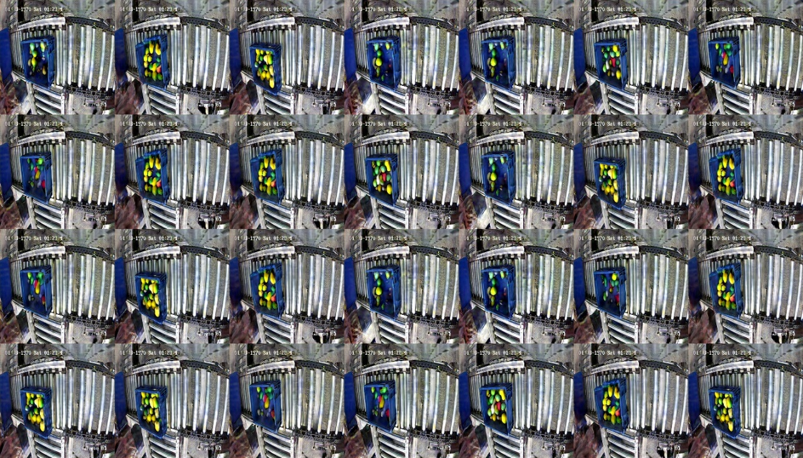
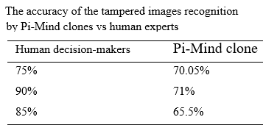
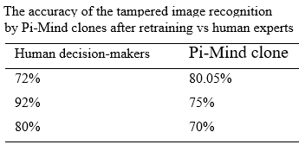
Adversarial training experiments (mimicking humans during adversarial attacks)
… within the NATO SPS Project “Cyber Defence for Intelligent Systems”
http://recode.bg/natog5511/
Experiment Set 2
Two attack scenarios are considered:
Attack Scenario 1: there is a “dangerous item” on the image but the image is “poisoned” in advance to be potentially misclassified as being “not dangerous”;
Attack Scenario 2: there is “no danger”, but the image is “poisoned” to be potentially misclassified as being “dangerous” causing a false alarm.
Using data-driven unconditional generative image modeling based on GAN’s modified architecture, we pursue two objectives: to train a powerful discriminator capable of detecting a tampered image; and to generate a pool of new high quality images, which are deliberately designed as adversarial samples (“corner cases”) aka “digital vaccine” for smart vaccination during retraining of the clones.

Slide 19
Adversarial training experiments
… within the NATO SPS Project
“Cyber Defence for Intelligent Systems”
http://recode.bg/natog5511/
CONCLUSION
We present adversarial learning environment, which facilitates the process of making digital cognitive clones of the decision makers. We show several experiments within such environment aiming to check the performance of digital clones both for business-as-usual decision situations and for critical decision-making. We experimented on image classification skills’ cloning process complicated by adversarial machine learning attacks on the images. Although human decision-makers still showed better performance in threat recognition, the results of the experiments are promising due to the high accuracy of the artificial predictions and (even better) high human-clone correlation of the decisions.
From 3000 generated images a batch of 300 most challenging samples for both human and artificial security officers, is selected as representation of disrupted reality and used to retrain the clones
Samples of generated adversarial content for cloning

Slide 20
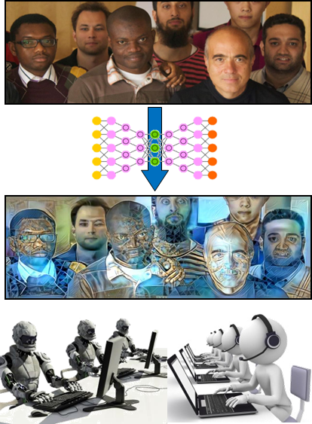
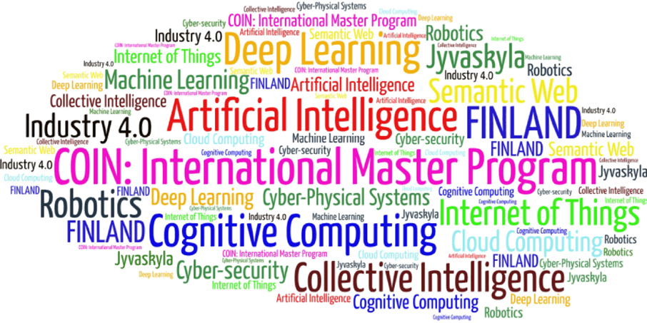
Come to study at our International Master Program
COIN: Cognitive Computing and Collective Intelligence …
… the first university program for collective intelligence, where humans learn together with their digital clones and autonomous digital assistants …
http://www.jyu.fi/ai
COIN

Slide 21
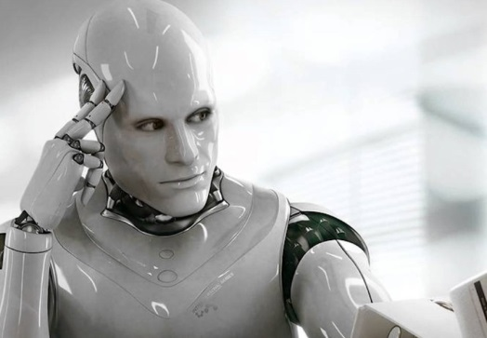
Link to the presentation: https://ai.it.jyu.fi/ISM-2020-Pi-Mind.pptx
Contact: vagan.terziyan@jyu.fi

